Slide 1




First Nations Launch 2022
Structures Webinar
Mark Abotossaway
Aundeck Omni Kaning Ojibwe
Spirit AeroSystems, Structures Analyst
First Nations Launch Advisor Liaison
The material contained in this document is based upon work supported by a National Aeronautics and Space Administration (NASA) grant or cooperative agreement. Any opinions, findings, conclusions or recommendations expressed in this material are those of the author and do not necessarily reflect the views of NASA.

Slide 2
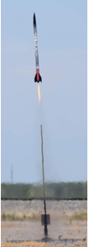
Webinar Overview
High Powered Rocket (HPR) Vehicle and Payload Structure
Structural Design Process
Materials Overview
Structural Analysis Process
Structural Test Process (during Design)
Assembly / Manufacturing / Integration Process
Structural Test Process (Post-Fabrication)
HPR Structural Failures
Notes:
Will combine / contrast industry structures with hpr structures

Slide 3
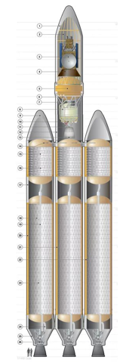

HPR Vehicle Structure
Nosecone
  (cone)
Airframe / Fins
  (tubes / plates)
Couplers / motor mounts
  (tubes)
Bulkheads / centering rings
  (rings / plates)
Electronics sleds / mounts
  (plates)
*Payload / challenge structure
Notes:
mechanics, materials, statics / dynamics class

Slide 4
Structural Design Process
You could make random selections, and hope it all works in the end…
  But that’s not engineering
Engineering design is when you develop a complete product
    (via simulations, calculations, research, trade studies, test)
  and you understand the performance of such product
      (via simulations, calculations, research, test)
    prior to building that product
The product needs to satisfy a set of criteria or ‘requirements’
  Set forth by the customer (WSGC FNL is your customer)
  Typically, tests are used to verify that the product does what its supposed to do, and satisfies the requirements
Notes:
Poor engineering is evident when vehicle doesn’t satisfy requirements.
Poor engineering is evident when – sized incorrectly, doesn’t fit properly, wasn’t tested etc.
Our design reviews try to ensure that your product will meet the requirements – that you have considered all factors when making choices

Slide 5
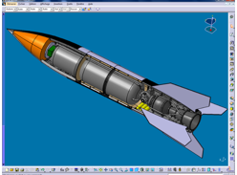
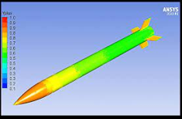
Industry Structural Design
Design tools include:
  3D CAD Modeler (CATIA, 3DX, Pro-E etc.)
  Computational Fluid Dynamics (CFD) tools
Previous design / or similar product that current design is based on
Industry standards simplify design practices

Slide 6
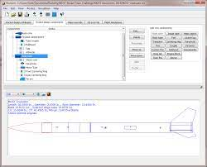
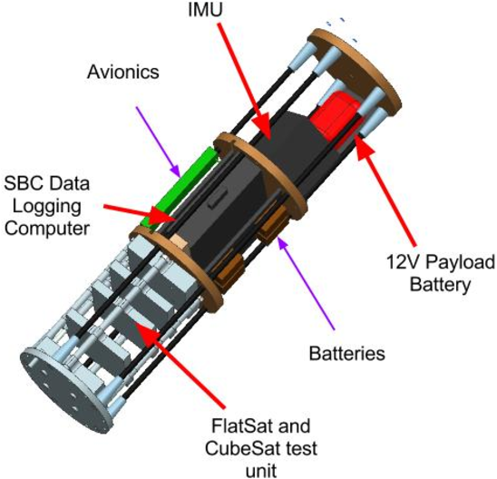
HPR Structural Design
Design tools include:
  RockSim (OpenRocket, RASAero)
  3D CAD Modeler (Solidworks, AutoCAD, etc)
Design starts from a blank sheet
  Little previous experience or data to pull from
  The challenge changes yearly
    Structure changes to optimize vehicle for that challenge
There are rocketry rules that confine your choices
  Listed as requirements

Slide 7
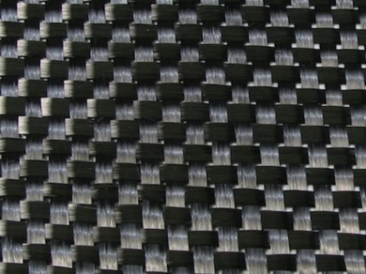
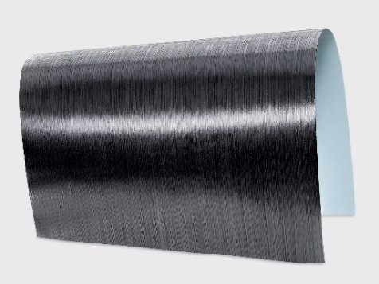
Structural Materials
Choosing the right material involves an understanding of all materials available
Different materials for interior vs exterior components
Consider environmental effects when selecting materials
  Consider thermal expansion when ‘mixing’ materials
The customer may limit your material selection

Slide 8
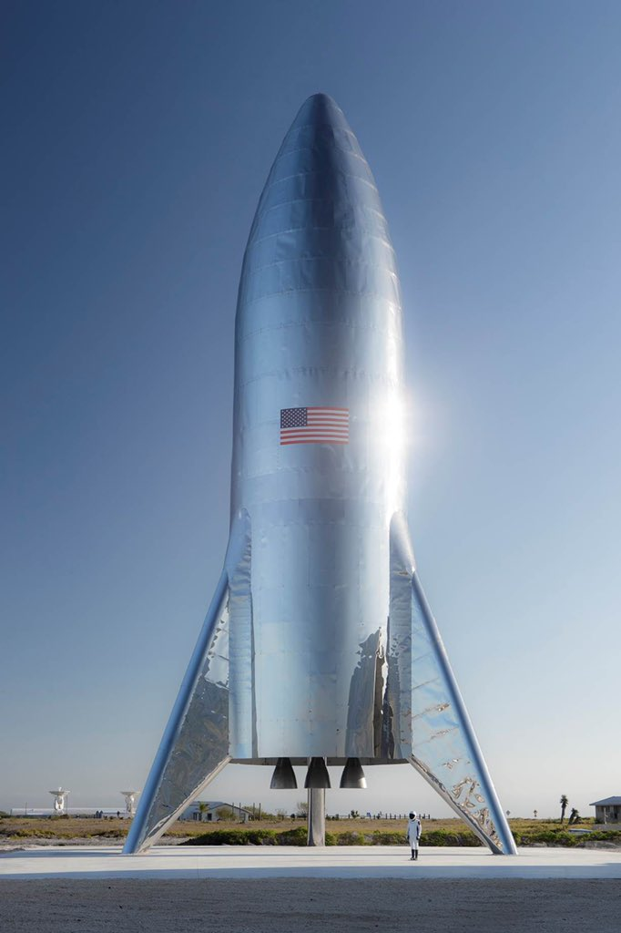
Industry Structural Materials
In industry, selection is based on a balance of
  Cost – Performance - Weight
New materials are developed alongside the design
  Carbon fiber plain cloth or tapes, and processes
  Metallic alloys
Operating environment is a selection factor
Fatigue / damage tolerance are also factors

Slide 9
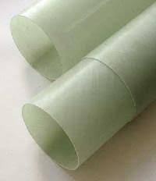
HPR Structural Materials
Commercial-Off-The-Shelf (COTS) materials can be grouped into:
  Phenolic Cardboard - Airframes
  Fiberglass – Airframes / Internals
  Carbon Fiber - Airframes
  Plywood - Internals
  Plastics - Internals
Suggest teams use mainly COTS components
  Based on Tripoli Wisconsin safety concerns
  We do not want any structural failures on Launch Day
  We cannot ascertain your fabrication / test abilities
  We may allow fabricated components – include in reports
Notes:
COTS components / materials

Slide 10
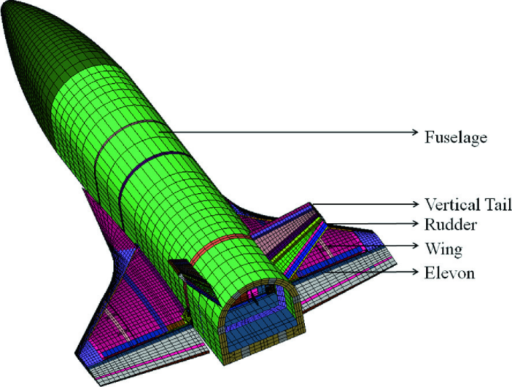
Structural Analysis Process
You must ensure the vehicle
  satisfies the performance parameters
  can withstand the loading (all components)
You must perform analysis to achieve this
  Simulations
  Calculations
If the results of a simulation / calculation do not satisfy the above
  You must change the design / material
  Repeat the analysis

Slide 11
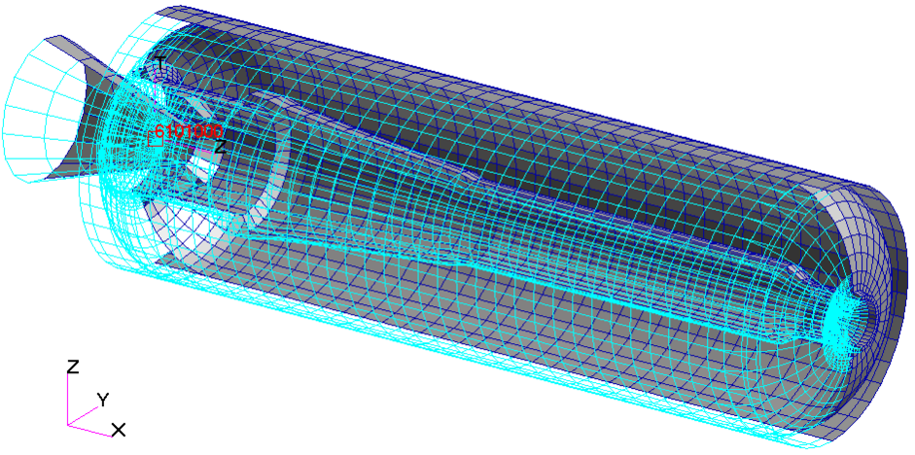
Industry Structural Analysis
Structural analysis for large vehicles is very detailed
Loads are developed early
  Finite Element Models (Aero FEMS)
  Wind Tunnel tests
  Internal loads model FEMs distribute load
Classical analysis methods are used
  Plates, shells, beams, cylinders etc.
Free body diagrams / load paths
Sizing parts to minimize weight

Slide 12
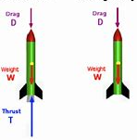
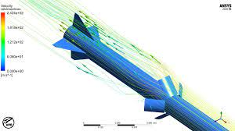
HPR Structural Analysis
Mainly use RockSim for COTS component selection
  Use RockSim to verify performance satisfied
May use other calculation methods to verify RockSim
You should understand the maximum load / force
  What components experience highest loading
  When is max loading
  Component selection based on load experienced
May use Computational Fluid Dynamics (CFD) to characterize your performance
F = m a

Slide 13
Structural Test Process (Design)
During design / analysis phases
  May test small COTS components to determine their best use
  Especially true if you are fabricating parts (3D printed, composite)
Not required but encouraged
  Know the strength / properties of your materials
  Consider testing your bonding materials and bond strength
Structural tests that can be conducted include
  Shear strength - Tension / compression - hoop strength - bending / deflection
These tests should be conducted early in a program
  The results should validate the selection of a certain material for example
Notes:
Test setups

Slide 14
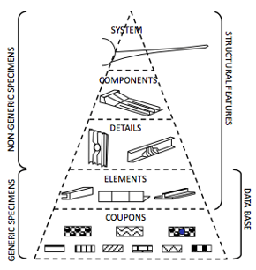
Industry Structural Testing
There exists a ‘test pyramid’
  Starts at coupon level
  Culminates in full scale vehicle testing
New materials are used / developed
  Coupon and element tests for materials
  Configured tests for the specific design
Testing is conducted alongside design
Fatigue and damage tolerance tests
  Projectile

Slide 15
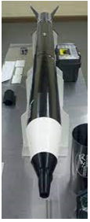
HPR Structural Testing
COTS structures should not require test (usually overdesigned)
May be interested in ascertaining the limits of the material
  Sample testing to failure
  Develop understanding of testing if you fabricate parts
If you fabricate your own components
  3D print materials - carbon fiber layups - carbon sandwich panel
HIGHLY recommend you do structural testing
  Shear-tension-compression strength, hoop strength, bending/deflection
You may want to use similar test pyramid as industry
Notes:
Show fabricated airframe

Slide 16
Manufacturing / Integration
Structures should be designed for ease of manufacture / assembly and integration
Keep manufacturing in mind when you make part / material selections
  Will this part be difficult to manufacture?
  Will this part be difficult to integrate?
  Is this material easy to work with? Difficult to modify?
Many good designs become terrible products when changes must be made because assembly / integration aren’t taken into consideration
Notes:
Think about the downstream processes when you are making design and analysis choices

Slide 17
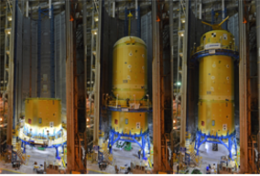
Industry Integration
Fabrication begins as design winds down
  First few units are slow to fabricate
  Usually more than 1 unit
Various supplier parts must all fit together
Tooling usually begins during design
  These may be long lead items
Design / analysis may need to change if assembly / manufacturing can’t meet the drawing spec
  Manufacturing engineers work with design team
  Liaison engineering supports
Notes:
Show fabrication / manufacturing

Slide 18
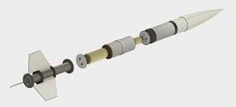
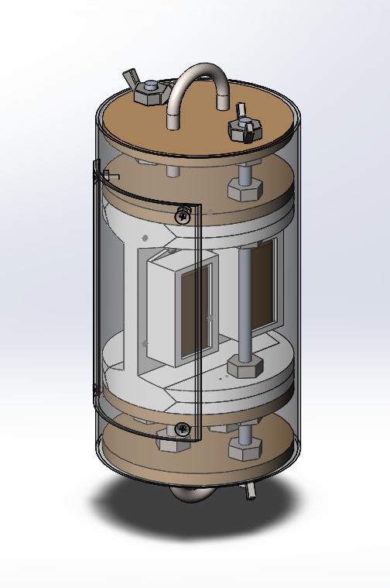
HPR Integration
COTS components should integrate easily
  Another benefit of using COTS components
Fabricating components / mixing parts - integration will be a concern
  Ensure you leave time for fabrication
Your payload / challenge components need to have an integration plan
  Use CAD models to ensure parts will fit, assembly will fit
  You may need to CAD up the entire rocket / all parts
  Ensure your RockSim matches your CAD models
Notes:
Payload integration

Slide 19
Structural Testing (Post-Production)
Products undergo rigorous testing following production
  Used to verify that the design satisfies the requirements
Human rated vehicles require much more testing
  Must demonstrate a complete autonomous flight
  Aircraft complete a series of flight tests, complete envelope
Testing also used to ensure the product is safe
  A structural failure in private is safer than a failure in public
  If all design considerations were followed, it is unlikely there will be a structural failure

Slide 20
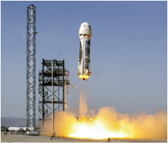
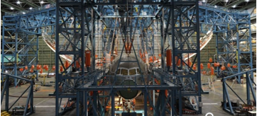
Industry Structural Testing
Rockets - full scale tests
  Autonomous flight test
  Shows the vehicles can perform safely
Aircraft – full scale tests
  Full scale static test to failure
  Full scale fatigue test for DSO
  Fleet perform flight tests

Slide 21
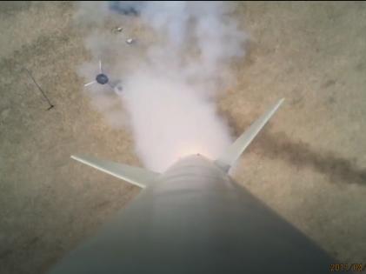
HPR Structural Testing
Although not required, we recommend that a flight test be built into your schedule and performed prior to Competition Launch
  It may even just be an empty vehicle flight, if you don’t want to risk damage to the challenge payload, or it is not flight ready
Your rocketry mentor would facilitate the launch for you, to ensure you are following safe rocketry procedures
  Do not plan a launch without a certified mentor

Slide 22
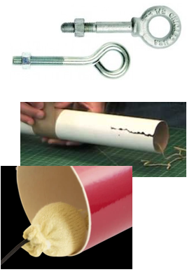
HPR Structural Failures
Eyebolts / Bulkheads
  If not sized properly eyebolts/bulkheads can yield
  Use washers to distribute load
  Use closed/forged eyebolts
  Use u-bolts, which distributes the load better
Zipper Event (Phenolic Airframes)
  A zipper event - shock cord tears into the airframe during the parachute deployment
  Strengthen the airframe area if there are concerns
  Size the shock cords properly (or ‘pad’ the shock cord where it meets the airframe at full deployment)
Notes:
Eyebolts – I’ve never seen one fail
Zipper – I’ve seen several zippers

Slide 23
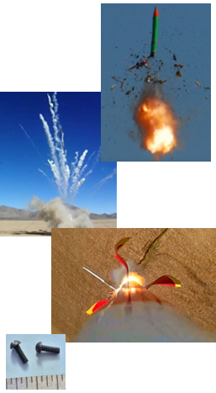
HPR Structural Failures
Catastrophe at Take Off (CATO)
  The motor (mount) is not restrained properly
  Ensure the centering rings and motor mount tubes are substantially bonded and secure
Fin flutter or divergence
  Fins may flex / oscillate under aerodynamic loads in flight – divergence
  Ensure you size your fins properly, use rigid material, and they are bonded substantially
Premature / late separation
  Pressure differentials may cause the airframe sections to separate in flight
  The use of plastic shear pins will remedy this
  Too many shear pins and the airframe may not separate
Notes:
Cato – I’ve seen twice
Fin flutter – lots of videos online
Premature sep – have not seen
Late/no sep – have seen a few

Slide 24
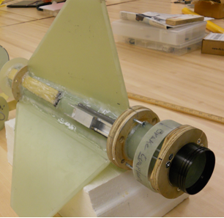
Component Sizing Tips
Size your payload first, then select the airframe (vehicle) based on the payload criteria
  In your challenge, addressing the payload should be your priority
Most kit components are already sized for their flight envelope
  Motor mount tubes, fin thickness, centering ring thickness etc.
  Adding your ‘challenge’ however, may mean its outside of its envelope
Notes:
3 or 4 fin – we spent time determining pros and cons
The size of the actuator eventually determined our diameter

Slide 25
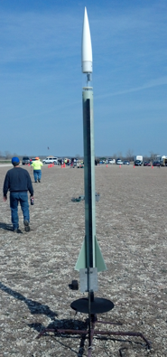
Component Sizing Tips
Swap / modify components if they are sized incorrectly (modify the kit to accommodate your payload)
  Expected load and type of loading
  Carbon wrap components (if capable) to add strength
Select the recovery hardware based on the expected amount of load
  First must determine the maximum load
  Eyebolts, quicklinks, shockcord etc. are all sized on load capability
Notes:
The size of the acrylic tube (and motion of the camera), determined our airframe diameter / kit selection
Verify or determine the amount of expected load in flight – then select components that can withstand that load. Be sure the understand not only the amount but type of load and direction as well.

Slide 26

Q & A

