Slide 1





First Nations Launch 2023
Introduction to Rocksim Webinar
November 29, 2022
Trent Cybela, Mechanical Design Engineer
Sierra Space Corporation
The material contained in this document is based upon work supported by a National Aeronautics and Space Administration (NASA) grant or cooperative agreement. Any opinions, findings, conclusions or recommendations expressed in this material are those of the author and do not necessarily reflect the views of NASA.
Notes:
Christine: Opens & welcomes everyone, screen share presentation WITH COMPUTER SOUND, begin recording session
Connie: Takes attendance, lets attendees into room
~~~
Documents to have open/available:
-Schedule
-Presentation
-Presentation w/ notes pdf
-Handbook
-Filler links

Slide 2
This session
will be recorded

Slide 3
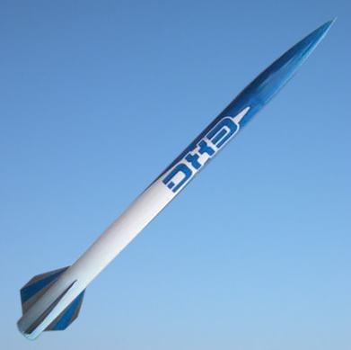
Rocket Build – Your First Level 1 Kit
Super DX3 - Madcow Rocketry
Single Deploy Rocket
38 mm I500, I600, J425R, J270W, or J250DM
Kit Features Include:
Heavy Duty Airframe Tubing
Precision Cut Plywood Fins & Rings
Pre-slotted Airframe
Nose Cone
Payload Section
Nylon Parachute Recovery
Shock Cord Mount
Figure 2-1: Image of Super DX3 Kit (paint not included)
Handbook Reference: 2c. Workshop Supply List pg. 10-11
Notes:
Note: Motor suggestions are listed. For the certification launch, we will only be using the 38 mm H219T – DMS/H100W-DMS

Slide 4
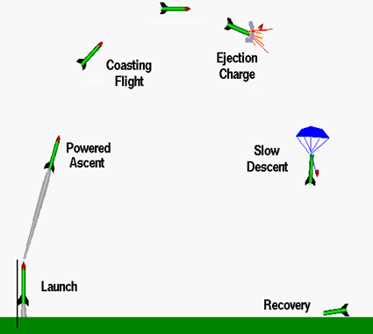
Rocketry 101 – Single Deploy Flight Profile
Launch
Powered Ascent
Coasting Flight
Ejection Charge
Slow Descent
Recovery
Figure 4-1: Single Deploy Flight Profile
Handbook Reference: 4b. Launch Profile Overview, pg 13

Slide 5
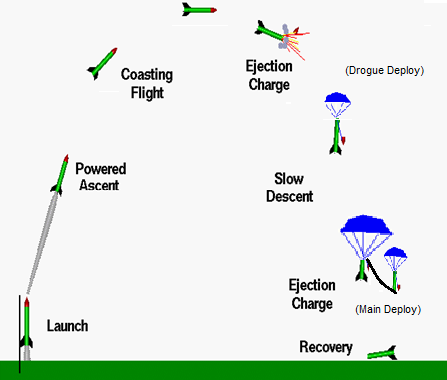
Rocketry 101 – Dual Deploy Flight Profile
Launch
Powered Ascent
Coasting Flight
Ejection Charge / Drogue Deploy
Slow Descent
Ejection Charge / Main Deploy
Recovery
Figure 4-2: Dual Deploy Flight Profile
Handbook Reference: 4b. Launch Profile Overview, pg 13

Slide 6
Rocketry 101 – Flight Profile Differences
Figure 4-1: Single Deploy Flight Profile
Figure 4-2: Dual Deploy Flight Profile
Handbook Reference: 4b. Launch Profile Overview, pg 13

Slide 7

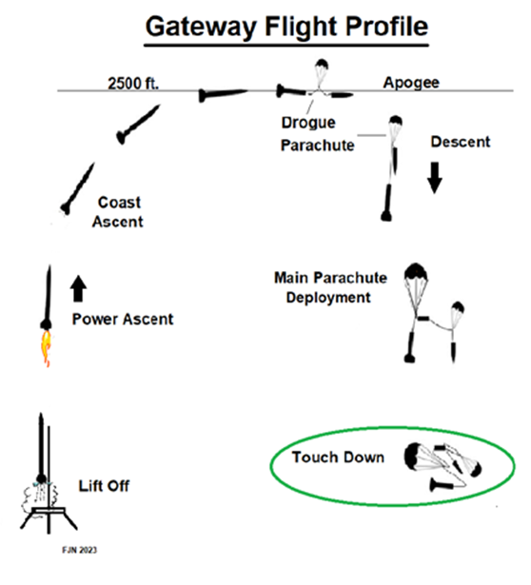
Rocketry 101 – Competition Flight
Figure 4-3: FNL 2023 Gateway Challenge

Slide 8
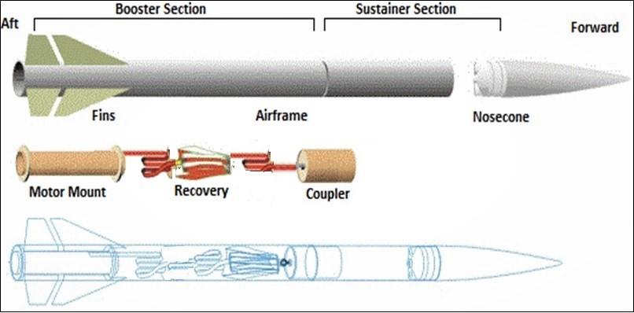
Rocketry 101 - Structures
Figure 5-1: High-Power Rocket with Coupler
Handbook Reference: 5a. Structures, pg 15

Slide 9
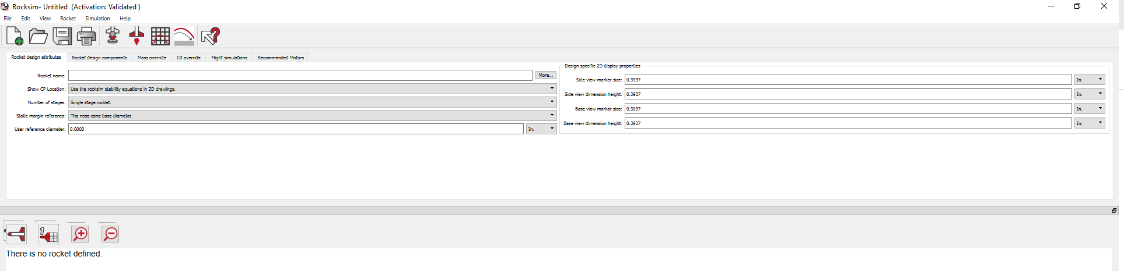
Rocketry 101 – RockSim Introduction
Creating a Model in RockSim 10
  RockSim: http://www.apogeerockets.com/rocksim.asp
Figure 11-1: RockSim 10
Handbook Reference: 6f. Commercial Software Packages, RockSim Overview pg 24, 44
Notes:
Christine: After finishing this slide, stop share screen and let Aaron/Trent share RockSim
RockSim is a computer program that allows you to build and modify rocket designs to determine their performance
You should already have access to this program – but if not please let us know. It should be free to download, and if memory serves the space grant team has emailed all of the team with an activation code to get access.

Slide 10
Rocketry 101 – RockSim Introduction
Simulations are THE key component to high powered rocket design
  Rocket Design Attributes
  Rocket Design Components
  Mass Override
  CD Override
  Flight Simulations
  Recommended Motors
Figure 11-2: RockSim 10 Folders
Handbook Reference: 11a. RockSim Overview, pg 44
Notes:
Christine: After finishing this slide, stop share screen and let Aaron/Trent share RockSim
inside this program you have the ability to build up, component by component a rocket design from scratch. Build into Rocksim is a massive database of parts. like body tubes, and nose cones, and parachutes, screws, fasteners, etc.
in our case, we can access a database of prebuilt rocket kits that are similar to the

Slide 11
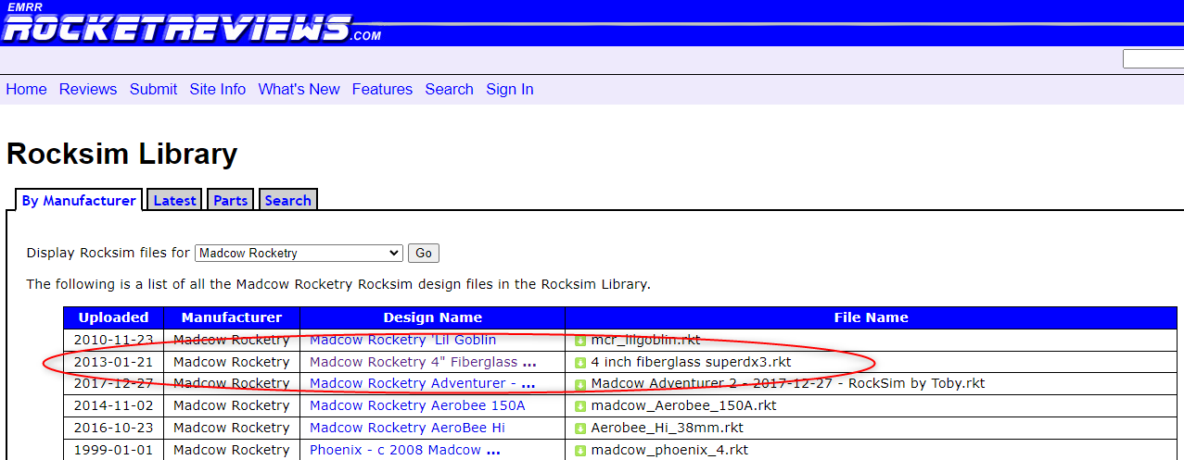
Rocketry 101 – RockSim Introduction
Download a pre-existing model of a Super DX3
  https://www.rocketreviews.com/rocksim-library.html
  Sort by Manufacturer
  Display RockSim files for Madcow Rocketry
  Download Super DX3
Figure 11-3: Rocket Reviews RockSim Library, Super DX3
Handbook Reference: 11a. RockSim Overview, pg 45
Notes:
Christine: After finishing this slide, stop share screen and let Aaron/Trent share RockSim

Slide 12
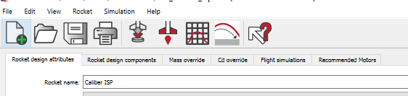
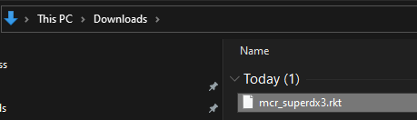
Rocketry 101 – RockSim Introduction
Import rocket file into RockSim 10
  Open the existing design file folder (Import Folder)
  Select mcr_superdx3.rkt file from download folder
Figure 11-4: RockSim Import Folder
Figure 11-5: Select Rocket File from Download Folder on Computer
Handbook Reference: 11. RockSim Overview, pg 45
Notes:
Aaron/Trent: Share screen, measure and compare a few components (motor tube length, diameter, weight – centering ring thickness, weight)

Slide 13
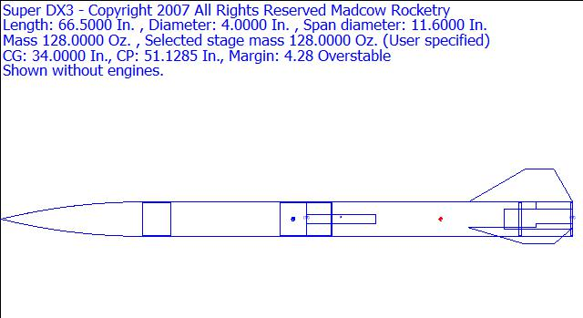
Rocketry 101 – RockSim Introduction
Figure 11-6: Super DX3 Stock File
Handbook Reference: 11. RockSim Overview, pg 45
Notes:
Aaron/Trent: Share screen, measure and compare a few components (motor tube length, diameter, weight – centering ring thickness, weight)

Slide 14
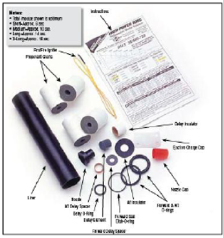
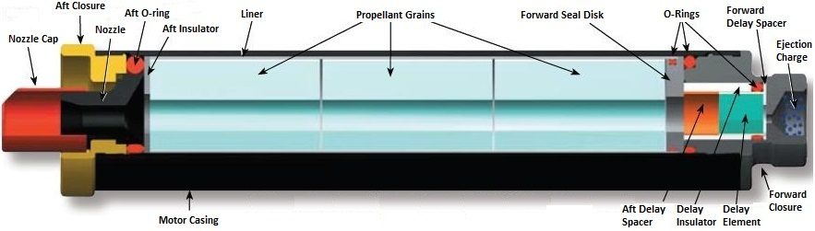

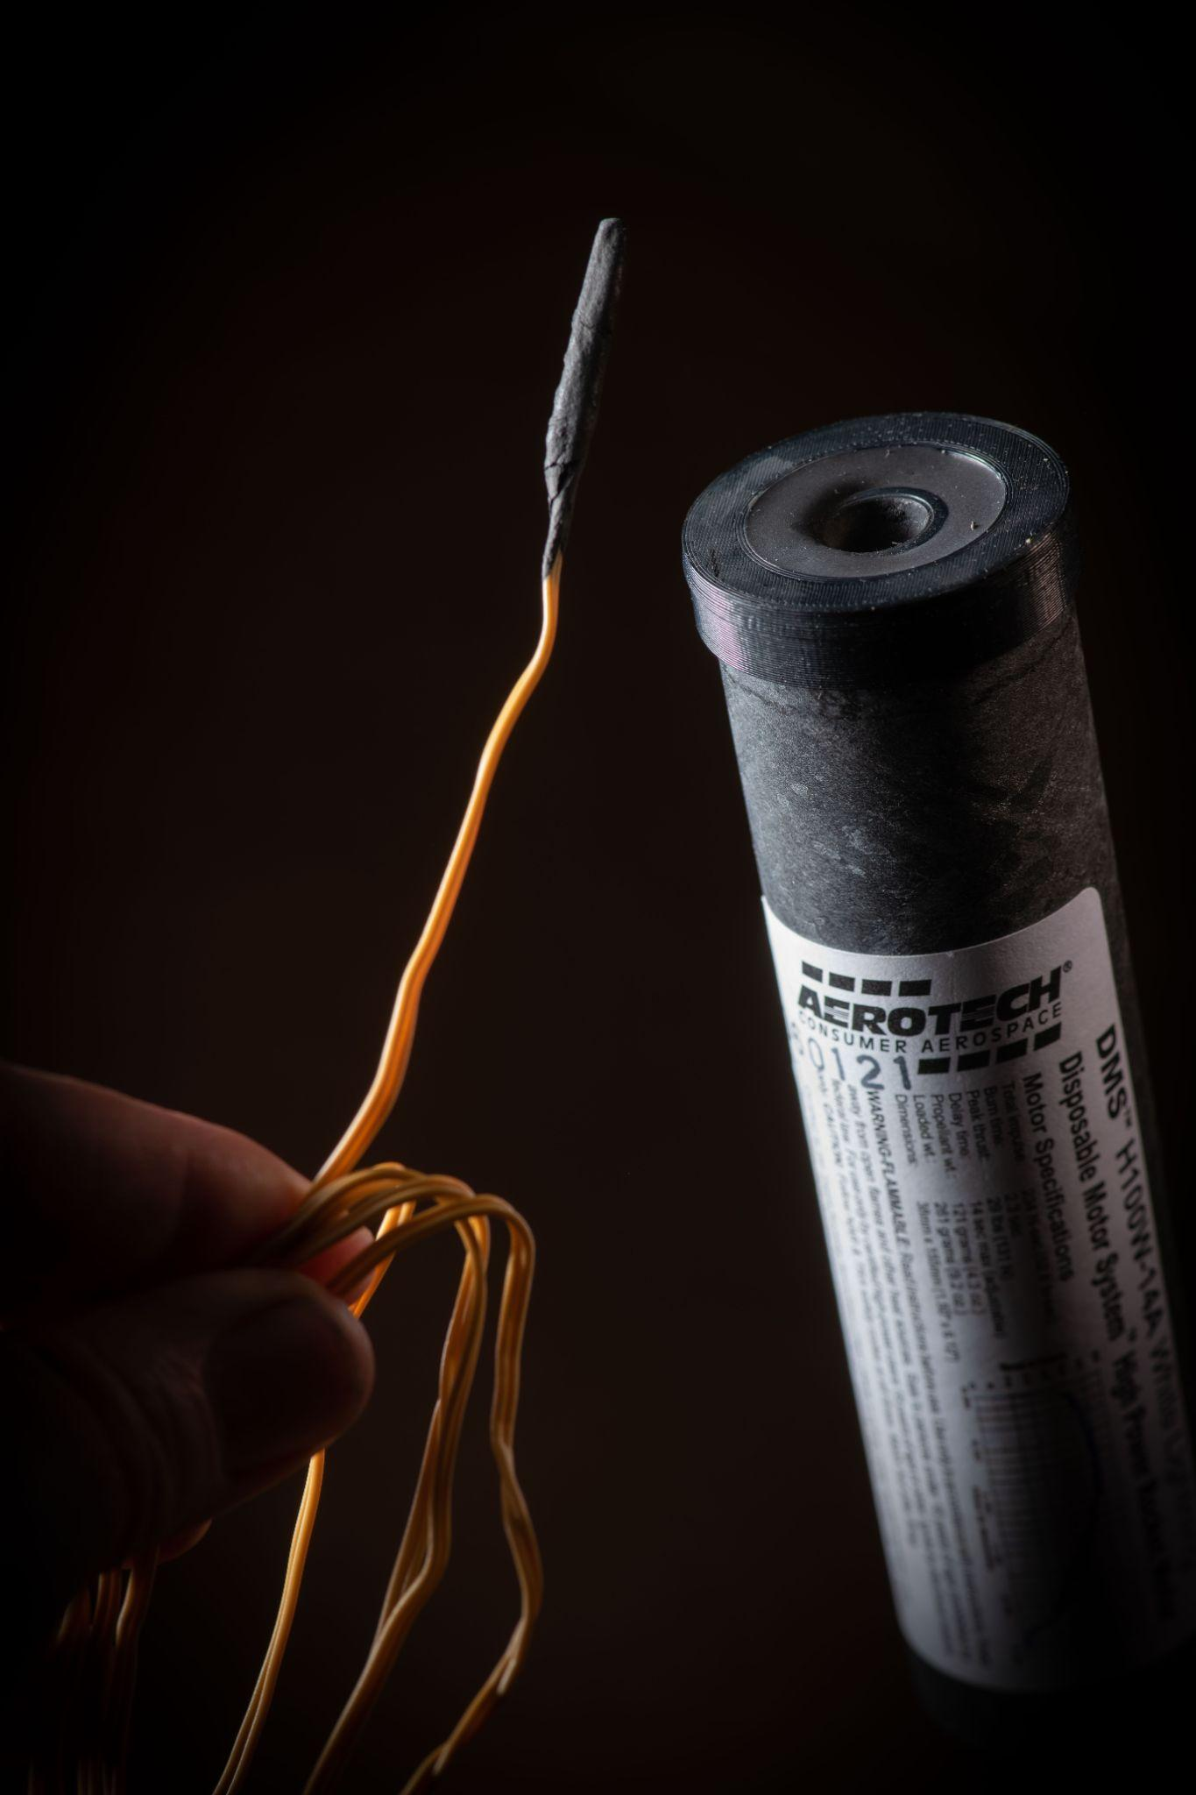
Rocketry 101 – Propulsion Overview
Figure 6-3: Cutaway Drawing of Typical Assembled RMS-Plus Motor
Figure 6-1: Motor Kit Example
Figure 6-2: Cesaroni Motors
Figure 6-4: Aerotech Single Use Motor with Ignitor 2
Handbook Reference: 6b-c. Propulsion Systems, pg 22-23

Slide 15
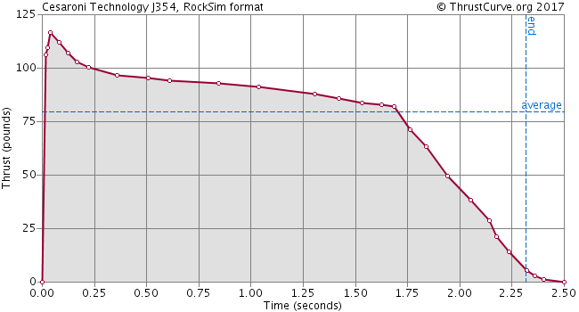
Rocketry 101 - Propulsion Overview
Thrust to Weight Ratio
  At a minimum this is 5:1 (you need 5 times the amount of thrust per weight)
  If your rocket weighs 10 lbs, your motor needs to produce at least 50 lbs of (average) thrust
Thrust Curves
  Burn time
  Max thrust
  Average thrust
  Either Newtons or pounds
Figure 6-5: Thrust Curve Example
Handbook Reference: 6. Propulsion Systems, pg 23

Slide 16
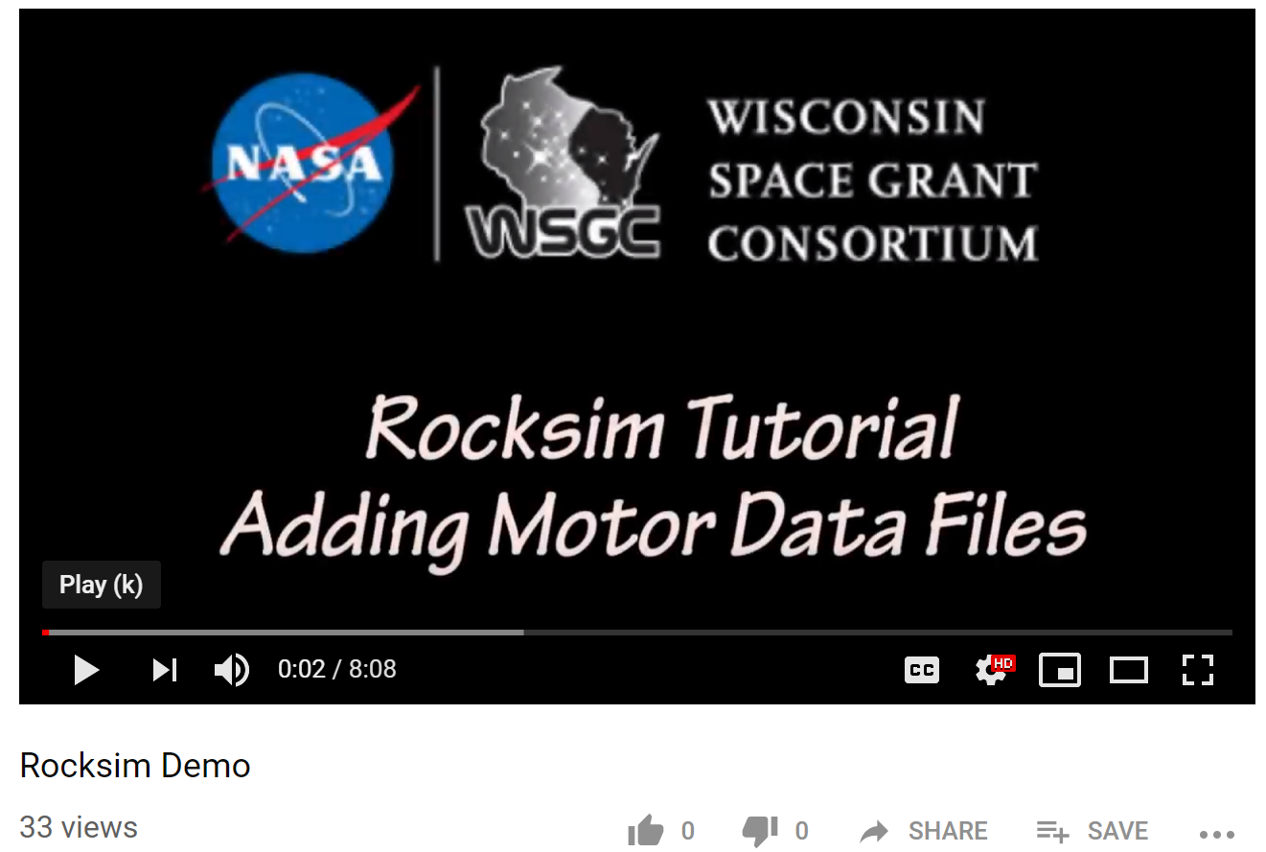
Rocketry 101 - RockSim Motors
Motor – Aerotech 38mm I500
  http://www.thrustcurve.org/
What to do when there isn’t an exact match
  https://www.youtube.com/watch?v=QIXN5jGysQg&feature=youtu.be
Handbook Reference: 11b. Selecting an Engine, pg 46
Notes:
Christine: Remove spotlight demo person
After finishing this slide, stop share screen and let Aaron/Trent share RockSim
Overview again the import of the correct kit and

Slide 17
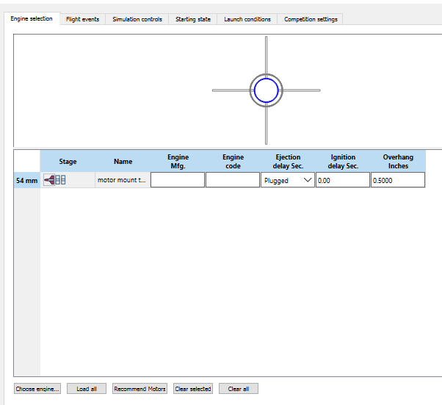
Rocketry 101 - RockSim Motors
Figure 11-7: Prepare for Launch Icon
Select the ‘Prepare for Launch’ icon
Select the ‘Choose Engine’ tab
Figure 11-8: Choose Engine Tab
Handbook Reference: 11b. Selecting an Engine, pg 46
Notes:
Aaron/Trent: Share screen
Demo loading of motors in RockSim, and some motor selection tips
Discuss RockSim library is not exhaustive, but ThrustCurve has more motors, representative of vendors.

Slide 18
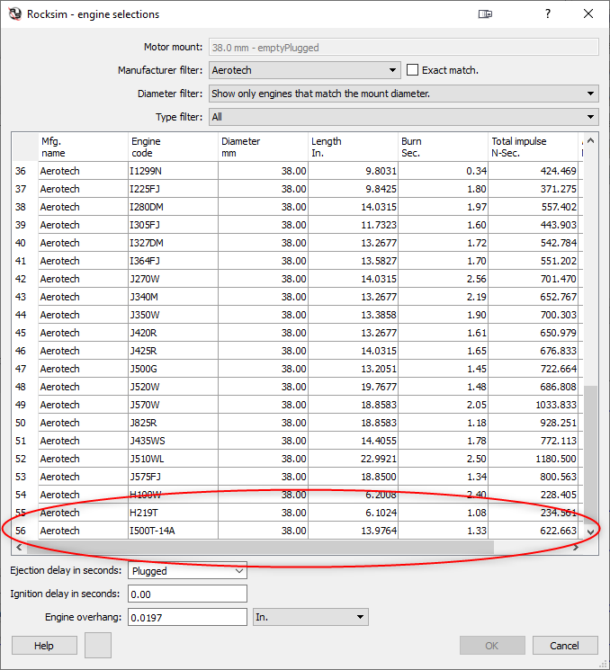
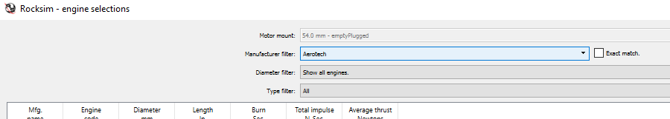
Rocketry 101 - RockSim Motors
Figure 11-9: Manufacturer Field and Diameter Filter
Select ‘Aerotech’ in the Manufacturer Filter field
Select the ‘Show all engines’ in the Type Filter field
Double click on the H219T/ H100W -DMS motor
Handbook Reference: 11b. Selecting an Engine, pg 46
Figure 11-10: Aerotech I500 Motor Selection
Notes:
Aaron/Trent: Share screen
Demo loading of motors in RockSim, and some motor selection tips
Discuss RockSim library is not exhaustive, but ThrustCurve has more motors, representative of vendors.

Slide 19
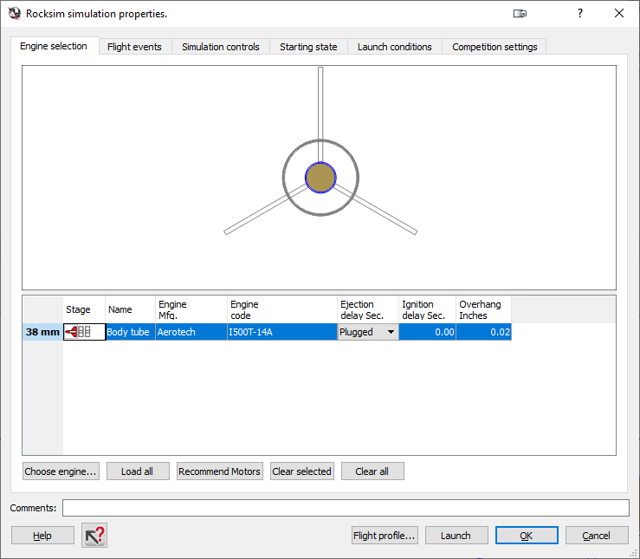
Rocketry 101 - RockSim Motors
The Aerotech I500 will automatically load into the RockSim software
Figure 11-11: Motor Uploaded to RockSim
Handbook Reference: 11b. Selecting an Engine, pg 46
Notes:
Aaron/Trent: Share screen
Demo loading of motors in RockSim, and some motor selection tips
Discuss RockSim library is not exhaustive, but ThrustCurve has more motors, representative of vendors.

Slide 20
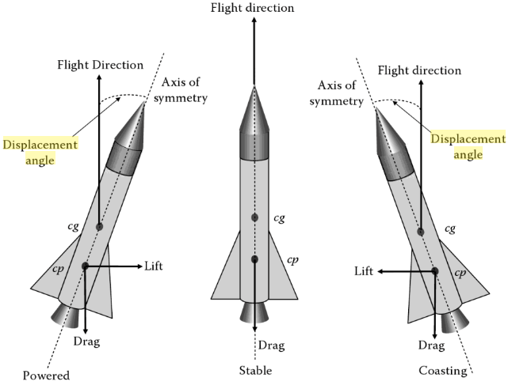
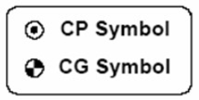
Rocketry 101 - Stability Overview
Center of Gravity (CG)
  What is it? Where is it?
Center of Pressure (CP)
  What is it? Where is it?
Stability Margin (SM)
  How do you determine the SM?
Remember: simulated CG and CP are not actual CG and CP (although they should be close!)
Figure 7-1: Rocket Stability Diagram
Handbook Reference: 7. Stability, pg 26

Slide 21
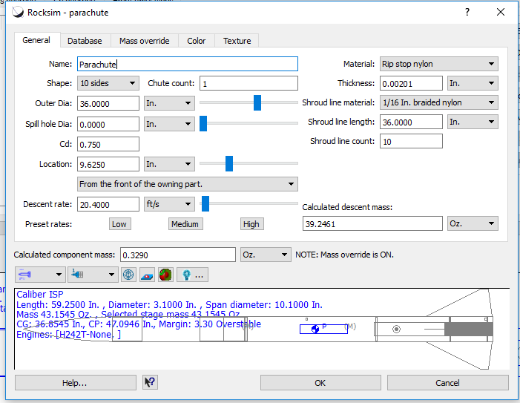
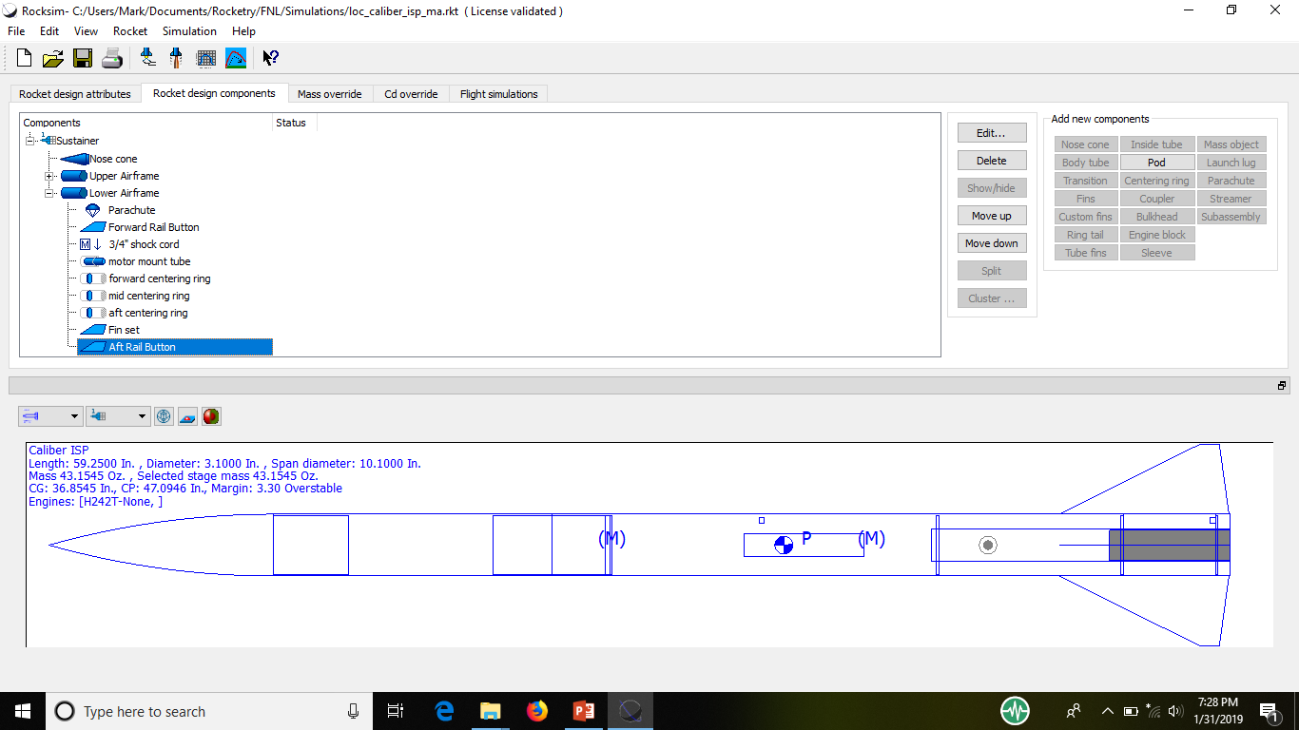
Rocketry 101 - Rail Buttons
Handbook Reference: 11. RockSim Overview, pg 47
Notes:
Aaron/Trent: Share screen
Discuss rail button modelling and effects on performance (nosecone, railbutton, parachute, electronics, simulate)
Discuss parachute selection and effects on performance

Slide 22
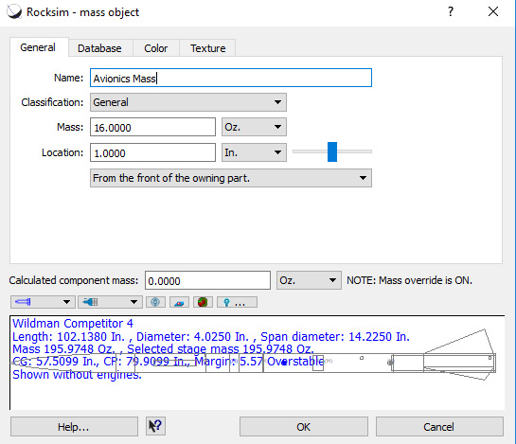
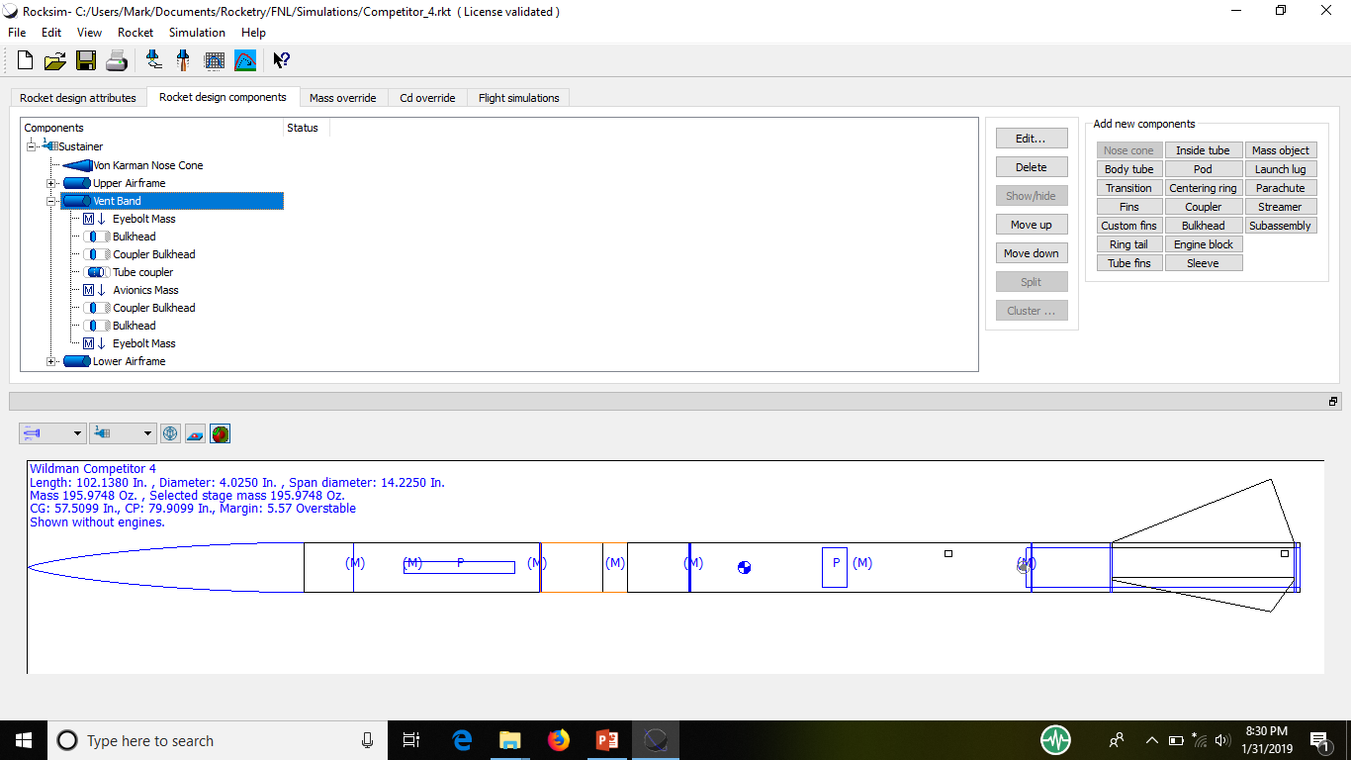
Rocketry 101 - Mass Objects
Handbook Reference: 11. RockSim Overview, pg 47
Notes:
Aaron/Trent: Share screen
Discuss dual deploy differences from single deploy
Discuss avionics bay modelling in dual deploy
Complete demo of mods to rocket for a 38m with lighter weight
Discuss parachute selections

Slide 23
Rocketry 101 - RockSim Update
Handbook Reference: 11. RockSim Overview, pg 47
Notes:
Aaron/Trent: Share screen
Discuss rail button modelling and effects on performance (nosecone, railbutton, parachute, electronics, simulate)
Discuss parachute selection and effects on performance

Slide 24
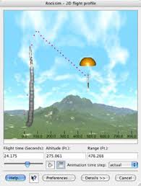
Rocketry 101 - Parachute Selection
There are two requirements to assist with parachute selection
  Descent Velocity – a safe rule of thumb to adhere to is a descent velocity (or descent rate) of approximately 20 ft/s
Most rocket simulators will determine the descent velocity for you
  The weight of the model must be as accurate as possible however
  Descent rate will also be affected by the motor selection (weight)
Figure 8-6: Example Recovery Simulation
Handbook Reference: 8c. Parachute Selection, pg 31

Slide 25
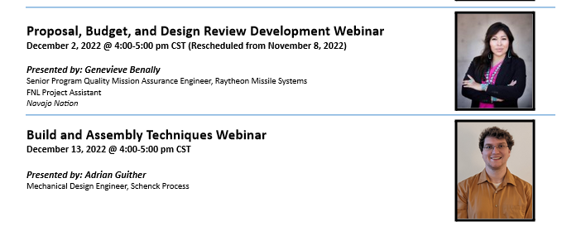
Webinar Schedule
NOTE: Join us on Zoom for FNL Office Hours December 9 from 1-3 pm

Slide 26
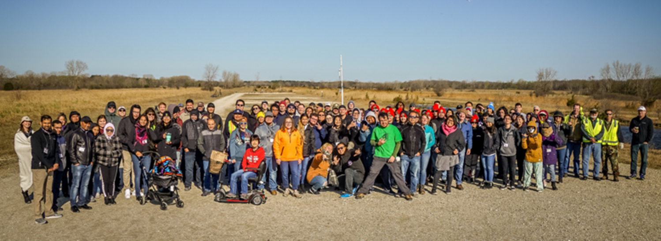
Questions?

