Slide 1

2019 First Nation Launch – Oral Presentation
UCLA Bearospace

Slide 2
Team Information
School: University of California, Los Angeles
Team Name: UCLA Bearospace
Mentor: Frank Nobile
Advisor: Dr. Audrey Pool O’Neal
Presenting Members: Lucia Gonzalez Ryan Rio
Sophia Martinez Rossana Rico
Aidan Carrizales Gisselle Livingston
Joshua Diaz Javier Gomez
Andy Muratalla Achille Hebert

Slide 3
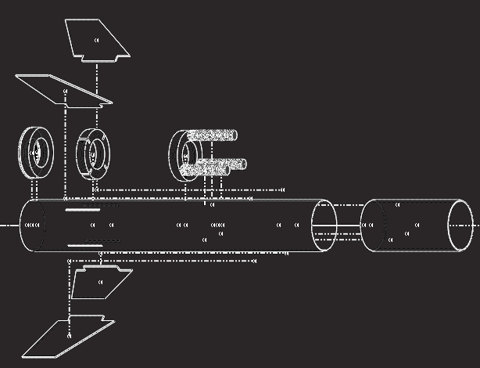
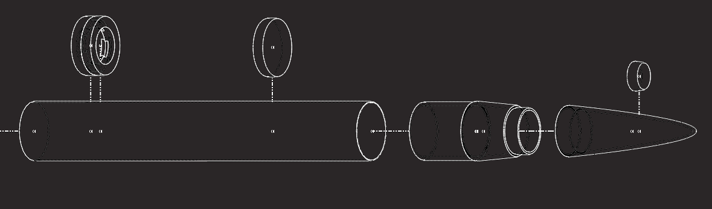
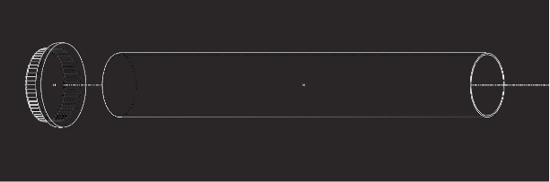
Launch Vehicle
Carbon Fiber Upper & Lower Body Tube
  Length - 26’’
  ID - 3.879’’
  Thickness - 0.038’’
PLA/ABS Nose Cone
  Length - 13’’
  Shoulder Length - 3.879’’
  Thickness - 0.222’’
Pine Nose Cone Bulkhead
  Small Diameter - 1.772’’
  Large Diameter - 1.972’’
  Thickness - 0.7320’’
Pine Bulkhead
  OD - 3.879’’
  Thickness - 0.748’’
Pine Centering Rings
  Outer Diameter (OD)
    W/ Rods - 3.8475’’
    Bottom - 3.8495’’
  Inner Diameter (ID)
    W/ Rods - 2.2945’’
    Bottom - 2.275’’
  Thickness -
    W/ Rods - 0.761’’
    Bottom - 0.7585
Carbon Fiber Coupler
  Length - 7.8’’
  OD - 3.879’’
Pine Fin Securing Mechanism
  OD - 3.8395’’
  Thickness - 0.7610’’
  Slots - 0.1545” x 0.46”
Pine Custom Locking Mechanism
  OD - 3.8470’’
  Thickness - 1.6’’
Fiberglass Fins
  Thickness - 0.134’’
3 Threaded Rods
  Total Mass - 20.99 oz
Total Length
  65.915’’
Avionics Storage Section w/ locking mechanism
  ~12.5 inches
Final Motor Choice
  54mm Aerotech J450DM

Slide 4
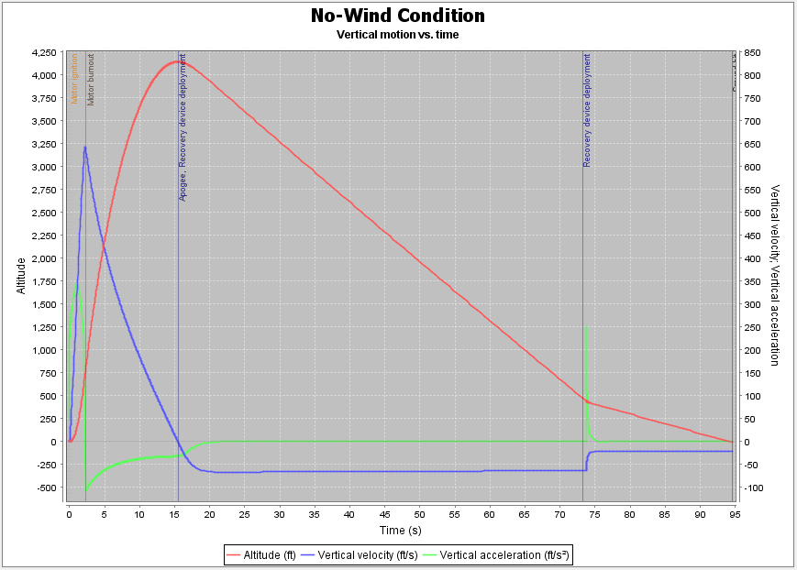
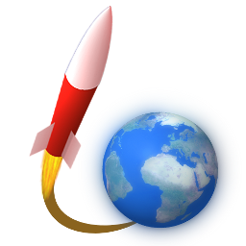
Launch Vehicle Performance
Flight Profile: Altitude, Velocity, Acceleration
Stability: 1.12 cal
CP: 47.707 in*
CG: 43.288 in*
Thrust to Weight Ratio**: 10.550
Rail Exit Velocity ***: 57.9 ft/s
Time To Apogee: 15 s
Predicted Apogee: 1445ft
*Measured from tip of nosecone
**Average thrust of propellant vs total weight of rocket
*** 72” Rail

Slide 5

Avionics Subsystem
Electronics Bay
  12.5’’ x ø3.9’’ designated space
  10.9’’ sled
  Located 21’’ from the nose cone
Vent Holes
  Four ø0.174’’ vent holes will be drilled 6’’ from the locking mechanism
Component | Power | Switch
Missile Works RRC3 | 9 V battery | Switches will be connected externally and will be hooked up to switch ports in altimeters.
PerfectFlite Stratologger SL100 | 9 V battery
Arduino Uno | 9 V battery | Switch will be wired in series with ground since there is no dedicated switch in the Arduino Uno. Switch will also be connected externally.
MPU6050
BMP180

Slide 6
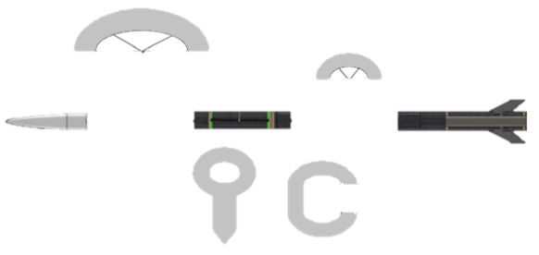
Recovery Subsystem
Parachute Recovery Scheme
  Drogue Chute: 21.5 inch diameter, deployed at apogee, located between lower and upper body tubes
  Main Chute: 60 inch diameter, deployed at 500 feet agl, located between upper body tube and nose cone.
Descent Rate
  Descent Rate Post-Drogue Chute deployment: 63.5 ft/s.
  Descent Rate Post-Main Chute deployment: 21.2 ft/s.
  Total Descent Time: 79.1 seconds
  Impact Velocity: 21.2 feet/second
Main Chute
Shock Cords
Drogue Chute
Tracking Devices
  None on-board
  Will rely on visual of rocket
Ejection Charges
  2 Black Powder Charges
  1 Motor Ejection Charge
Upper Body Tube
Nose Cone
Lower Body Tube
Eye bolts drilled into centering rings and bulkheads
Quick links used to attach shock cords to eye bolts

Slide 7
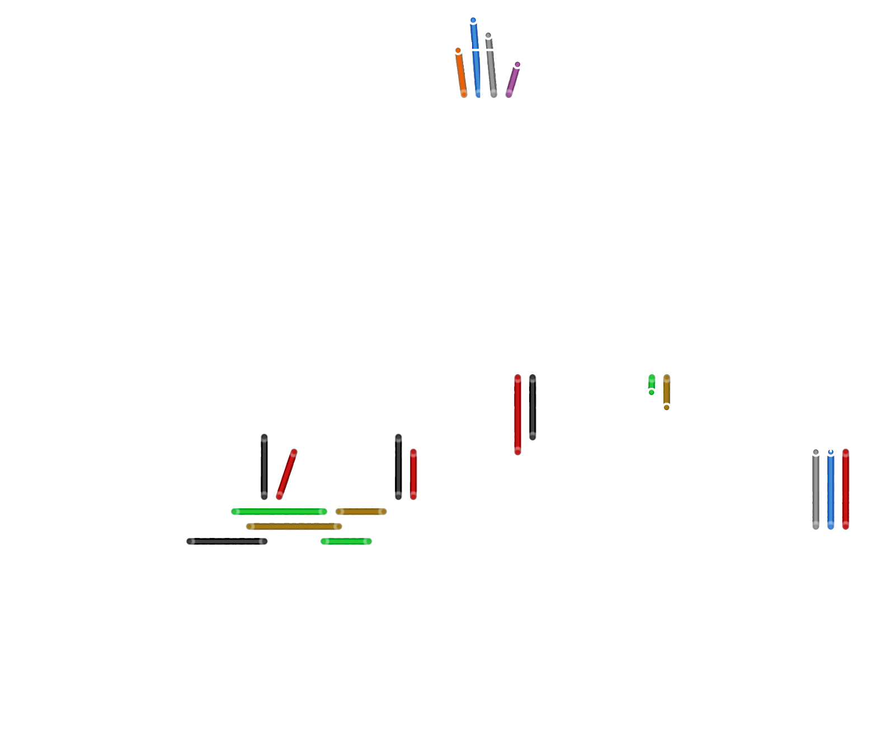

Payload / Experiment
Components
  Arduino Uno (microcontroller
  MPU6050 (gyroscope/accelerometer)
  BMP180 (barometric pressure sensor)
  Micro SD Card module
  9V Battery
Nestled into Avionics sled
Records 5 data types (acceleration, gyration, pressure, temperature, and altitude) and saves them onto a microSD card
Arduino is powered by a 9V battery, which powers the rest of the electronics
  Once switch is connected, Arduino will initialize a calibration phase which will calibrate the gyroscope
  Pressure and altitude must be manually calibrated by inputting pressure conditions for the day
  Data is stored in a microSD card. Each data type is delineated by a comma “,“

Slide 8
Challenges / Lessons Learned
Technical Challenges
  Balancing mass components for an acceptable stability
  Accessibility of machinery needed to manufacture parts
  Calibration of various sensors
Programmatic Challenges
  Acquiring necessary parts in a reasonable time frame
  Creating a fast-paced yet unrushed schedule of events
Lessons Learned
  Keep an updated OpenRocket file available to all members during build phase
  Always have a back up plan for machining
  Thoroughly research all sensors before use
  Order parts as soon as need arises
  Planning more sequential workshops for new members

Slide 9
Questions?

