Slide 1




First Nations Launch 2023
Rocket Mentorship
Webinar
October 25, 2022
The material contained in this document is based upon work supported by a National Aeronautics and Space Administration (NASA) grant or cooperative agreement. Any opinions, findings, conclusions or recommendations expressed in this material are those of the author and do not necessarily reflect the views of NASA.
Notes:
‹#›

Slide 2
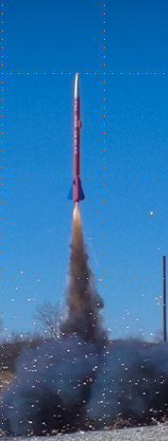
FNL Rocketry Mentor
The intent of this Webinar is to:
  Define what comprises an experienced Rocketry Mentor
  Note the importance of having an experienced, certified Rocketry Mentor on your team
  Provide some tips how to seek and acquire a Rocketry Mentor
We will do this by:
  Sharing experience from former student competitors
  Sharing experience from current advisor
  Sharing experience from current mentor
Notes:
Overview slide

Slide 3
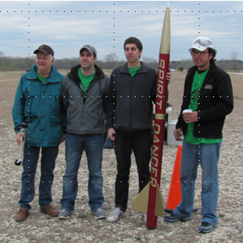

Mark Abotossaway - Alumni
First Nations Launch - Advisor Liaison
  TRA / NAR Certified Level 1
Structures Engineer – Blue Origin
Various rocketry roles and experience
  U of Minnesota FNL Team Lead 2011 – 2013
  U of Minnesota NASA SLI Team Lead 2012
  U Montana Spaceport Cup Mentor 2019
  FNL Project Assistant since 2016
Notes:
FNL Advisor Liaison – Webinar Moderator

Slide 4

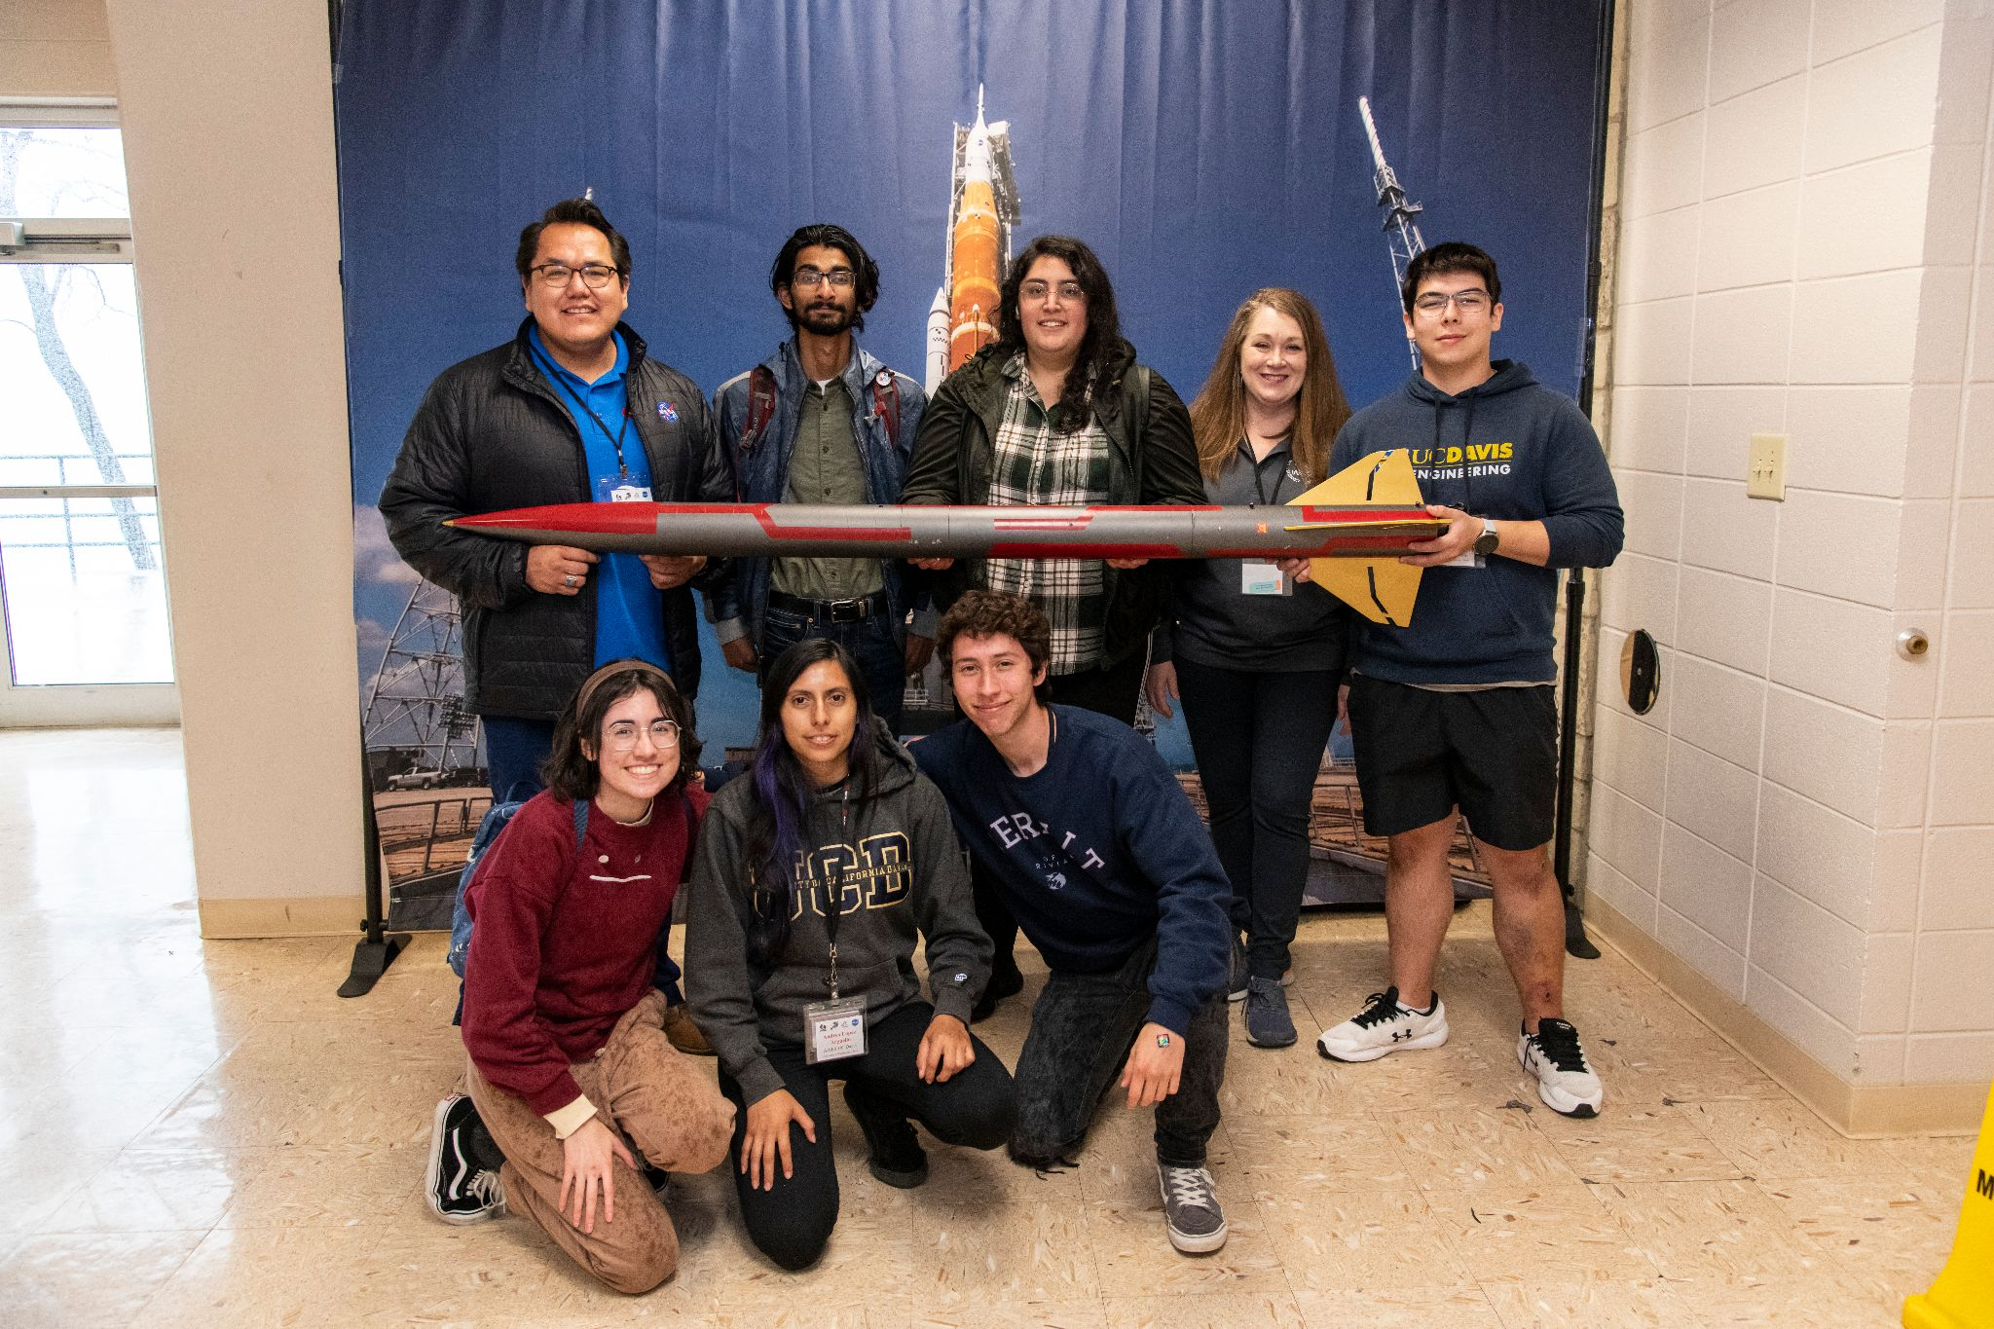
Andrea Lopez Arguello – Alumni
UC Davis School of Law Staff
  UC Davis FNL Team 2019-2022
    2 Years in FNL
  UC Davis Team Lead 2019-2022
  Achievements
    2022 Moon Challenge Grand Champion
    2022 Written Reports - 2nd Place
    2022 Oral Reports - 2nd Place
    2021 Moon Challenge Grand Champion
    2021 Written Reports - 2nd Place
    2021 Next Step Award Winner - USLI
Notes:
Guest

Slide 5
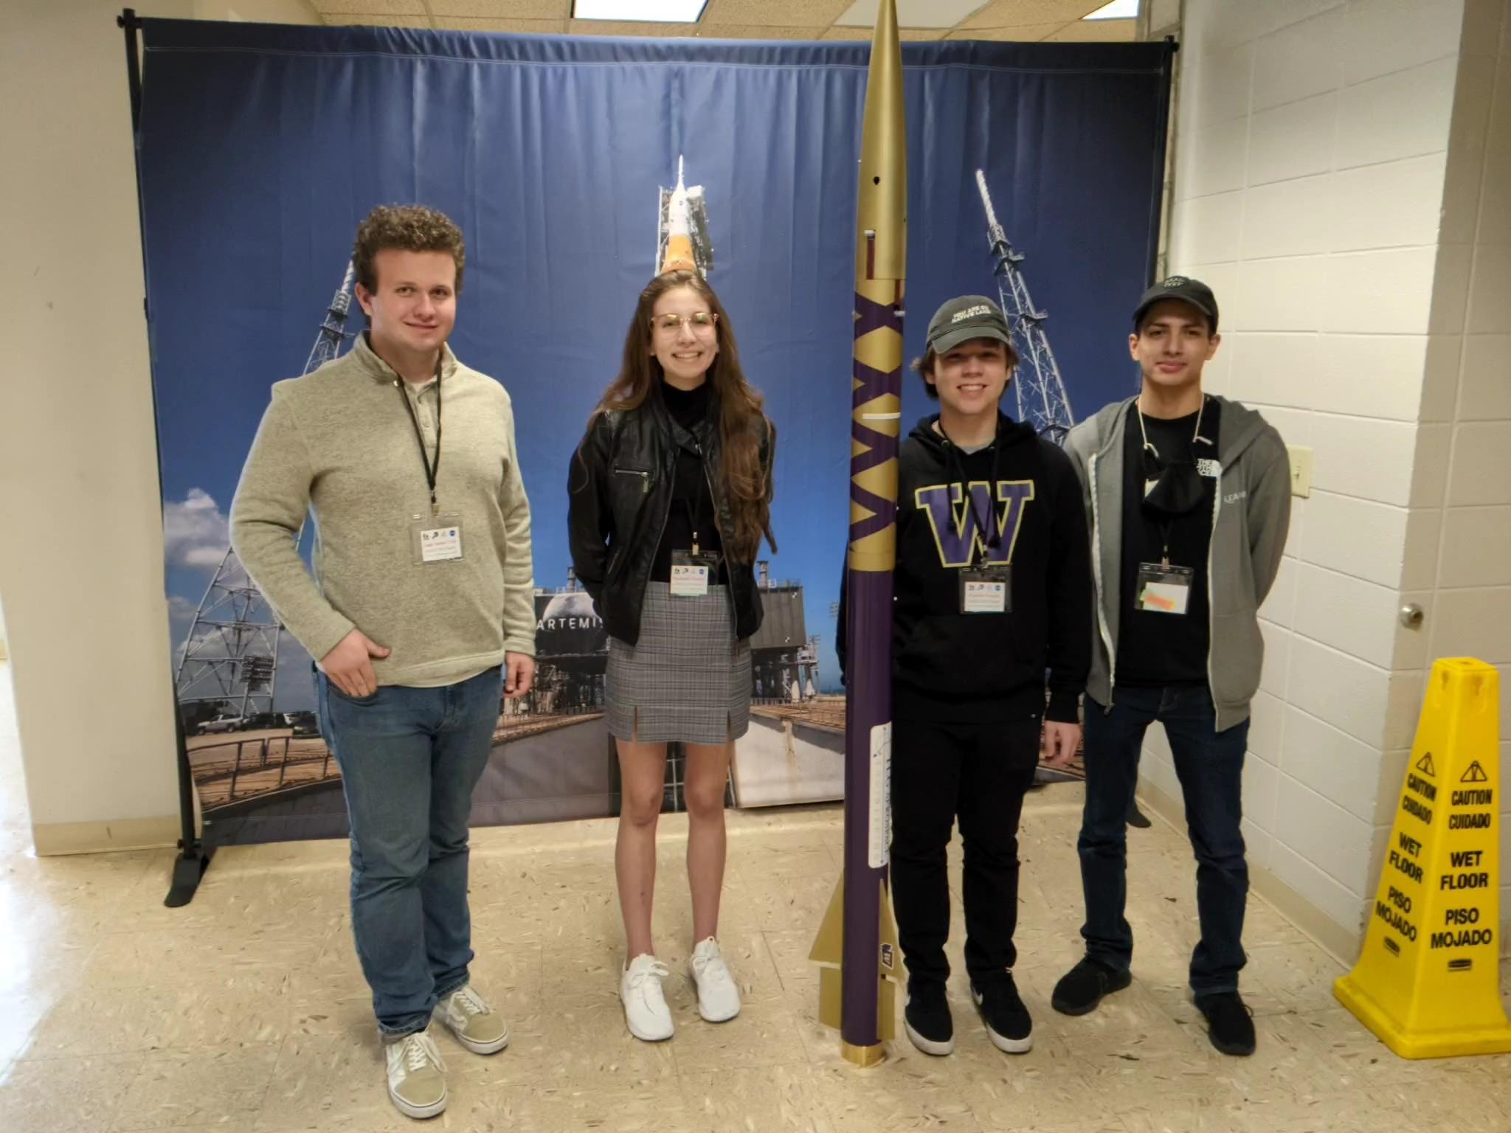

Scott Pinkham – Current Advisor
Advisor - Lecturer American Indian Studies
  NAR Certified Level 1
  FNL - University of Washington and AISES Advisor
  University of Washington / AISES UW
  Advisor since 2021
Notes:
Guest

Slide 6
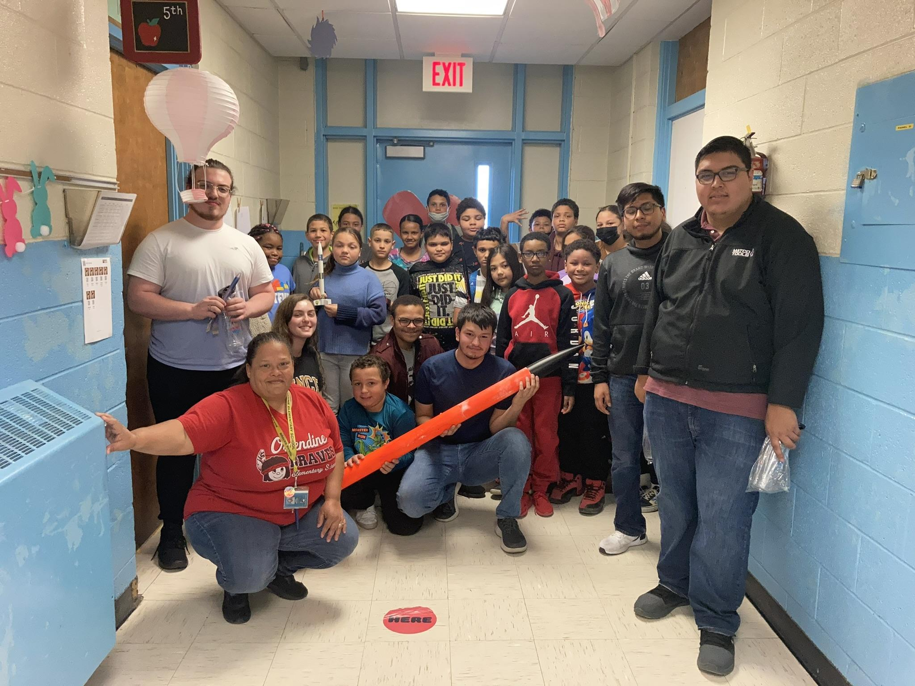

Steven Singletary – Current Advisor
Advisor - Clinical Assistant Professor
  TRA Certified Level 1
  FNL - University of North Carolina Pembroke
  Advisor since 2021
Notes:
Guest

Slide 7

Mike Harrell – Current Mentor
Mentor – Faculty Member, Earth and Space Sciences Dept, Facilities Project Engineer
  NAR Certified Level 2 - TRA Tri-Cities
  Various rocketry mentorship roles
  University of Washington mentor - FNL 2020-2021
Notes:
Guest

Slide 8
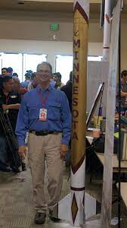
Gary Stroick – Current Mentor
Mentor - Off We Go Rocketry
  TRA Certified Level 3 - TRA Minnesota Board of Directors
  Various rocketry mentorship roles
  Leech Lake Tribal College - FNL 2019 - 2022
  Fond du Lac Tribal College - FNL 2021-2022
  NASA USLI Experience (University of Minnesota)
  ESRA Spaceport America Cup Experience (University of Minnesota)
  NASA Minnesota Space Grant Consortium - Great Midwest Rocket Launch
Notes:
Guest

Slide 9
What is a Rocketry Mentor?
First Nations Launch defines a Rocketry Mentor as someone who:
  Is an active member of either:
    National Association of Rocketry (NAR - https://www.nar.org/)
    Tripoli Rocketry Association (TRA - http://www.tripoli.org/)
  Is experienced to the level of the competition rocket or higher
    Certified Level 2 is acceptable (Certified Level 3 is better)
  Is a member of a local rocketry club (preferable)
    Has access to local launch site, and can facilitate local launches
  Can assist the team with rocketry design, procurement and build
The Rocketry Mentor:
  may or may not have an engineering degree
  may or may not be associated with the school
Notes:
FNL Definition of Rocketry Mentor

Slide 10
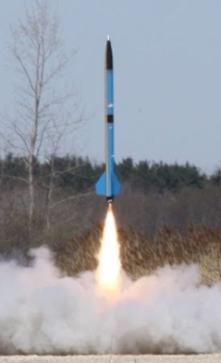
Responsibilities of a Mentor
A volunteer who is tasked with:
  Assisting students with rocket design/simulation and kit selection
  Assisting students with rocket part procurement
  Assisting students with rocket build and component testing
  May be required to facilitate a local launch
    Can facilitate a test launch (if desired)
    Handle / teach safe handling of energetics / motors (if required)

Slide 11
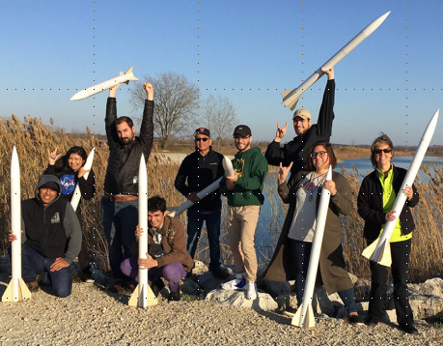
Benefits of Having a Mentor
Panel will contrast some of their experiences with and without an experienced Rocketry Mentor
  Simulations
    Understanding performance parameters
  Design
    Selecting proper components
  Procurement
    Procuring components / lead time
  Build
    Building with proper / safe methods
  Test
    Testing proper components at right time
  Flight
    Assisting with launch preparation
Notes:
Panelists can share experiences / tips – will go around in order – keep section under 15 minutes (4 min each)

Slide 12
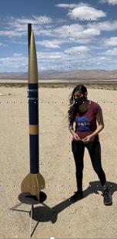
How to Acquire a Mentor
The teams must acquire their own Rocketry Mentor
  They can select based on location, preference, etc.
  The Team Lead and/or the Advisor should be seeking a Mentor
  FNL Advisor Liaison can assist as needed (email Mark)
First, see if your school has an existing rocket team or club (for another competition for example)
  Reach out to that club to see if they can provide a mentor
  They may also recommend a mentor, or assist with your search

Slide 13
How to Acquire a Mentor
Next, look online to see what rocketry clubs are in your area
  TRA Prefectures
    http://www.tripoli.org/Prefectures
  NAR Chapters
    https://www.nar.org/find-a-local-club/nar-map-locator/
You can email the club board (from the website)
You can attend a monthly meeting or launch (usually open to public – National NAR or TRA membership preferred)
    Most clubs are aware of the various rocketry competitions
    Most clubs will volunteer individuals to mentor (when approached)

Slide 14
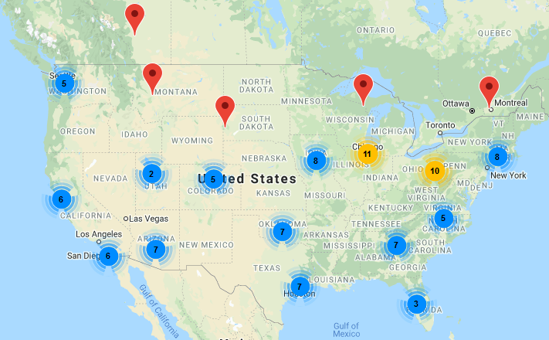
Tripoli Rocketry Association
www.tripoli.org
Notes:
These are all the Tripoli Prefectures across the country.
The blue dot (with number) signifies there are a that many number of Prefectures in that area (must zoom map to see distinctly).
If you are a team looking for a mentor, consult the Tripoli website to find a Prefecture near you.

Slide 15
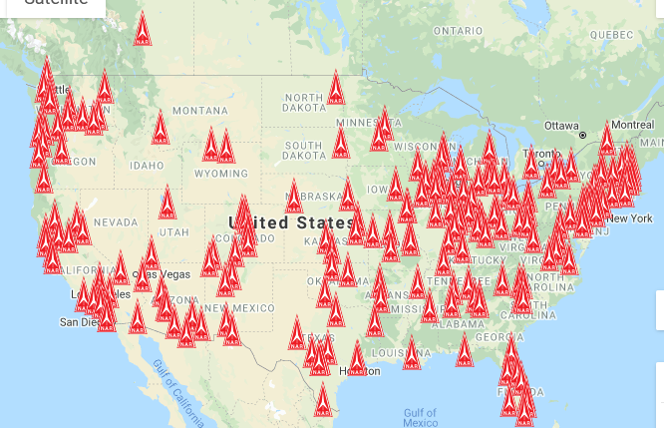
National Association of Rocketry
www.nar.org
Notes:
These are all the NAR Clubs across the country.
If you are a team looking for a mentor, consult the NAR website to find a club near you.

Slide 16
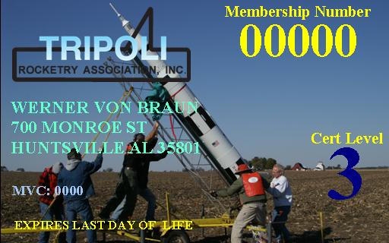
How to Acquire a Mentor - Tips
Avoid common pitfalls when finding a Rocketry Mentor
  Ensure your Rocketry Mentor is properly certified
  Ensure your Rocketry Mentor is active (up-to-date)
    We ask that you provide your mentors NAR or TRA membership number
    We can verify if they are active and what level certification
  Do not wait to find your Rocketry Mentor
    The sooner they are involved, the better
    Its best to have a mentor before Proposal submission
  Teams can have more than one Rocketry Mentor
    Divide the work, provides redundancy

Slide 17
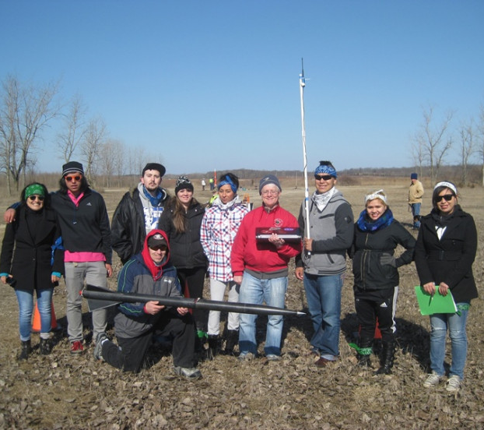
How to Acquire a Mentor
The Panel can share some of their Rocketry Mentor experience
  Information about their mentors / clubs / sites
  How they acquired their mentors
  How they came to be mentors
  Share any pitfalls or mistakes to avoid
Notes:
Panelists can share experiences / tips – will go around in order – keep section under 15 min (4 min each)

Slide 18
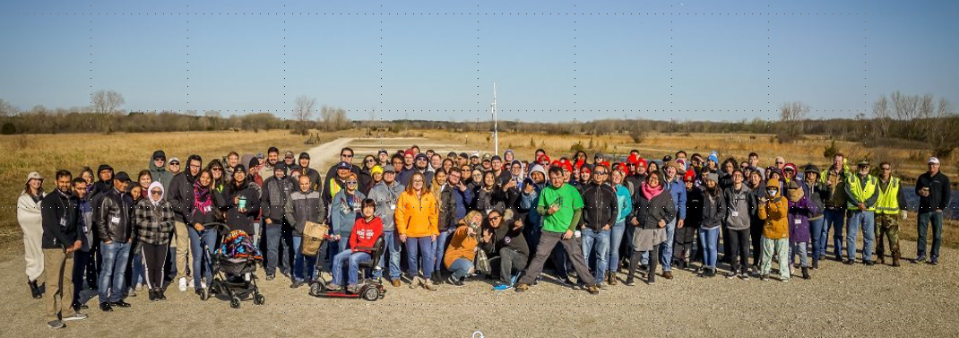
2023 @ Kansasville, WI
Q & A
Notes:
‹#›

Slide 19
Speaker Contacts
Andrea Lopez Arguello - UC Davis Law
Scott Pinkham - University of Washington
Steven Singletary - University of North Carolina Pembroke
Mike Harrell - University of Washington
Gary Stroick - University of Minnesota
Mark Abotossaway - FNL Advisor Liaison
  mark.a.abotossaway@gmail.com

Slide 20
Benefits / Challenges
Can you share a bit about your FNL experience without a mentor
  Simulation experience / challenges?
  Design experience / challenges?
  Procurement experience / challenges?
  Build experience / challenges?
  Flight operations / flight test experience?
Can you share a bit about your FNL experience with a mentor
  Simulation experience / challenges?
  Design experience / challenges?
  Procurement experience / challenges?
  Build experience / challenges?
  Flight operations / flight test experience?
Notes:
BACKUP – talking points

Slide 21
Benefits / Challenges
Can you share how you acquired a mentor?
  Discuss your rocketry mentor details?
  Discuss how you contacted or met your mentor?
  TRA or NAR?
  Any other benefits after acquiring your mentor?
You can add any other additional talking points you think relevant
  You can let me know
Notes:
BACKUP – talking points

