Slide 1




First Nations Launch
Kick-Off Meeting
2023
The material contained in this document is based upon work supported by a National Aeronautics and Space Administration (NASA) grant or cooperative agreement. Any opinions, findings, conclusions or recommendations expressed in this material are those of the author and do not necessarily reflect the views of NASA.
Revised 10.29.22
Notes:
‹#›
Christine
‹#›

Slide 2
Overview
Welcome and Introductions
Competition Overview
Reports and Scoring
Prizes and Awards
Recruitment
Resources
Reimbursements
Patch Contest
#IAMFNL
‹#›
Notes:
‹#›
Christine
‹#›

Slide 3
Meet the FNL Team
Wisconsin Space Grant Foundation
Kevin Crosby, Director kcrosby@carthage.edu
Christine Bolz, Assistant Director cbolz@carthage.edu
Courtney Kadolph, FNL Project Coordinator ckadolph@carthage.edu
Connie Engberg, Project Support Assistant cengberg@carthage.edu
Megan Goller, Accounts Assistant mgoller@carthage.edu
First Nations Launch
Frank Nobile, Technical Coordinator, Wisconsin Tripoli maxq3@aol.com
Mark Abotossaway, Project Assistant/Advisor Liaison, Blue Origin (Alumni) mark.a.abotossaway@gmail.com
Tripoli Rocket Association
Bob Justus, Tripoli Assistant, Illinois Tripoli bob@mhbofni.com
Kevin Harnack, Tripoli Assistant, Wisconsin Tripoli
‹#›
Notes:
‹#›
Christine
‹#›

Slide 4
Meet the Judges
NASA
Orson John, Navajo NASA Goddard
James Wood, Osage NASA Kennedy Space Center
Aaron Yazzie, Navajo Jet Propulsion Laboratory
Joe Connolly, Haudenosaunee, Onondaga Nation NASA Glenn
Lauren Denson, Apache Jet Propulsion Laboratory
United States Air Force
Haida Star Eagle, Matinecock Tribe of NY
Raytheon
Genevieve Bennally, Navajo
Aaron Ashley, Dakota-Omaha
Arcadis
Jennifer Bennett, Ojibway
The Boeing Company
Sean Osurman, Hawaiian

Slide 5
Gateway Challenge Teams
Honolulu Community College* Hawaii
Lac Courte Oreilles Ojibwa University Wisconsin
Nueta Hidatsa Sahnish College North Dakota
‹#›
Notes:
‹#›
Connie

Slide 6
Moon Challenge Teams
Carthage College* Wisconsin
University of Colorado- Boulder Colorado
Fond du Lac Community College Minnesota
Fort Lewis College Colorado
New Mexico State University* New Mexico
Northern Oklahoma College Oklahoma
Northwest Indian College Washington
Turtle Mountain Community College North Dakota
United Tribes Technical College North Dakota
University of Wisconsin-Madison* Wisconsin
‹#›
Notes:
‹#›
Connie
‹#›

Slide 7
Mars Challenge Teams
University of California Los Angeles California
University of Washington Seattle Washington
Massachusetts Institute of Technology* Massachusetts
Northern Arizona University Arizona
University of Hawaii - Manoa Hawaii
Oklahoma University* Oklahoma
University of North Carolina Pembroke North Carolina
Queen’s University Ontario, Canada
‹#›
Notes:
‹#›
Connie

Slide 8
Supplied by WSGC to Teams
$4,000 Project/Travel Award
  Reimbursements will be issued through Carthage College
  Reimbursement deadlines are March 6 and May 8, 2023
  Additional travel funds for Mountain, Eastern, Pacific, Atlantic and Hawaiian Time Zones
Launch Weekend Hotel Accommodations and Select Meals
  Maximum three (3) rooms for three (3) nights per team at competition hotel
  Last day to secure lodging is February 27, 2023
  Select meals: Friday breakfast and lunch, Saturday lunch and dinner
Low-Power Rocket
  Each team will receive a low-power rocket for the demonstration flight requirement
  New teams will receive a launch pad
  Flight demo deadline is January 23, 2023
Two (2) Rocketry Reference Books (New Schools)
  Model Rocket Design and Construction; Modern High-Power Rocketry 2
Competition Ejection Charges
Competition Rocket Motor(s) and Motor Casing
  One (1) reloadable motor of your choice and one (1) motor casing per team will be provided
  Motor selection deadline is February 27, 2023
Report Feedback
  Provided a minimum of one (1) week prior to submission of next report
  No feedback will be given on FRR report
‹#›
Notes:
‹#›
Christine
‹#›

Slide 9
Optional Resources Available
by WSGC to Teams
Additional Travel Funds
  Additional travel funds for Mountain, Eastern, Pacific, Atlantic and Hawaiian Time Zones
  Based on one-way travel to Carthage College
    $500
      1,000-1,999 miles
      Fort Lewis College, Massachusetts Institute of Technology, Northern Arizona University
    $1,000
      2,000-2,999 miles
      Northwest Indian College, University of California Los Angeles, University of Washington Seattle
    $1,500
      3,000+ miles
      University of Hawaii at Manoa, Honolulu Community College
Outreach Kit - Reach for the Star
  15 low power rocket - valued at $25 per rocket
  http://www.rocketcompetition.com/
‹#›
Notes:
‹#›
Christine
‹#›

Slide 10
Additional Non-FNL Support
Additional funding should be above and beyond FNL funding
Additional support should not replace FNL funding
Funds can come from:
  Your state’s Space Grant
    https://national.spacegrant.org
  Academic Institutions
  Student Groups
  Industry
Non-FNL additional funding can be used for
  Travel to and from Kenosha, WI for mentors and additional team members
  Stipend for team’s TRA/NAR mentor(s)
  Mobile tools for the rocket group (battery operated, hammer, Dremel, drill, screwdriver, scale)
  Traveling tool box to bring to launch weekend
  Safety equipment – PPE
  Launch 2 Learn Workshop at academic institution
  Level I Rocket, Motor, and Certification Fee
  Level II Rocket, Motor, and Certification Fee
  Outreach events (i.e. low-powered rocket event, displays, etc.)
  Team shirts, jackets, etc.
‹#›
Notes:
‹#›
Christine
‹#›

Slide 11
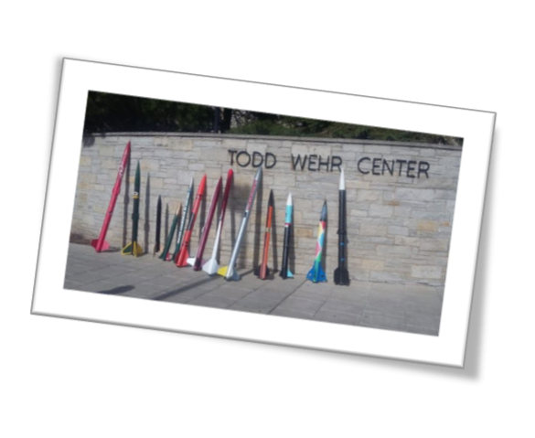
Launch Weekend
April 28-30, 2023
Thursday, April 27, 2023
  Teams Arrive in Wisconsin
Friday, April 28, 2023
  Welcome Breakfast/Competition Kick-off, Team Workday, Motor Build Workshop,Breakout Sessions, Final Safety Inspections, Oral Presentations
Saturday, April 29, 2023
  Launch Day @ Richard Bong Recreational Park
  Closing Banquet @ Carthage College
Sunday, April 30, 2023
  Rain Date, Certification Launches @ Richard Bong Recreational Park
‹#›
Notes:
‹#›
Christine
‹#›

Slide 12
Timetable 0
Date | Activity https://spacegrant.carthage.edu/first-nations-launch/calendar/
Nov 1, 2022 | Kick-off Meeting @ 4:00 pm CDT (Zoom) (Moon/Mars)
Nov 8, 2022 | Proposal, Budget, and Design Review Development Webinar @ 4:00 pm CST (Zoom) (Moon/Mars)
Nov 14, 2022 | Award Acceptance Material Due (Moon/Mars)
Nov 15, 2022 | Structures Webinar @ 4:00 pm CST (Zoom)
Nov 22, 2022 | Project Management Webinar @ 4:00 pm CST (Zoom)
Nov 29, 2022 | Introduction to RockSim Webinar @ 4:00 pm CST (Zoom)
Dec 12, 2022 | Proposal Due (Moon/Mars) Preliminary Budget Due (Moon/Mars) Flysheet Due (Moon/Mars); RockSim Due (Moon/Mars)
Dec 13, 2022 | Build & Assembly Techniques Webinar @ 4:00 pm CST (Zoom)
Dec 16, 2022 | Notice of Intent to Compete Due (Gateway) Request Virtual Rocketry Workshop Due
Jan 2, 2023 | Award Announcement (Gateway)
Jan 3, 2023 | Kick-off Meeting (Gateway) at 4:00pm CST (Zoom)
Jan 10, 2023 | Grant Management Webinar @ 4:00 pm CST (Zoom)
Jan 12, 2023 | Launch 2 Learn Kit Reveal @ 4:00 pm CST (Zoom)
Jan 16, 2023 | Award Acceptance Material Due (Gateway)
Jan 17, 2023 | Avionics/Altimeters Webinar @ 4:00 pm CST (Zoom)
Jan 20-21, 2023 | Launch 2 Learn Rocket Certification Virtual Workshop (Registration Required)
Notes:
‹#›
Christine
‹#›

Slide 13
Timetable
Jan 23, 2023 | Preliminary Design Review (PDR) Report Due (Moon/Mars); Flysheet Due (Gateway/Moon/Mars); RockSim Due (Gateway/Moon/Mars) Flight Demo Due - Upload rocket demo flight video on Facebook and/or Twitter
Jan 24, 2023 | Recovery Webinar @ 4:00 pm CST (Zoom)
Jan 30- Feb 2, 2023 | PDR Virtual Presentations (Zoom) (Gateway/Moon/Mars)
Feb 6, 2023 | Final Requests Due to Change to Different Competition Challenge
Feb 20, 2023 | Patch Design Due
Feb 21, 2023 | Advisor/Mentor Meeting @ 4:00 pm CST (Zoom)
Feb 27, 2023 | Critical Design Review (CDR) Report Due (Moon/Mars); Flysheet Due (Gateway/Moon/Mars); RockSim Due* (Gateway/Moon/Mars) Final Motor Selection Due (Gateway/Moon/Mars) Official Team Roster & Lodging List Due (Gateway/Moon/Mars) Team Bio Due (Gateway/Moon/Mars) Team Photo Due (Gateway/Moon/Mars) All Team Member Registration on WSGC Website & FNL Application Due (Gateway/Moon/Mars)
Mar 6, 2023 | Reimbursements Due (First payout) (Gateway/Moon/Mars)
Mar 6-9, 2023 | CDR Virtual Presentations/Initial Virtual Safety Inspection with WSGC (Zoom) (Gateway/Moon/Mars)
Mar 28, 2023 | Launch Operations Webinar @ 4:00 pm CDT (Zoom)
Apr TBD, 2023 | Student Launch Initiative (Next Step Award 2023)

Slide 14
Key Changes for 2023
The Gateway Challenge
Webinars
  Mentor, RockSim, Design Reports, Project Management, Grant Management, Structures, Challenge Design, Avionics, Recovery, Launch Ops, Data Analysis
Additional funding for certain time zones
New Handbook Appendices providing more support and guidance
TRA/NAR Mentor Requirement
RockSim submission required – all teams – each cycle
Reimbursement Process
Training Videos
New Awards
  Top Advisor, Top Team Lead, Rookie Team
Notes:
‹#›
Christine
‹#›

Slide 15
Team COVID-19 Safety Plan
Local Launch Site
Local Mentor
Local TRA/NAR Prefecture
Note: As the coronavirus (COVID-19) situation continues to evolve, FNL will closely monitor and follow guidelines from federal, state and community officials regarding on-site competitions. Protecting the health and safety of team members, staff and judges is our primary priority. Challenge managers will be in contact with participants on specifics and changes to the challenges, if any.
‹#›
Notes:
‹#›
Christine
‹#›

Slide 16
FNL COVID-19 Safety Plan
Launch Site Protocol
Carthage College Protocol
Virtual, Hybrid, and In-Person Planning
Note: As the coronavirus (COVID-19) situation continues to evolve, FNL will closely monitor and follow guidelines from federal, state and community officials regarding on-site competitions. Protecting the health and safety of team members, staff and judges is our primary priority. Challenge managers will be in contact with participants on specifics and changes to the challenges, if any.
‹#›
Notes:
‹#›
Christine
‹#›

Slide 17
FNL COVID-19 Safety Plan
Utilize Team Structure for Assignments
Weekly Virtual Meetings
Online Lab/Log Book
Limited Lab Access
‹#›
Notes:
‹#›
Danielle
‹#›

Slide 18

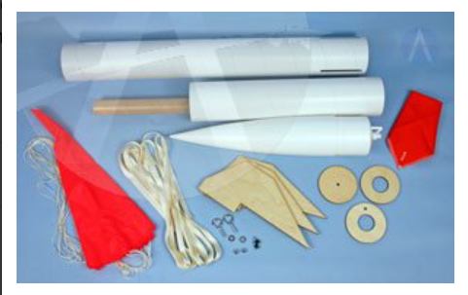
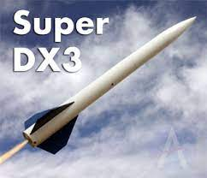
Gateway Design Objective
  Teams are required to design and construct a dual deploy high-power rocket from the following list:
  Mad Cow 4” Diameter Super DX-3 kit
  Mad Cow 4” Diameter Fiberglass Super DX-3 kit
  The team shall select one of the rockets listed in handbook.
  The team shall select one of the motors listed in handbook.
  The rocket shall reach an altitude of 2500’ AGL.
  The team / rocket should satisfy all other requirements as outlined in this Handbook.
  The team does not need to write reports but are required to submit a Flysheet at PDR, CDR and FRR.
‹#›
Photos courtesy of Apogee Rockets
Notes:
‹#›

Slide 19
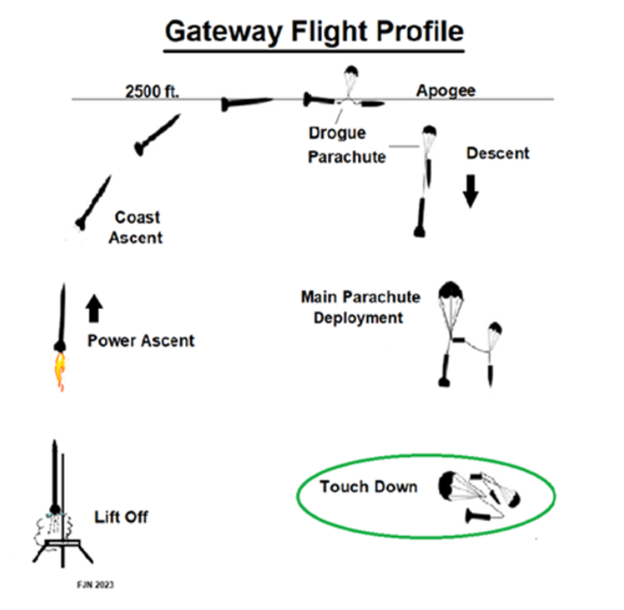
Gateway Flight Profile
‹#›
Revised 10.29.22
Notes:
‹#›

Slide 20

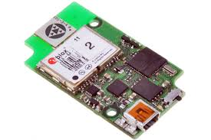
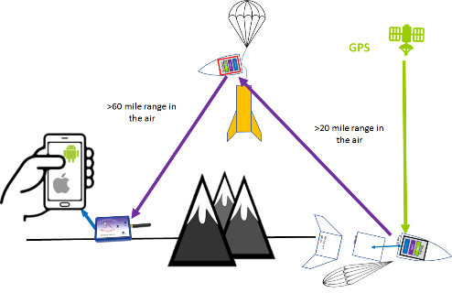
Moon Design Objective
Design, test and fabricate specific structural design components:
  Nose Cone/Shoulders
  Bulkheads/Centering rings
  Fins
  Avionics Sled
The focus is on material science, fabrications, and understanding material properties and strengths.
Teams shall design their rockets for an expected apogee of 3000' - 4000' AGL.
‹#›
Photos courtesy Art of Technology
Notes:
‹#›
Frank
‹#›

Slide 21
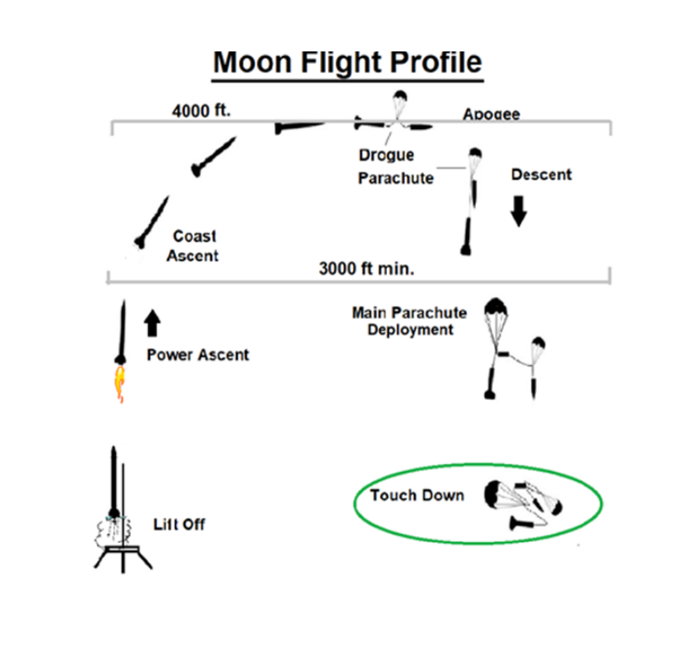
Moon Flight Profile
‹#›
Revised 10.29.22
Notes:
‹#›
Frank
‹#›

Slide 22

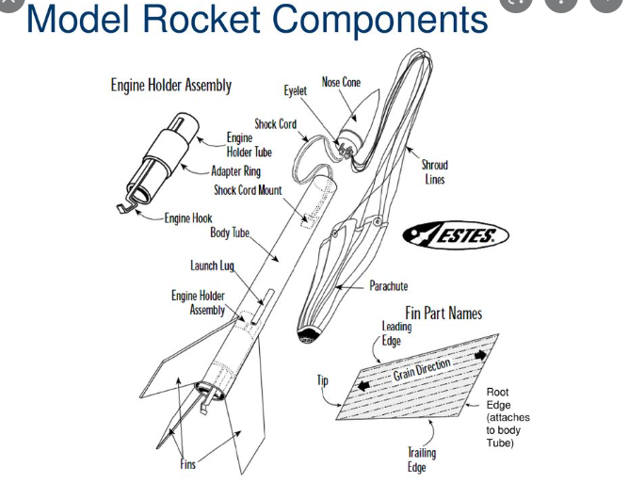
Mars Design Objective
Select a 'base' dual deploy kit from our pre-selected list
Design, test, and fabricate all structural dual deploy rocket components:
  Airframes (body tubes)
  Couplers (internal tubes)
  Nosecones / shoulders
  Bulkheads / Centering Rings
  Fins
  Avionics sled
Utilize a COTS motor mount tube.
Select a motor from those listed in our handbook
Design their rockets for an expected apogee of 3500' - 4000' AGL
‹#›
Photos courtesy NASA and Apogee Rockets
Notes:
‹#›

Slide 23
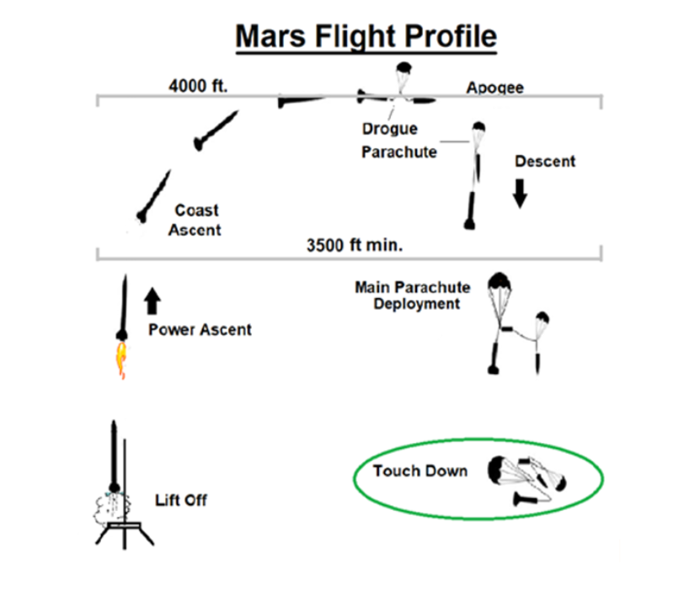
Mars Flight Profile
‹#›
Slide updated 10.29.22
Notes:
‹#›

Slide 24
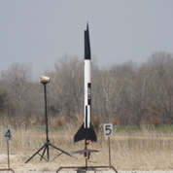
Safe and Successful Flight
Safe Flight must achieve:
  Launch
  Stable, vertical flight during ascent
  Recovery system(s) must successfully deploy
  Rocket must be recovered in flyable condition
‹#›
Notes:
‹#›
Frank
‹#›

Slide 25
Competition Criteria (All Teams)
All teams must follow all requirements of the Competition Handbook- the following is a subset of those requirements:
  All projects during the construction process must have a minimum of one (1) scheduled virtual inspections with the designated safety officer (TBA)
  All projects must be 90% constructed and ready to fly two (2) weeks prior to launch day
    90% = Airframe, motor mount, fins, payload airframe, couplers, bulkheads, should be permanently attached.
  All projects must be designed to enable the motor deployment charge as a backup recovery system at apogee.
  All final competition projects must have a documented flight/stable RockSim simulation profile.
  Photographs are required during the construction of the motor mount and fin fillet assembly process to ensure proper construction techniques has been adhered.
  All projects must have an aero-dynamic design. No odd rocs. Note: No flying pyramids, saucers or spools.
  The “Center of Pressure” (CP) and the “Center of Gravity” (CG) must be indicated on rocket.
‹#›
Notes:
‹#›
Frank
‹#›

Slide 26
Competition Criteria Summary
Quality and timely completion of program milestones (see Program Milestones section in handbook)
Success of competition flight
Recorded altitude of competition flight
Recorded pre-flight mass of the rocket airframe (excluding electronics, parachute/recovery equipment, motors, and miscellaneous hardware components)
  The team's rocket shall be compared against a reference kit built by Tripoli Rocketry to determine the percent (%) mass reduction achieved
Dimensions of the rocket
  The team's rocket shall be compared against a reference kit built by Tripoli Rocketry to determine accuracy
Highly recommended (although not required):
  Teams should plan to complete a full-scale flight test prior to launch weekend.
  Conversely, teams should plan to complete various small scale flight tests, to validate component functionality.
‹#›
Notes:
‹#›
Frank
‹#›

Slide 27
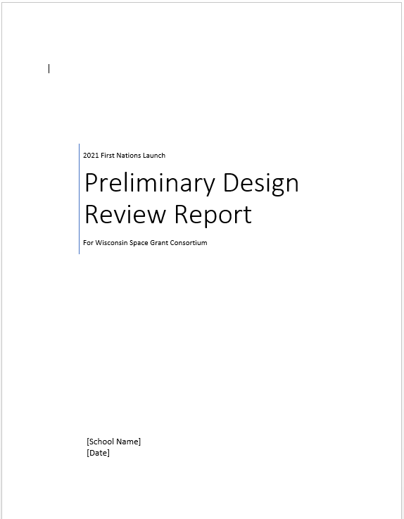
Scoring Overview (Moon/Mars)
5 Written Reports are due:
  Proposal, PDR, CDR, FRR, PLAR
  Each report carries equal weight
  Each report builds on previous reports
2 Virtual Presentations w/judges
  In-time feedback (one week prior to next report due date)
Flight and payload performance are scored
Late reports are docked 20% per day
  Due date is 11:59 CST / CDT (see Calendar)
Outreach effort
  Up to 10 bonus points

Slide 28
Challenge Change
Challenges build off each other
  Gateway Moon Mars
FNL website now has video series of instructional videos and webinars https://spacegrant.carthage.edu/first-nations-launch/rocket-instructional-vide oswebinars/
Only one competition motor provided per team
New Awards
  Top Advisor
  Top Team Lead
  Rookie Team
  Reach for the Stars

Slide 29
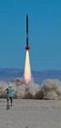
Written Design Reviews (Moon / Mars)
Communicate the engineering and design effort involved
  Analysis of predicted performance (compare actual)
    Temporary RockSim V9 – TARC Temporary License (Exp. Aug 31) - $20
    https://www.apogeerockets.com/Rocket_Software/RockSim_Educational_TARC
      TARC Team Number: FNL23_(Your team’s award #)
  SHOW the design and construction as it progresses (pictures, diagrams, etc.)
Reports are due when posted on Competition Handbook calendar
  Reports = 75% of overall score
A Report Template (MS Word) is provided for each report
  Link to Report Templates are found on the WSGC Website
    https://spacegrant.carthage.edu/first-nations-launch/rubric/
Design Review Development Webinar (optional) – Nov 8, 2022
Gateway Teams do not submit reports

Slide 30
Fly Sheets (All Teams)
Teams are required to submit a flysheet at first 4 cycles
Proposal, PDR, CDR, FRR
  The template can be found on the FNL Website under ‘Report Templates and Scoring Rubrics’
  https://spacegrant.carthage.edu/first-nations-launch/rubric/
The Flysheet is a summary of the technical specifications of your rocket / payload
Fill out the Flysheet after your report is complete
  Fill as much as you can at each cycle, from info in your report
    You may not understand much at Proposal, but will have a complete sheet at FRR
  If you don’t understand a specification – ask
  If you don’t have a specification, leave it blank
    We don’t expect all specifications at the Proposal
‹#›
Notes:
‹#›

Slide 31
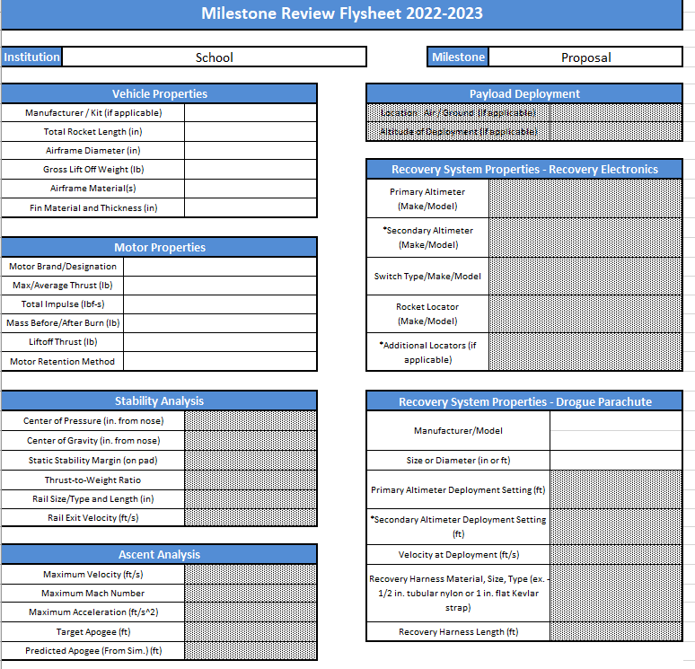
Flysheets Example (All)
‹#›
Notes:
‹#›

Slide 32
Virtual Design Reviews (All Teams)
Summarize and present your written design report
A PowerPoint template is provided for each Virtual Review
  Links to virtual review templates are found in the WSGC Website
    https://spacegrant.carthage.edu/first-nations-launch/rubric/
Every team member should participate during the presentation.
  The presentation is limited to 20 minutes
  Teams present report (8-10 minutes)
  Judges and Tripoli Rocketry Association member will ask questions about your design at the end of your presentation (3-5 minutes)
Each team given a presentation slot based on Judge’s schedule.
  It will be the team’s responsibility to be in attendance
‹#›
Notes:
‹#›
Aaron
‹#›

Slide 33
Flight Readiness Review
Similar to your Virtual Design Reviews – except in-person - summarize and present your entire First Nations Launch experience and present your as-built rocket and payload
A PowerPoint template is provided for presentation
  Link to Launch Weekend Presentation template is found in the WSGC Website
    https://spacegrant.carthage.edu/first-nations-launch/rubric/
Every team member should participate during the presentation
  The presentation is limited to 15 minutes (6-8 minutes for your team to give the presentation, 3-5 minutes for judges and questions and 5 minutes for scoring).
Judges only will ask questions, following presentation (3-5 minutes). If time allows there may be additional questions from the audience.
  Consider documenting your project with video or picture logs, using this information to compile your presentation.
‹#›
Notes:
‹#›
Aaron
‹#›

Slide 34
Competition Scoring (Mars/Moon)
Scoring Breakdown for MARS / MOON Teams
Competition Proposal Written Report Preliminary Design Review (PDR) Written Report PDR Presentation w/ judges Virtual Presentation Critical Design Review (CDR) Written Report CDR Presentation w/judges Virtual Presentation Flight Readiness Review (FRR) Written Report FRR Virtual Safety Inspection Virtual Presentation Post-Launch Assessment Review Report (PLAR) Written Presentation | 5 pts. 15 pts. 5 pts. 15 pts. 5 pts. 15 pts. 5 pts. 10 pts. | 75 pts overall
Launch Weekend Oral Flight Readiness Presentation | 5 pts. | 5 pts
Launch Weekend- Mission Performance Launch Weekend- Challenge | 10 pts. 10 pts. | 20 pts overall
TOTAL | 100 pts
Conduct an Education Outreach Project Submit Education/Public Outreach Form BONUS |  | Up to 10 pts
Submissions received after 11:59 pm CST on the due date will receive a deduction of 20% for each day they are late.
‹#›
‹#›
Notes:
‹#›
Aaron
‹#›

Slide 35
Competition Awarded Prizes
Grand Prize Award $3000 w/invitation to a NASA Center
2nd Place $2000
3rd Place $1000
Aesthetic Award Team whose rocket has the most innovative and professional appearance
Team Spirit Award Team chosen by their peers as the team that shows interactive spirit, helpfulness, and cooperation.
Altitude Award Team whose actual apogee is closest to the predicted apogee in the Flight Readiness Report.
Judges Award Team chosen by the judges as the team who met the goals of the program and
exemplified hard work and determination
Next Step Award Up to $15000 Project/Team Travel Award w/invitation to Student Launch at Marshall Space Flight Center and/or RockOn! at Wallops Flight Facility
Outreach Award $500
Patch Design Award $100
Team Advisor Stipend Up to $1000 (Teams must meet the conditions of participation
Top Advisor (New) Awarded to an advisor or co-advisor that equips, encourages, and empowers their
team to compete with confidence and capabilities that lead to next step opportunities
Top Team Lead (New) Awarded to the team lead that fulfills their role with excellence
Rookie Team (New) Awarded to a new team that completes all phases of the rocket competition with determination and perseverance.
‹#›
Notes:
‹#›
Christine
‹#›

Slide 36
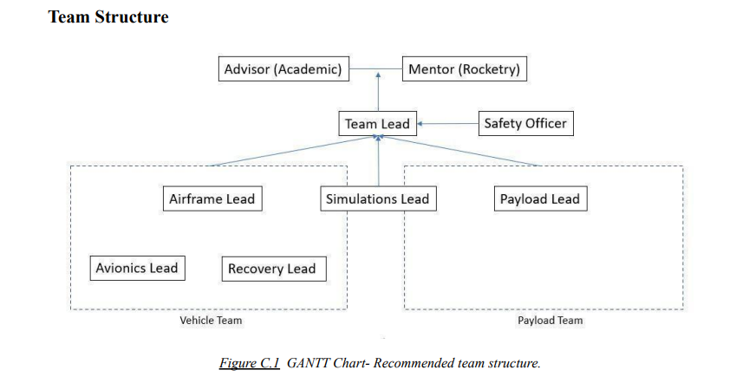
First Nations Launch Teams
4-6 members per team on average
Advisor
Meetings/Telecons for assistance, maintain student driven project
New schools/new advisor: Can be paired up with a veteran advisor
  Will receive additional support / attention from FNL Advisor Liaison Mark
Team Lead: Meetings/Telecons for assistance
Team Lead Responsibility: Communication and document submission
23
Notes:
‹#›
Danielle
‹#›

Slide 37
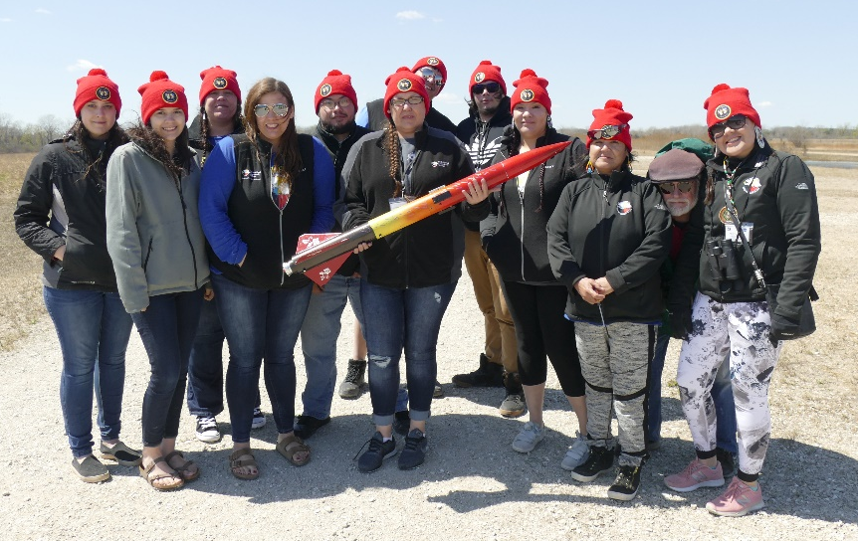
Team Recruitment
How do we get students to participate
and be engaged this year?
Coordinate 5-10 minute presentations in
classrooms and club meetings
Hold a virtual recruiting event
  Max 20 minute presentation
  Invite FNL alumni (from your institution or another returning team)
Reach out to other faculty for assistance, ask that they share recruiting emails
Tap into new applicant pools
Use the excitement of the L2L Workshop to get Level 1 certification
Share other ideas in the chat!
24
Notes:
‹#›
Danielle
‹#›

Slide 38
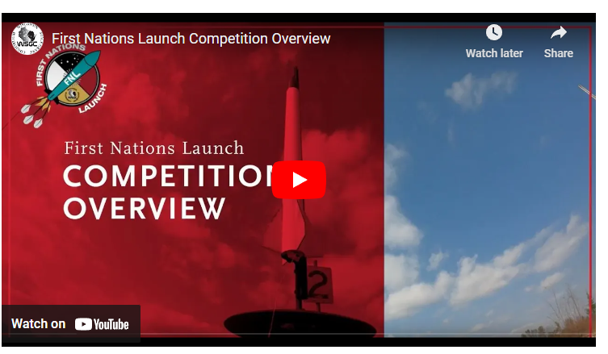
Training Video Series
https://spacegrant.carthage.edu/first-nations-launch/rocket-instructional-videoswebinars/
Overview
Avionics
Recovery Systems
Rocket Assembly
RockSim
Range and Motor Safety
‹#›
Notes:
‹#›
Danielle
‹#›

Slide 39
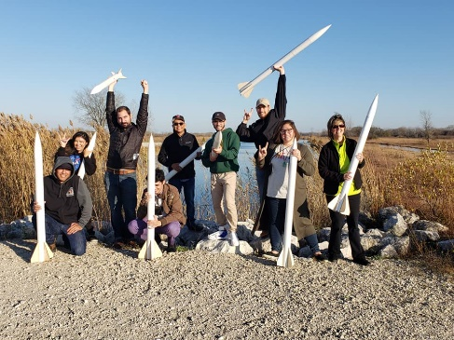

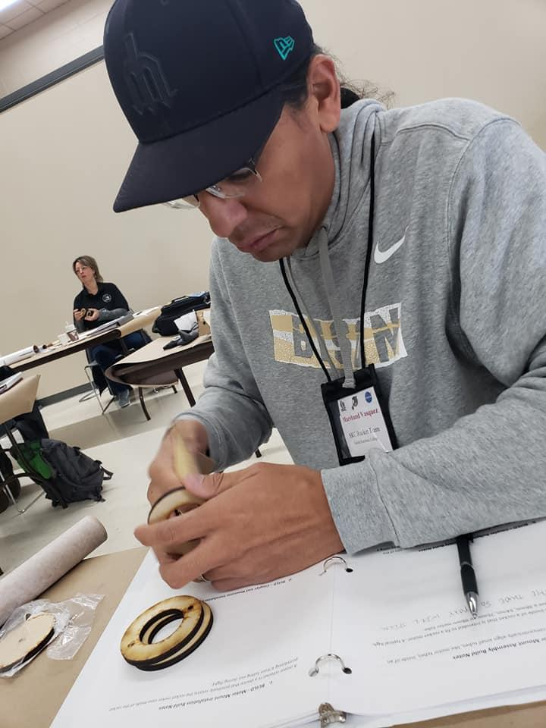
Launch 2 Learn Workshop
Introductory Rocket Workshop
Options: Carthage College, Team Institution, or Virtual
1-2 day Kit Rocket Build
Level I Certificatoin (TRA/NAR)
Current TRA/NAR members are not eligible
Virtual Workshop Request due December 16, 2022
  Include Number of Advisors and Students attending
January 20-21, 2023 is the virtual workshop
Materials & Supplies covered by FNL
There may be institution costs associated with in-person workshop
https://spacegrant.carthage.edu/first-nations-launch/launch-2-learn-rocket-certification-workshop/
‹#›
Notes:
‹#›
Christine
‹#›

Slide 40

Outreach
One goal of First Nations Launch is to promote science, technology, engineering, and math (STEM) fields through educational opportunities throughout the United States.
  Outreach Form
Reach for the Stars (RTFS)
Each team may request a “Reach for The Stars National Rocket Competition” kit
The team will then conduct a Reach for the Stars outreach event for 15 students age 10-18
RFTS participants will be eligible for the RFTS National Winners’ Celebrations at the U.S. Space and Rocket Center in Huntsville, Alabama
http://www.rocketcompetition.com/index.html
‹#›
Notes:
‹#›
Christine
‹#›

Slide 41
Team Scheduling Guidance
Create a project schedule early on (can be a Gantt chart, excel spreadsheet or similar) to meet report deadlines
Schedule will assist with having a safe and successful flight
Choose a schedule that works best for the entire team (simple or detailed)
Update the project schedule regularly so you can anticipate any schedule issues early on
Include concept phase, preliminary phase, design phase, flight readiness, post launch
Details may include: purchase deadlines, build deadlines, report deadlines
Project Management Webinar – November 22, 2022
‹#›
‹#›
Notes:
‹#›
Danielle
‹#›

Slide 42
Competition Weekend
Welcome Breakfast
  One team to host the icebreaker event
    University of Hawaii at Manoa - 2022
    College of Menominee Nation - 2019
Special Guests
  Bret Benally Thompson - AISES Tribal Elder
  Captain Haida StarEagle - U.S. Space Force
  Professionals leading breakout sessions
Rocket Workshop
  99% Ready to Fly - Limit to Minor Fixes
  Half-day workshop
Breakout Sessions
  Special Topics
  30-60 minutes presentations
    Special Topics
Rocket Fair
  Present your rocket as a team to other teams, judges, and special guests
‹#›
‹#›
Notes:
‹#›
Danielle
‹#›

Slide 43
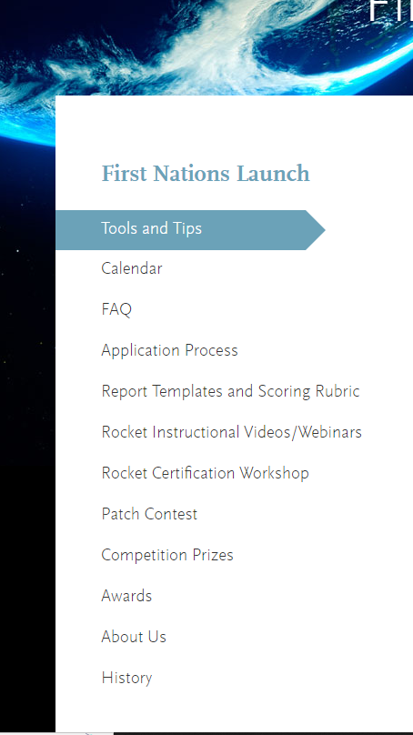
FNL Website
Tools and Tips
Calendar
FAQ
Application Process
Report Templates and Scoring Rubric
Rocket Instructional Videos/Webinars
Rocket Certification Workshop
Patch Contest
Awards
About Us
History

Slide 44
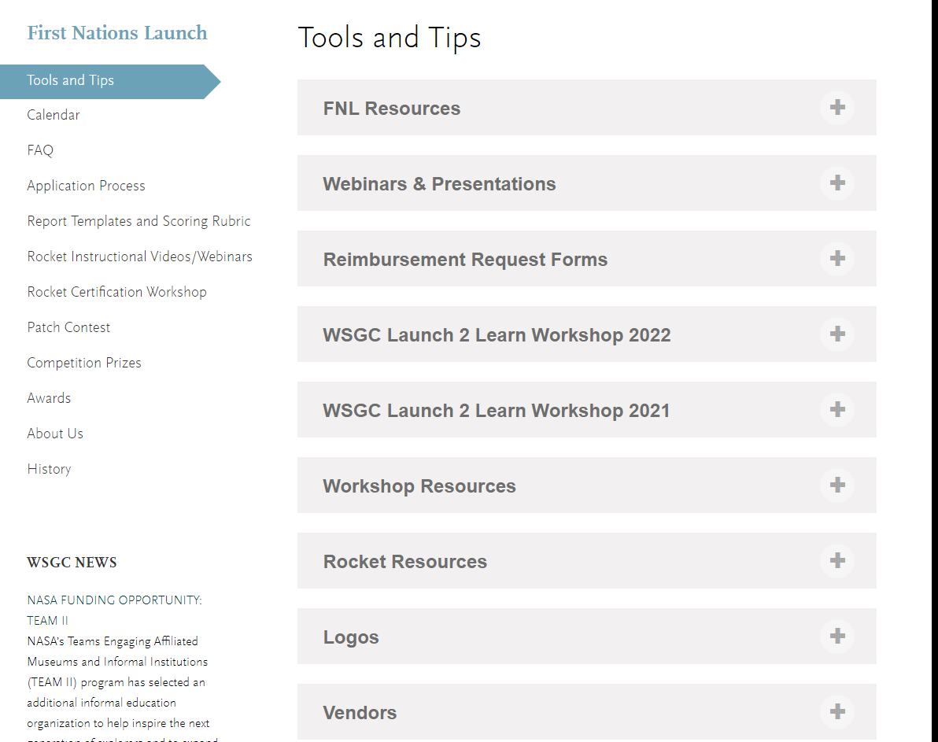
Tools and Tips
FNL Resources
  Media Release Form
  Team Bio Form
  Team Roster and Lodging Form
Reimbursement Request Forms
  Project and Travel Expense Reimbursement Forms
  Project and Travel Expense Form
Instructions
First Nations Launch Home Page
  Competition Handbook
  Calendar
Link for forms and additional information https://spacegrant.carthage.edu/first-nations-launch/tools-and-tips/
General Resources: https://spacegrant.carthage.edu/fnl/faq/
30
Notes:
‹#›
Danielle
‹#›

Slide 45
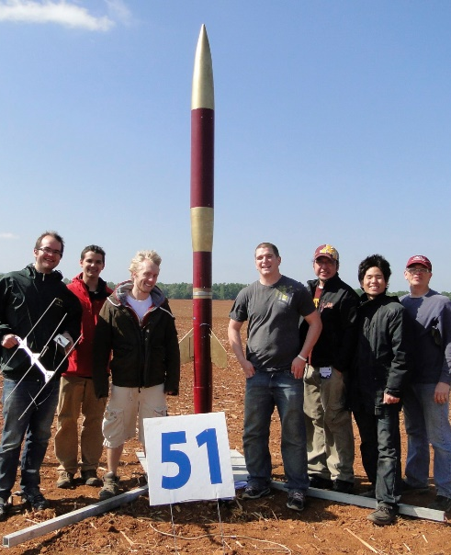
Advisor Liaison – Mark Abotossaway
FNL Alumni and Engineer designated as support
  In particular to assist new teams, technical or non-technical
Retention and Recruiting
  Will assist with tips for maintaining/growing the team
Advisor Mentorship
  Will help pair with veteran advisors
Outreach Efforts
  Can encourage and support local STEM outreach
Next Step Opportunities and Others
  Can provide support with SLI, Spaceport America Cup and RockOn
‹#›
Notes:
‹#›
Mark
‹#›

Slide 46
Team TRA / NAR Mentors
Each team requires (can be the same individual)
  Faculty Advisor (usually non-technical)
  Certified, active TRA / NAR Rocketry Mentor (experienced in HPR)
Mentor must be
  Experienced
  Active TRA or NAR member (membership number needed)
  Certified at or above the level of team rocket (L2 or higher)
  Local to the team with access to a certified launch site
  Mentor does not need to attend Launch Weekend
The Advisor Liaison will help teams find a local Mentor
  Use the TRA / NAR websites to find local clubs/contacts
See the “Mentorship Webinar” for more information
‹#›
Notes:
‹#›

Slide 47
WSGC Reimbursement
Two Options
  The FNL team will submit reimbursement requests to WSGC through the University/College.
      Quarterly Invoice by Institution
    OR
  Individuals will submit reimbursement requests to WSGC for supply and travel expenses.
      March 6, 2023 and May 8, 2023 deadlines
      Submit digital receipts and reimbursement forms per the reimbursement instructions.
‹#›
Notes:
‹#›
Connie
‹#›

Slide 48
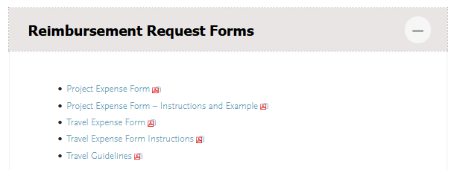
Submitting Reimbursement Requests
Reimbursement request forms available on “Tools & Tips” under “Reimbursement Request Forms”
Tools and Tips | Wisconsin Space Grant Consortium | Carthage College
Project Expense Form
Project Expense Form Instructions
Travel Expense Form
Travel Expense Form Instructions
‹#›
Notes:
‹#›
Connie
‹#›

Slide 49
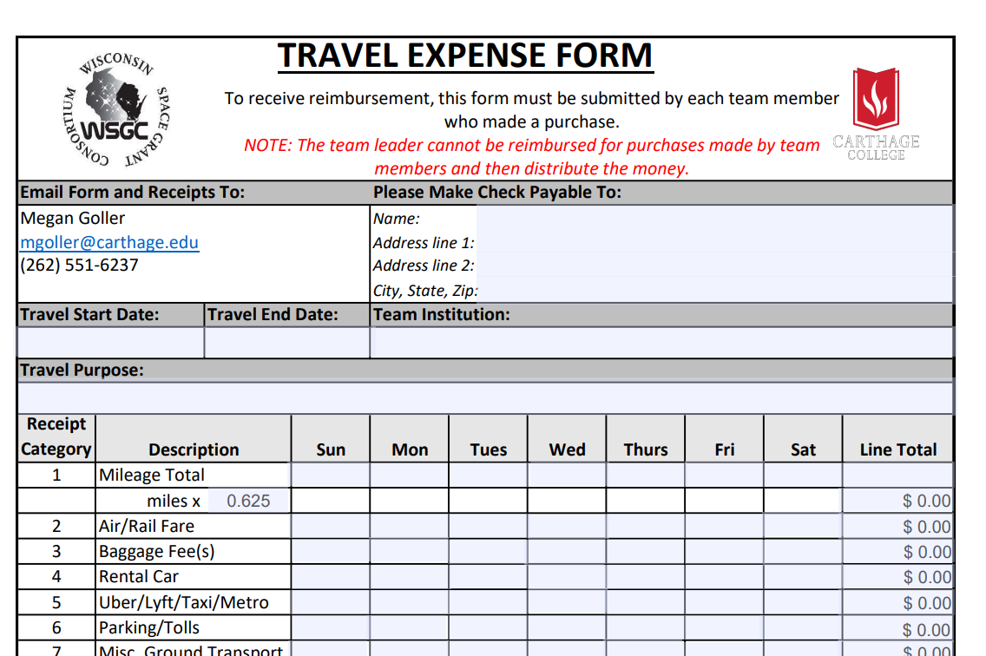
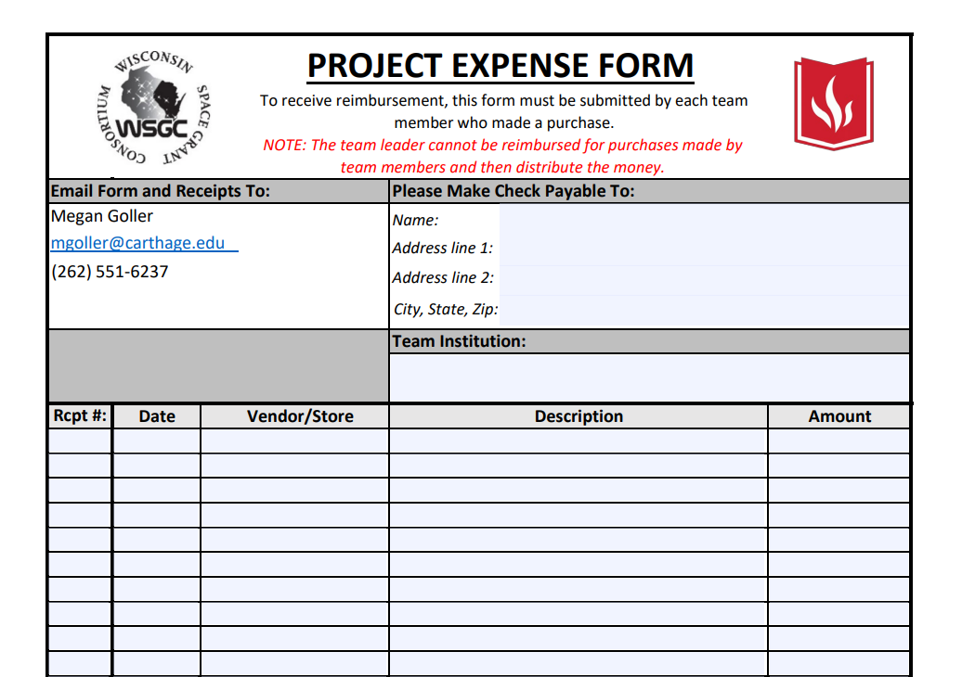
Submitting Reimbursement Requests
Project reimbursement form
Travel reimbursement form
Updated reimbursement forms
  .625 Mileage
Incomplete information will be delayed in being submitted for reimbursement
Email reimbursement forms, along with digital receipts, to Megan Goller mgoller@carthage.edu
‹#›
Notes:
‹#›
Connie
‹#›

Slide 50



Patch Contest
FNL participants can enter
Individuals or Groups
Details announced in November
Due in February 20, 2023
Janna Steen, Nueta Hidatsa Sahnish College
2020 Winning Design
2020 Competitions: Moon Capsule and Moon Lander Vehicle
Alex Armendariz, Cal Poly Pomona
2021 Winning Design
2021 Competition: Moon Warning Sensor System
Evie Clark, University of Colorado, Boulder
2022 Winning Design
2022 Competitions: Moon GPS and Mars Cold Gas Thruster
‹#›
Notes:
‹#›
Christine
‹#›

Slide 51
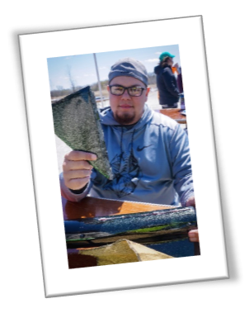
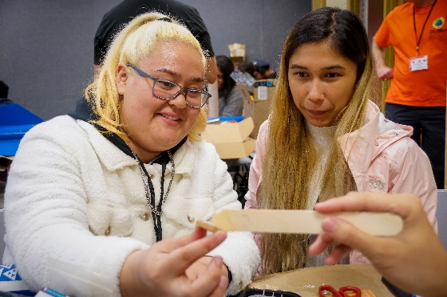
#IAMFNL
#IAMFNL
#IAMFNL
Send #IAMFNL a 30-second video clip
Send #IAMFNL photos
Tag Wisconsin Space Grant Consortium in videos and photos
Tell your story about how FNL has made a difference
Be featured during launch weekend
‹#›
Notes:
‹#›
Danielle
‹#›

Slide 52
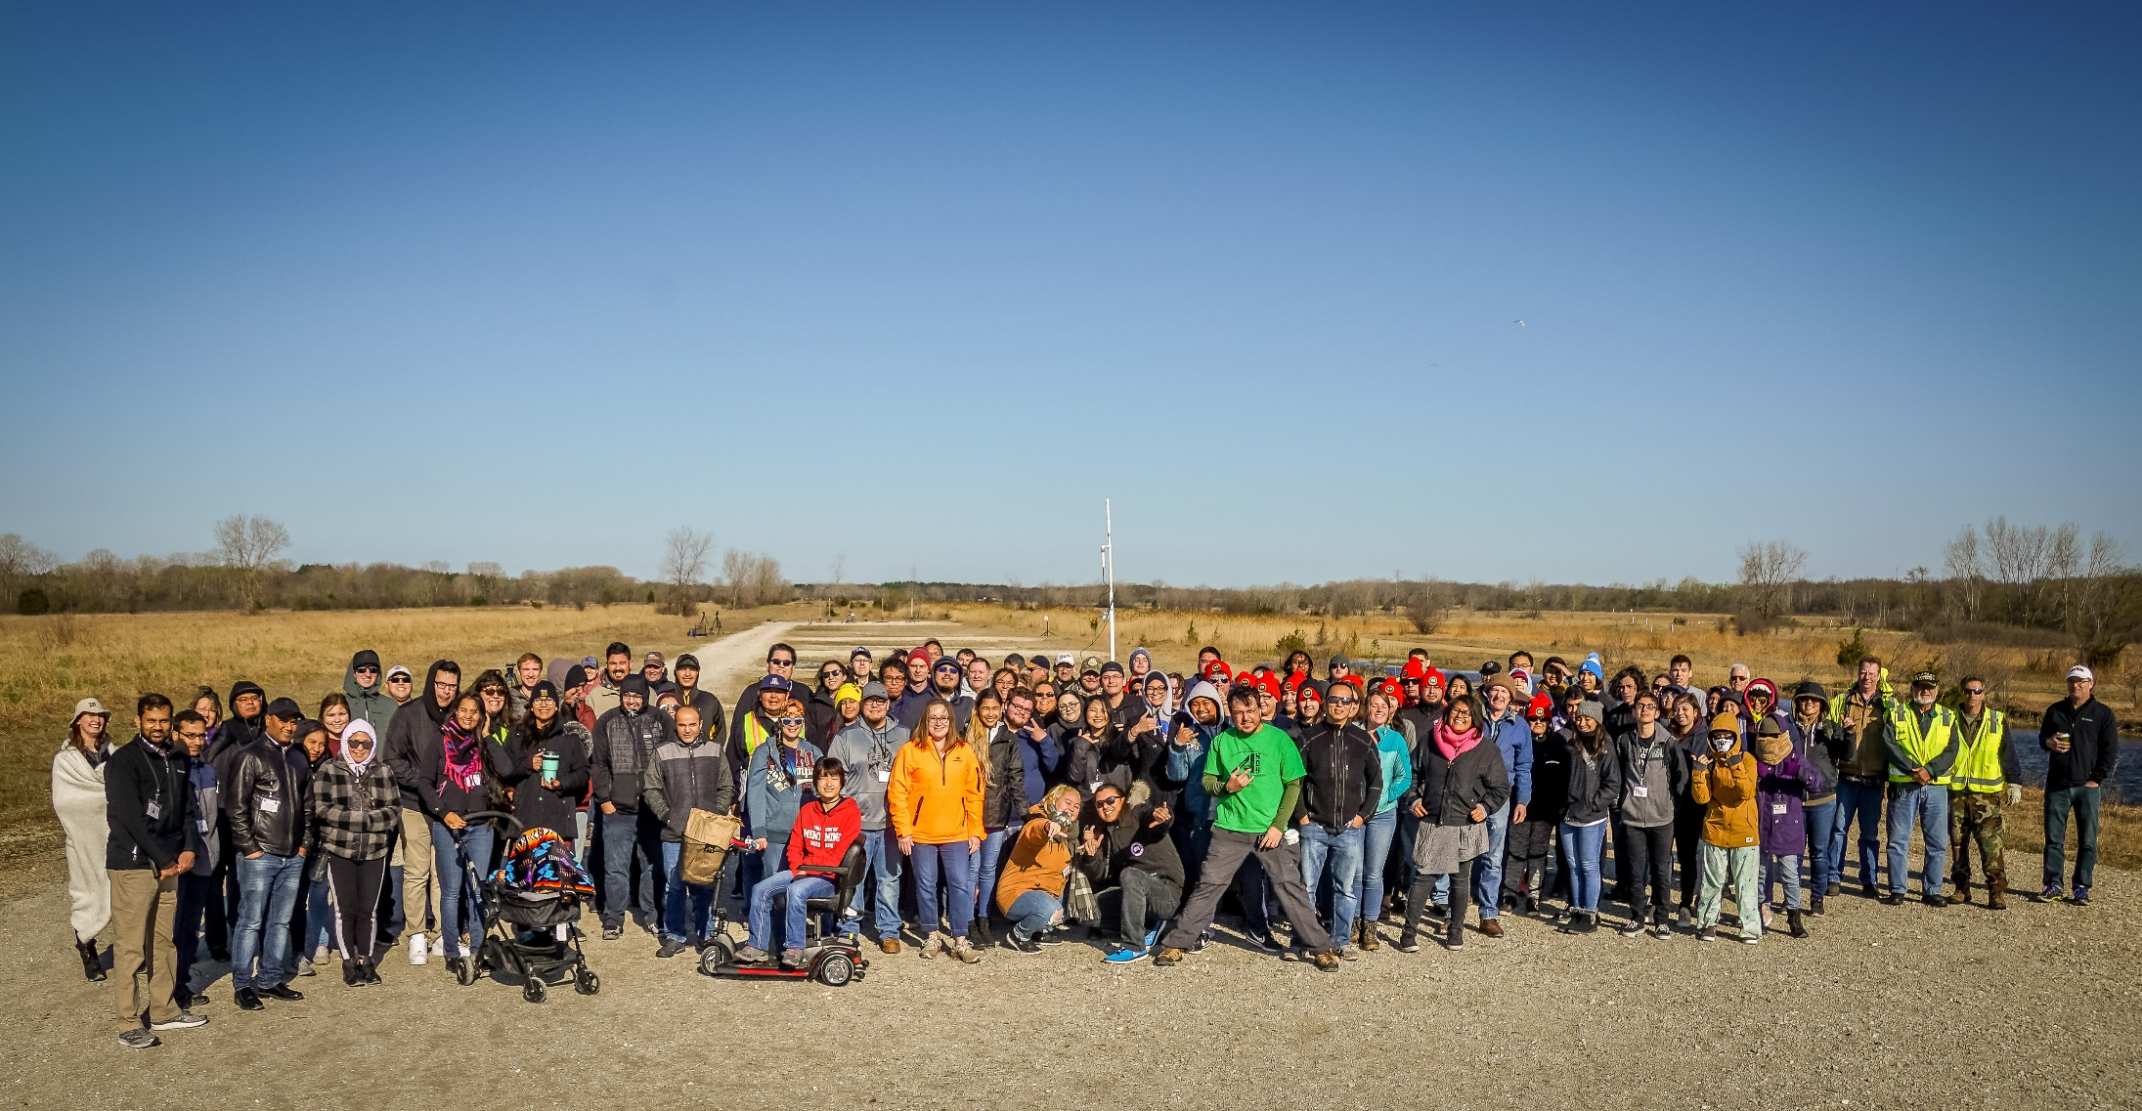
2023 @ Kansasville, WI
Q & A
‹#›
Notes:
‹#›
Christine
‹#›

