Slide 1

Project Management Workshop
14th Annual First Nations Launch
Material Credit
Dr. Juan A. Román
Former Deputy Director
Engineering and Technology Directorate
NASA Goddard Space Flight Center
Greenbelt, Maryland
Presenter: Orson John
NASA Goddard Space Flight Center
Greenbelt, Maryland

Slide 2
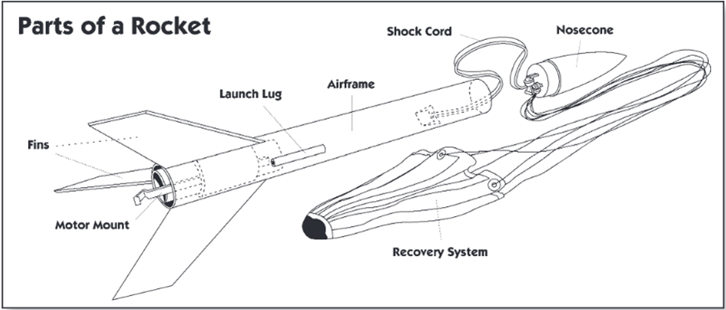
Goddard does work in teams and through projects
Teams
Common Goal(s)
Interdependent
Complementary skills
Projects
Time-defined
Cost-controlled
Limited scope
Projects have to be planned, organized, implemented and controlled

Slide 3
Project Management
Project has a start date, end date and produces a tangible product
Project Management is both an art and a science
  As a science, it is the foundation for the art of leadership
Good Project Manager (PM) demonstrate vision, motivate, and coordinate people to achieve objectives.

Slide 4



Project Management
Project has a start date, end date and produces a tangible product
Project Management is both an art and a science
  As a science, it is the foundation for the art of leadership
Good Project Manager (PM) demonstrate vision, motivate, and coordinate people to achieve objectives.
FNL
  Team Lead should implement the tools of Project Management
  Team Lead will need to define the vision, motivation, and coordinate people to achieve objectives of FNL
    Gateway, Moon, and Mars Engineering Challenges

Slide 5
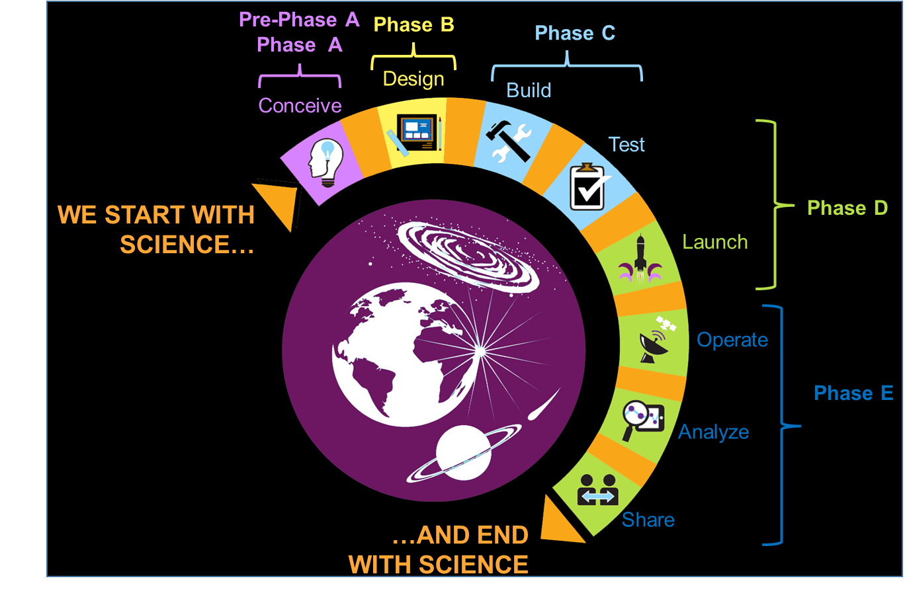
NASA Project Life Cycle
At NASA, it all begins and ends with science. We derive and share information, solutions, and technology for the benefit of all—NASA, the Nation, and the World.
Engineers and many others are involved in
all parts of the Project Life Cycle.

Slide 6
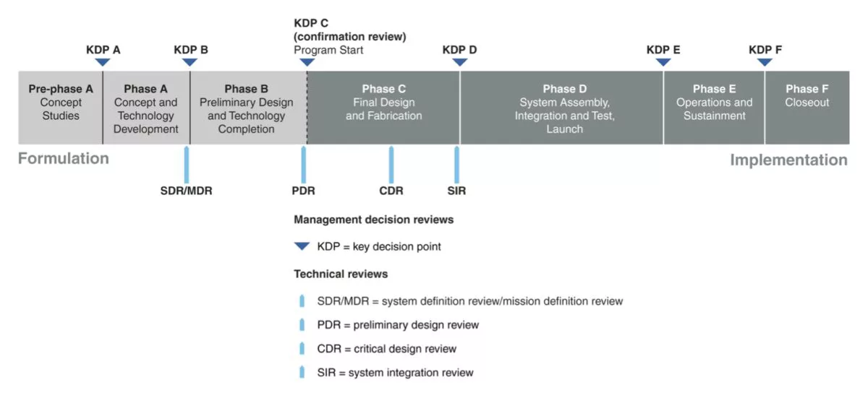
Develop and visualize the FNL Timeline
Organize the execution of the project in such a way that they can be well-tracked and well-managed.

Slide 7
FNL Life Cycle
Develop and visualize the FNL Timeline
Outlining objectives and major reviews
  Understanding objectives for each Phase (Student Handbook)
Phase A
Concept
Studies
Phase B
Preliminary Design
Phase C
Final Design
Rocket and Payload
Phase D
Rocket / Payload Assembly
Travel & Launch
Phase E
Operations and Flight
Proposal
PDR Report and PDR Presentation
CDR Report and CDR Presentation
FRR Report and FRR Presentation
PLAR
Post Flight Report

Slide 8
Elements of a Schedule: Key Terminology
For the purpose of this workshop, we define a schedule as containing the following elements:
Task: A higher level subdivision of work scope that will be further broken down into supporting activities.
Activity: A detailed step that needs to be performed to complete a task.
Sequence (Logic): The order in which activities and milestones need to take place.
Milestone: An important event with no duration signifying measureable progress toward, or achievement of, an activity, task or objective.
Duration: Length of time estimated to complete an activity.
Critical Path: Longest sequence of activities in the schedule from beginning to end.
Slack: The amount of duration an activity or milestone can be delayed without causing a delay to subsequent activities or the project/subsystem completion date.
Notes:
Task examples:
Fabricate enclosure
Final assembly/integration of payload
PDR Review preparations
Activity examples:
The steps necessary to build the enclosure e.g. Buy materials, design the enclosure, fabricate parts, assemble parts, etc.
Milestones include:
Finalize enclosure

Slide 9
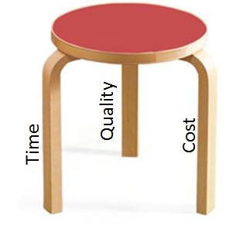
Schedule Purpose and Functions
A schedule is… a tool for identifying what the Project Manager (PM) and her/his team intends to do and when they intend to do it.
Functions:
Integrates subsystem’s tasks/activities into a logical flow.
Establishes the intended timetable for achieving objectives.
Helpful for setting work priorities
Supports the development of a time-phased cost estimate and resource plan
Provides a means to measure work accomplishment
Helpful in identifying potential problems early
Developing a credible schedule is critical to the project’s success

Slide 10
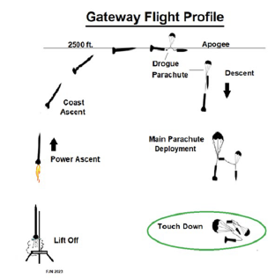
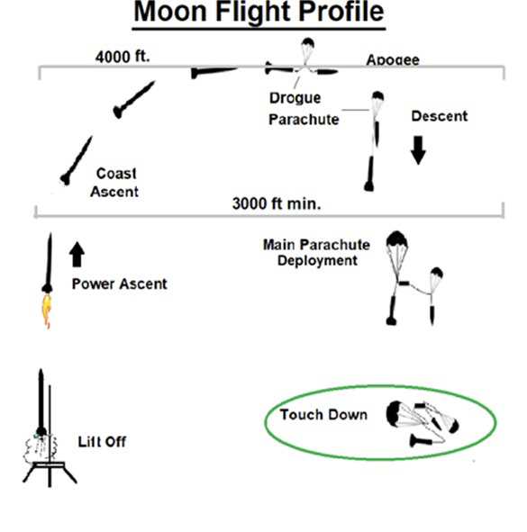
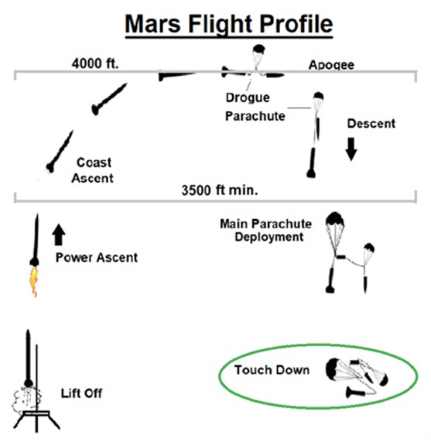
Schedule Purpose and Functions
What is the FNL objective?
Gateway, Moon, and Mars Engineering Challenges
Functions: Identify major functions to meet the objective and translate to a timeline
Identify Requirements (teams, faculty, cost)
Identify subsystem’s tasks/activities
Establishes timetable for achieving objectives.
  Milestone reviews, Activities by weeks or months
  Schedule meetings in advance
Helpful for setting work priorities
  Class & Works schedules (Establish Availability for FNL)
Develop budget for cost estimates and resource plan
Provides a means to measure work accomplishment
Identify potential problems early
  Schedule conflicts, ordering items, resources, labs
Notes:
Challenge Requirements (FNL Handbook)

Slide 11
Planning a Project and Creating the Schedule
Steps in Gathering Project Information
Set goals & objectives
List the tasks
Estimate duration
Determine sequence
Assign resources
Entering General Information
Set up calendars
  Project
  Resource

Slide 12
Planning a Project and Creating the Schedule
FNL
  Competition requirements and Deliverables (Student Handbook)
  Set goals & objectives
    Find what is needed for Proposal, PDR, CDR, FRR (each milestone)
  Set up calendars
  List the tasks
    Presentations and Reports
    Vehicle Requirements
    Payload Requirements
    Budget
  Estimate duration
  Outline steps needed to accomplish each task
  Assign resources
    Team member tasks and communication
Steps in Gathering Project Information
Set goals & objectives
List the tasks
Estimate duration
Determine sequence
Assign resources
Entering General Information
Set up calendars
  Project
  Resource

Slide 13
Defining the FNL Project/Challenge
What are Milestones?
An important event signifying measureable progress toward, or achievement of, an activity, task or objective. By definition milestones have no duration.
Milestones - Characteristics
Demonstrate accomplishment of work scope
Indicate to external stakeholders that progress is being made
Signify the achievement of major objectives such as the completion of a design review, finish of a test, or delivery of a component
Represent the retirement of risk such as the completion of a life test, receipt of a long lead component
Notes:
A milestone is a way to observe, measure and monitor the progress and/or performance of a project. Milestones in general exist as intermediate stages that must be fulfilled before reaching a final goal or objective. In terms of their usefulness, milestones can be defined and provide a foundation from which to monitor progress. They can also serve as proof for explaining and reporting the status of a project. Key characteristics of milestones include their frequency and potential for providing opportunities for course corrections and learning experiences. Milestones can also be used to maintain accountability and motivate staff.

Slide 14
Defining the FNL Project/Challenge
What are Milestones?
An important event signifying measureable progress toward, or achievement of, an activity, task or objective. By definition milestones have no duration.
Milestones - Characteristics
Demonstrate accomplishment of work scope
Indicate to external stakeholders that progress is being made
Signify the achievement of major objectives such as the completion of a design review, finish of a test, or delivery of a component
Represent the retirement of risk such as the completion of a life test, receipt of a long lead component
FNL Milestones
Proposal, PDR, CDR, FRR, PLAR
  Student Handbook
  Identify Criteria and Expectations
  Know WSGC deadlines.
  Document progress along the way to each deadline
  Progress
    How are you meeting objectives and requirements
    Maintain accountability for each task
    Risks: challenges or problems (know who to contact)
Notes:
A milestone is a way to observe, measure and monitor the progress and/or performance of a project. Milestones in general exist as intermediate stages that must be fulfilled before reaching a final goal or objective. In terms of their usefulness, milestones can be defined and provide a foundation from which to monitor progress. They can also serve as proof for explaining and reporting the status of a project. Key characteristics of milestones include their frequency and potential for providing opportunities for course corrections and learning experiences. Milestones can also be used to maintain accountability and motivate staff.

Slide 15
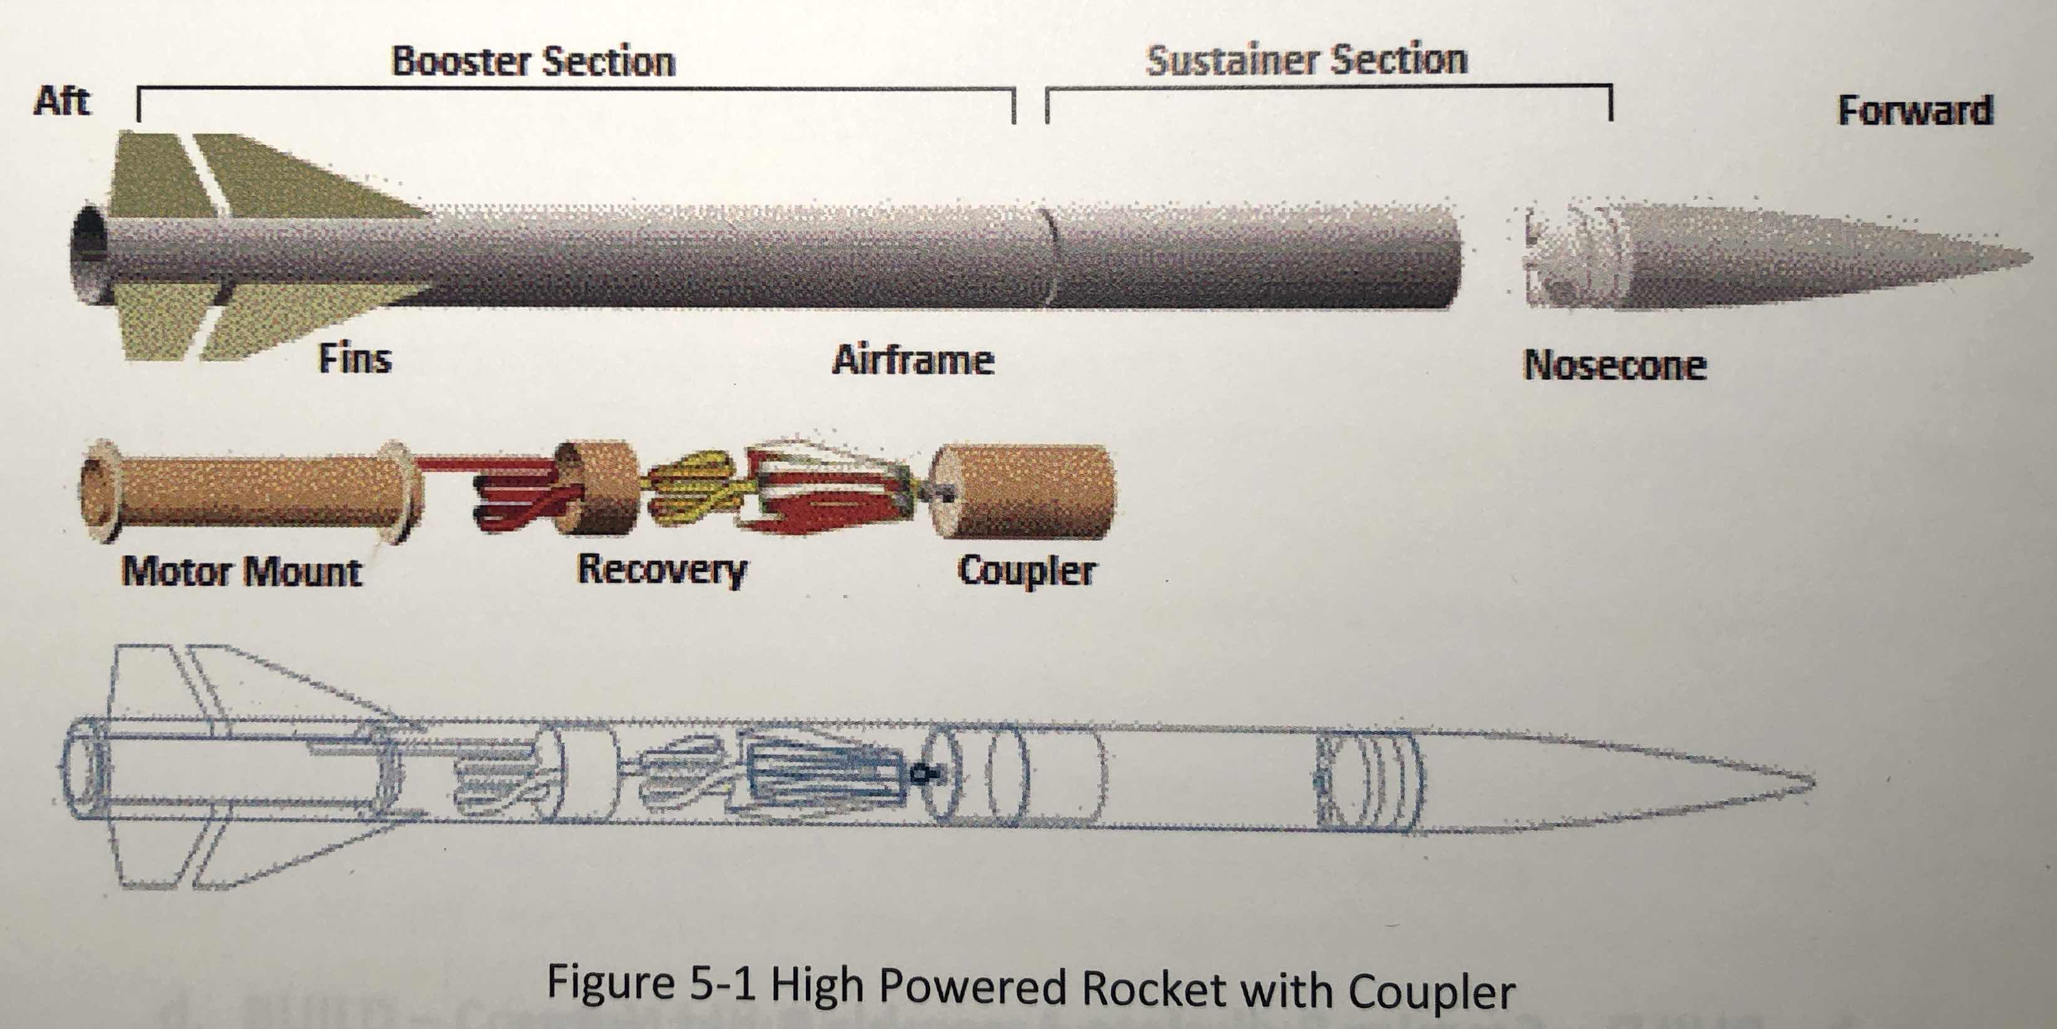
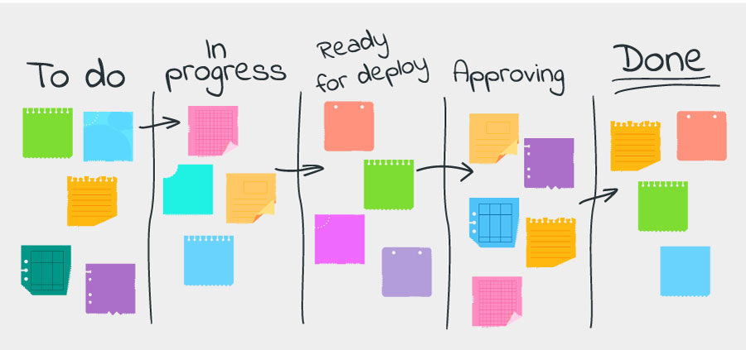
Defining the FNL Project/Challenge
Break Project into Tasks and Milestones
  Scope project first
  Create list of tasks
  Use experienced staff to plan the project
Tasks
  Activities that must be finished to achieve end result of the project
  Take project from event to event
  May include reviews & walk through
Tasks - Characteristics
  Precise and detailed
  Significant
  Appropriate level of detail
  Task scope and assumptions
Defining Tasks
  Top down
    start with major project phase
    add details
  Bottom up
    list all tasks group into phases
Consider using notecards or Post-It to visualize your activities on the wall when discussing them within your team

Slide 16
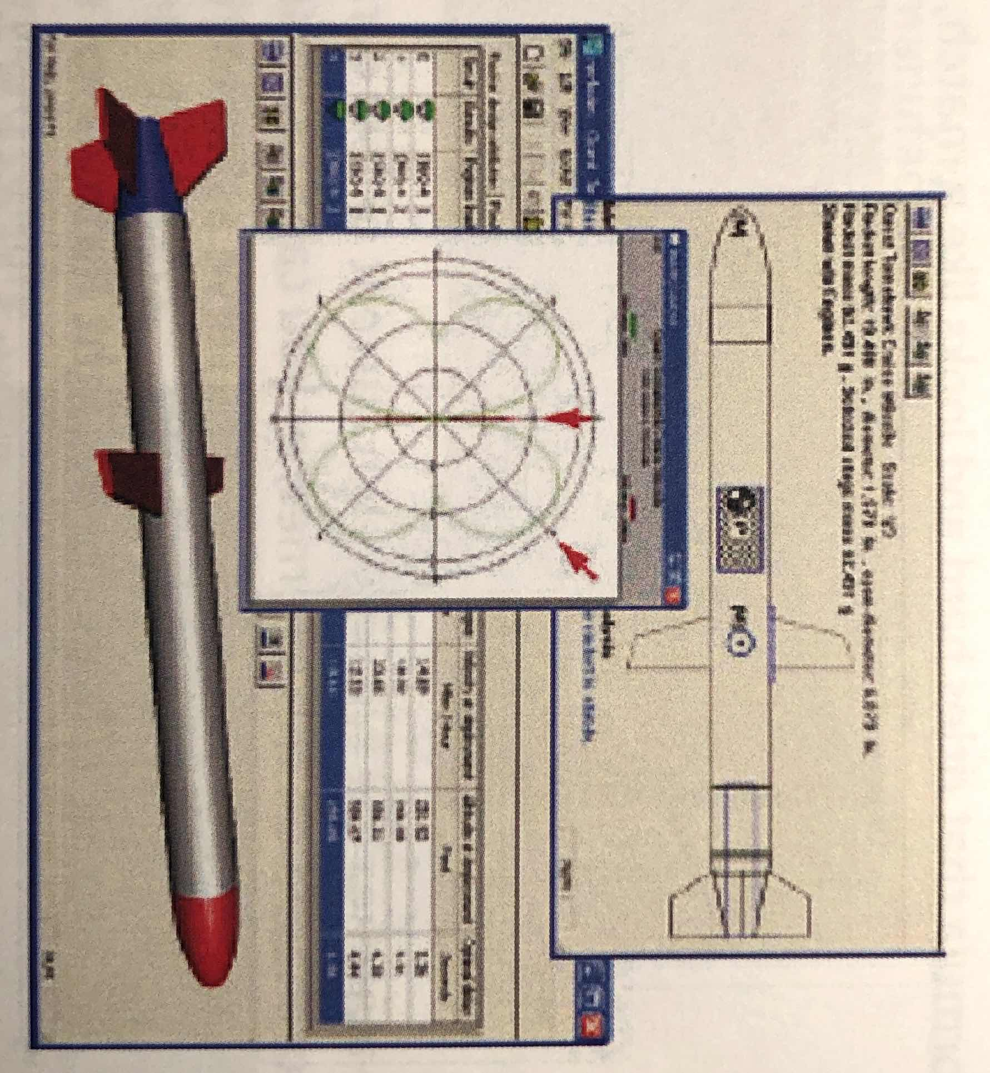
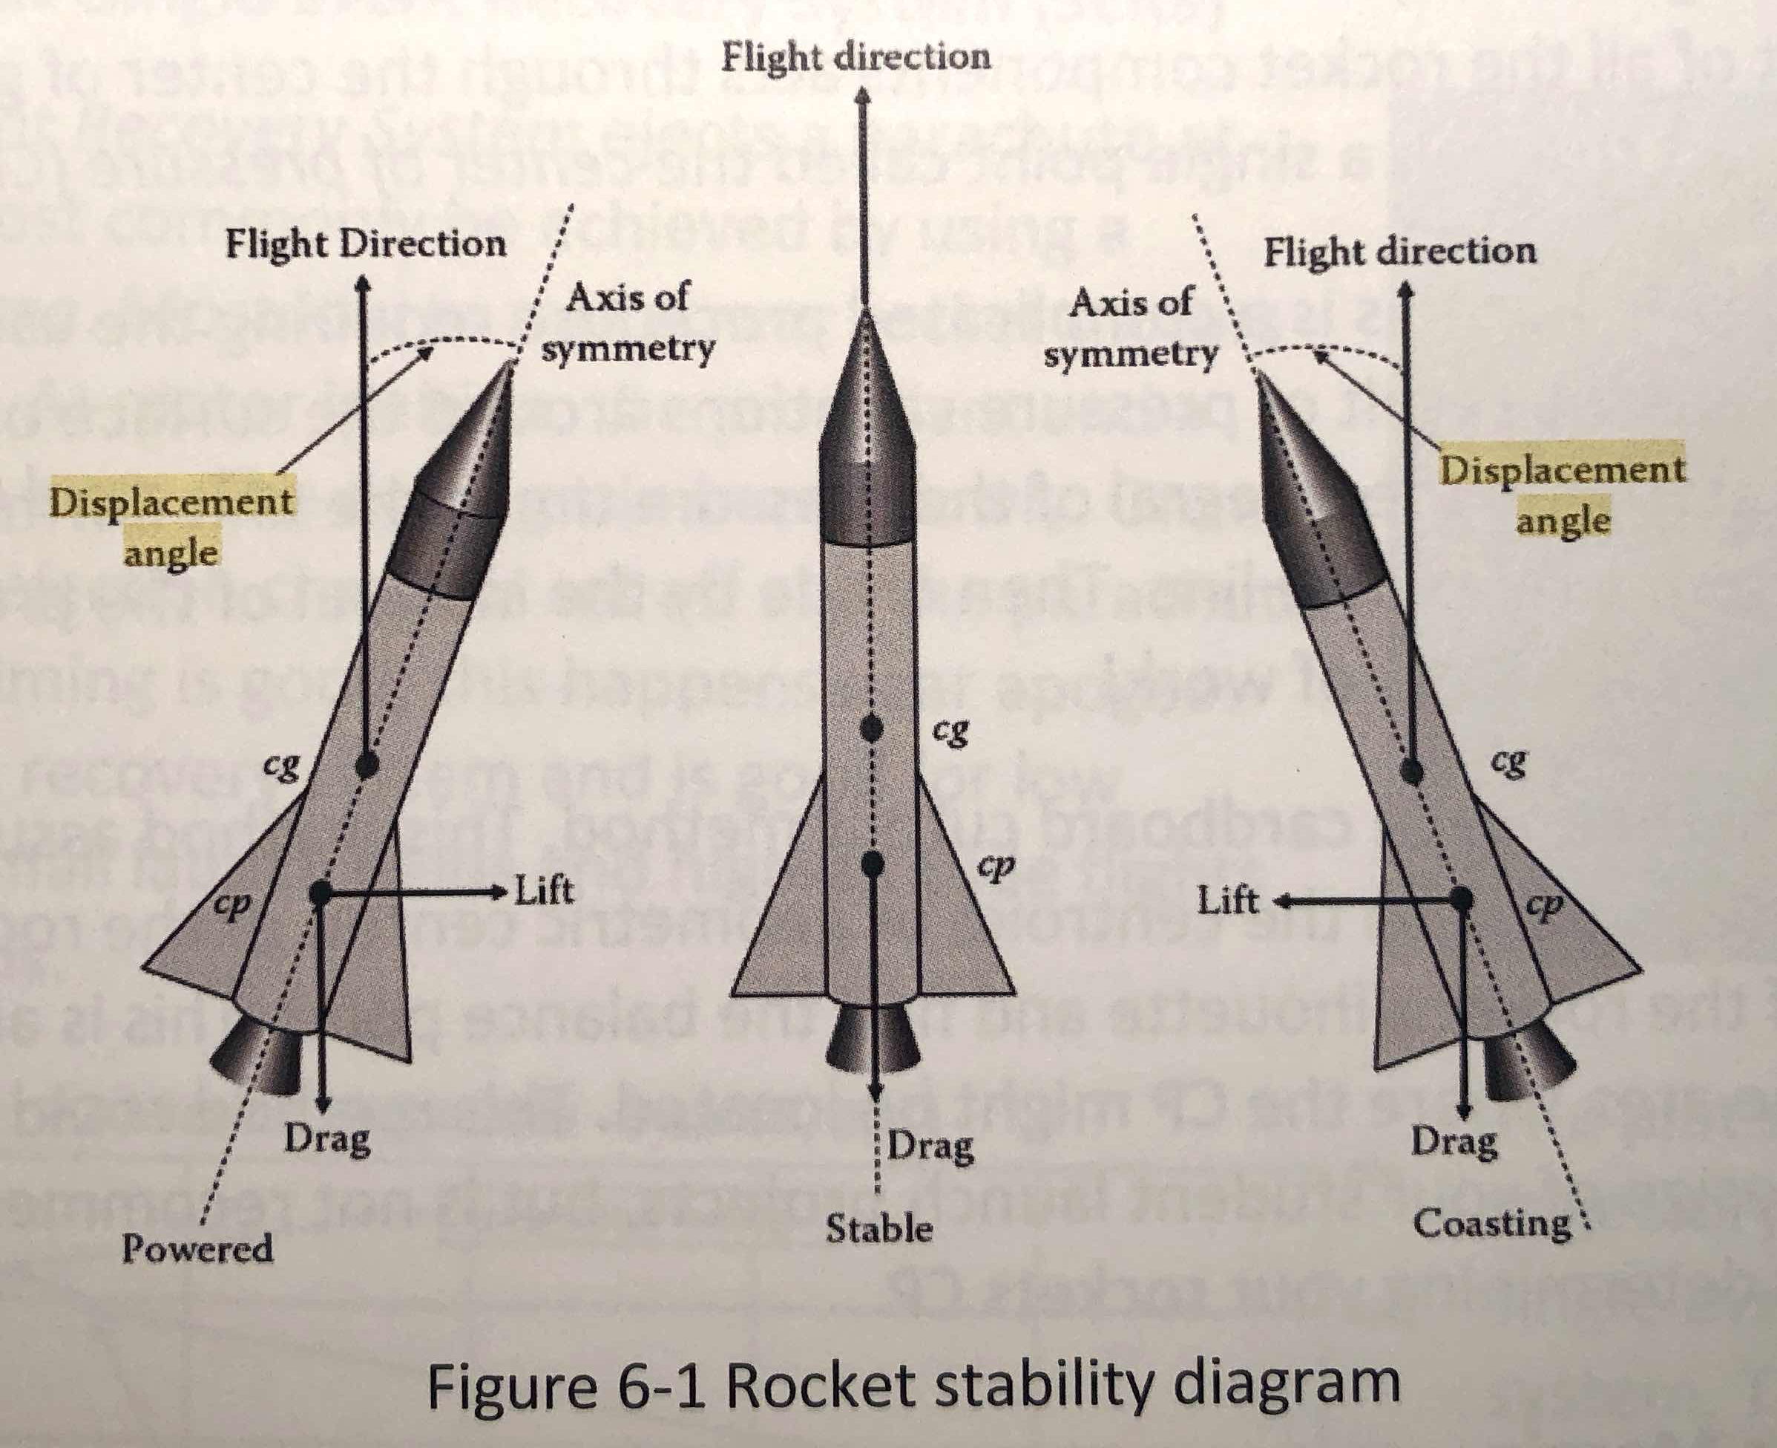
Estimating Tasks
Structures
Systems
Materials:
Parts & Subassemblies
Nose Cones
Airframes & Couplers
Motor Tubes
Motor Retainers
Centering Rings & Bulk Plates
Fins
Rail Buttons
Construction Techniques
Design Considerations
Stability
Center of Gravity
Center of Pressure
Determining Task Duration: period between start and end of task
Do’s
  Apply realistic estimates
  Consider each task independently
  Consider experience of the assigned resource
  Estimate in units [e.g., hours, days]
  Assume normal working conditions
  Match resource with type of task
  Consider task complexity

Slide 17
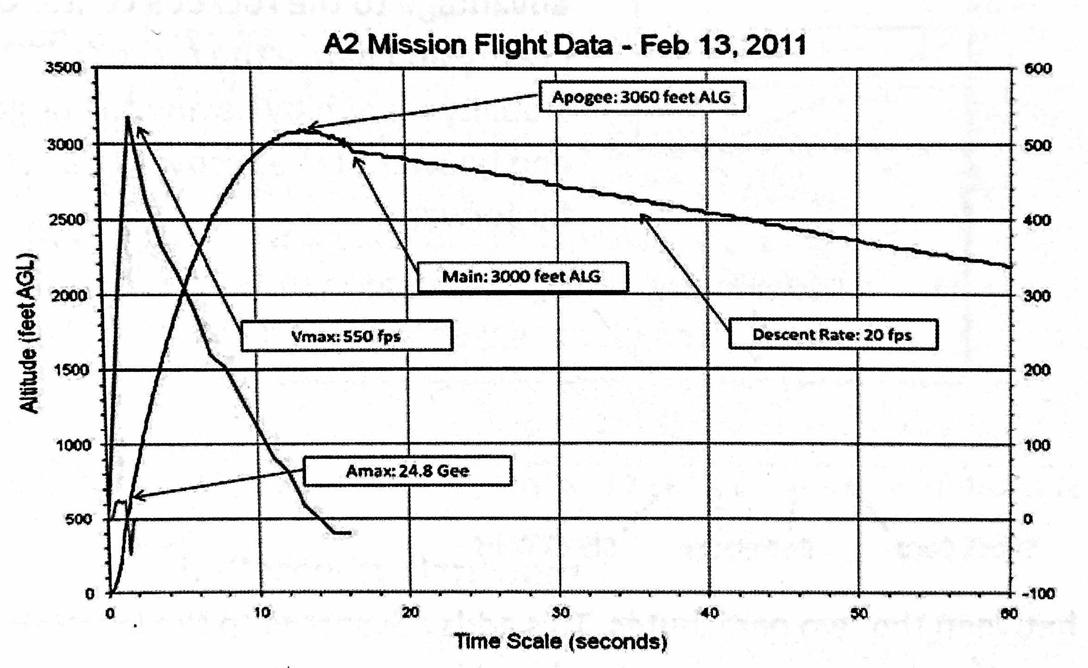
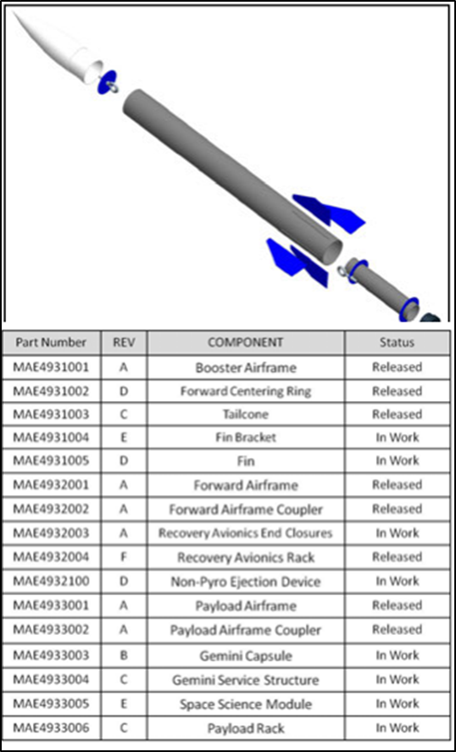
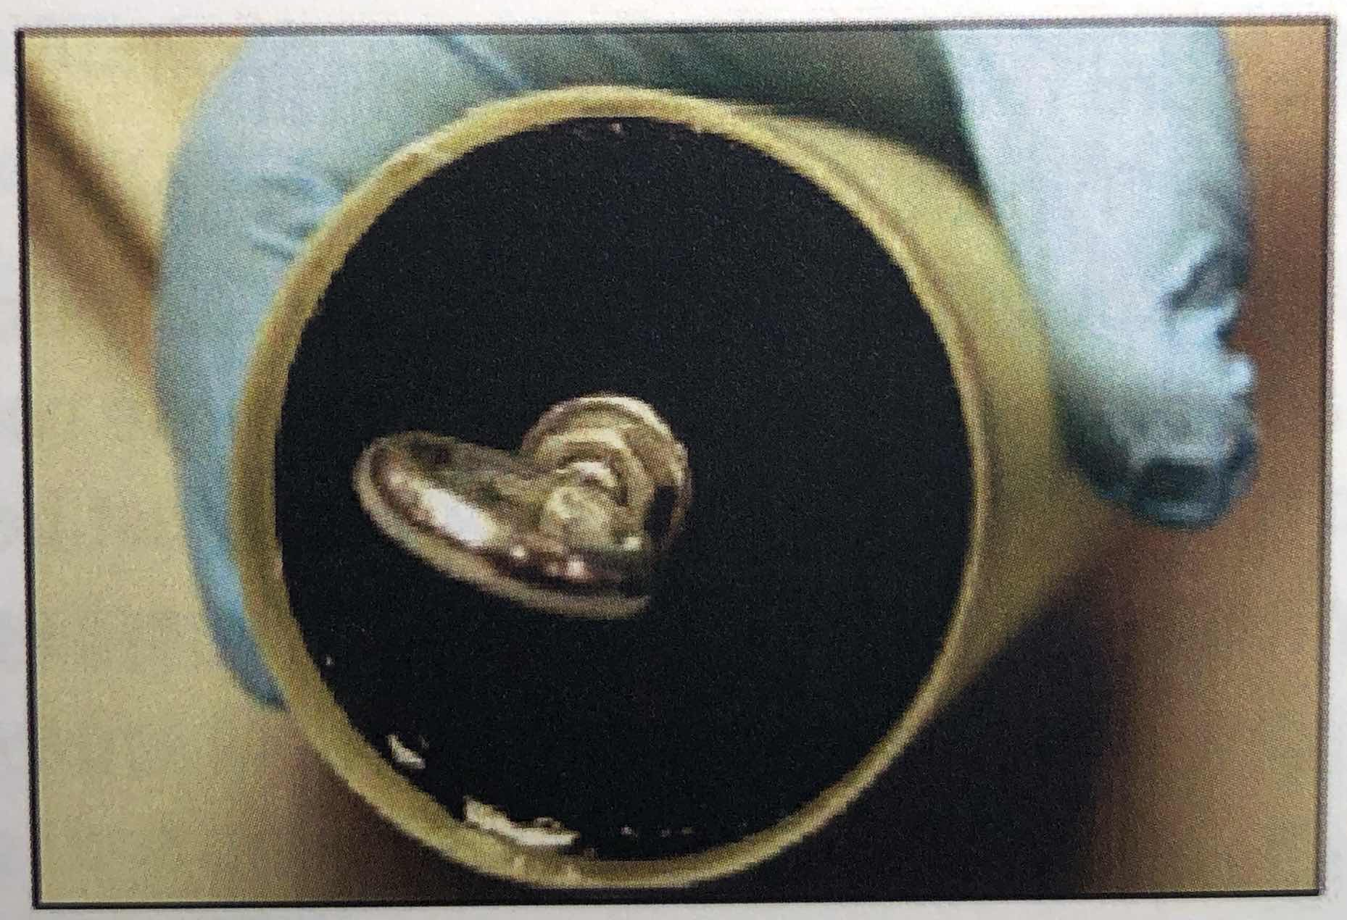
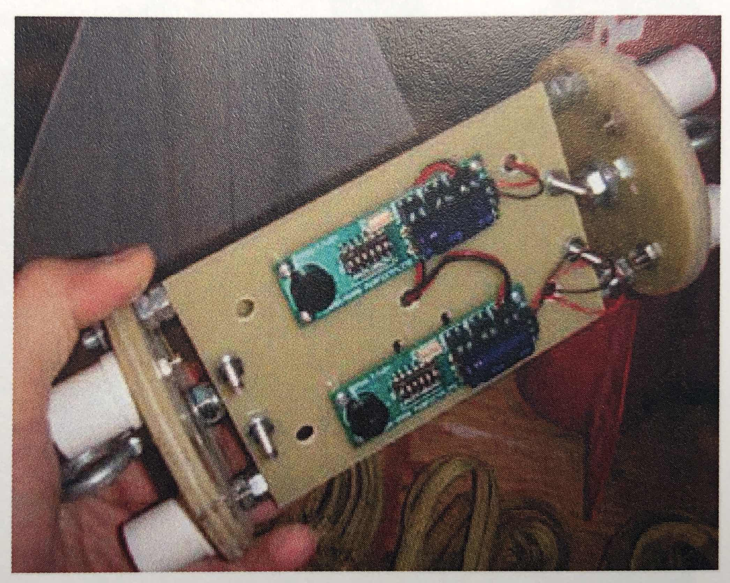
Sequencing Tasks
Task Dependencies
  Task sequence
  Task relationship
  Lead or Lag time
  Constraint
Task Sequence
  What tasks must be finished before another?
  Predecessor - successor
Task Relationships
  What are the related tasks?
https://www.nasa.gov/sites/default/files/atoms/files/sl_video_instruction_book.pdf

Slide 18
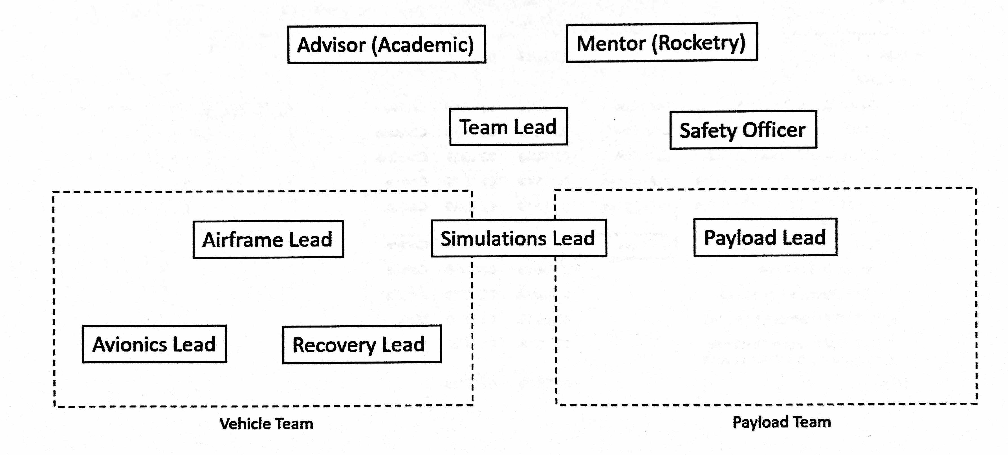
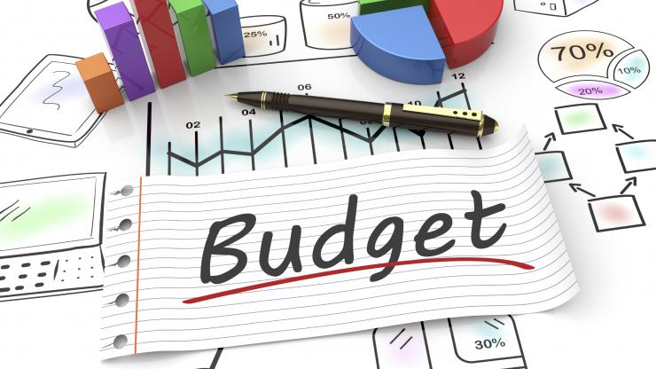
Assigning Resources
Assigning People, Equipment and Costs to Tasks
  Point of Contact
  Who will do the task?
  When are they needed?
Resource Requirements - Considerations
  Facility – Labs
  Skills required - specialist/consultants
    Mentors or Advisors
  Team Schedules
  Number of resources required
  Types of other resources required - (e.g. equipment)
Estimating Costs - Considerations - Why Plan Costs? → Budget
  Equipment costs
  Other costs
  Are costs fixed or variable?
Google image

Slide 19
Schedule Management - 1
Why Plan? - Time-consuming, but critical
Schedule management is a critical component of project planning and control
  FNL: know your target deadlines and work to develop a task schedule
Schedules are part of project baselines, and critical milestone completions often are important project events that are reported to stakeholders
  FNL: know in advance what is needed (ie Handbook)
Schedule development and control starts with the objectives, assumptions, activity definition, task order, & duration estimation
  FNL: have a complete overview of all activities
  Understand the basics of Rocketry → know handbook and other rocketry resources. Tool and Tips. Workshops.

Slide 20
Schedule Management - 2
Plan ahead and identify steps early to determine reasonable schedules and to limit future schedule risk
Team progress
  Keep schedule updated
  Check in with each member of your team
  Faculty member check ins
  Include all internal and external critical milestones
Ensure objectives are accomplished within project commitments
  Follow handbook milestone guidelines as those are the requirements
  Utilize the tools you are being taught in your studies

Slide 21
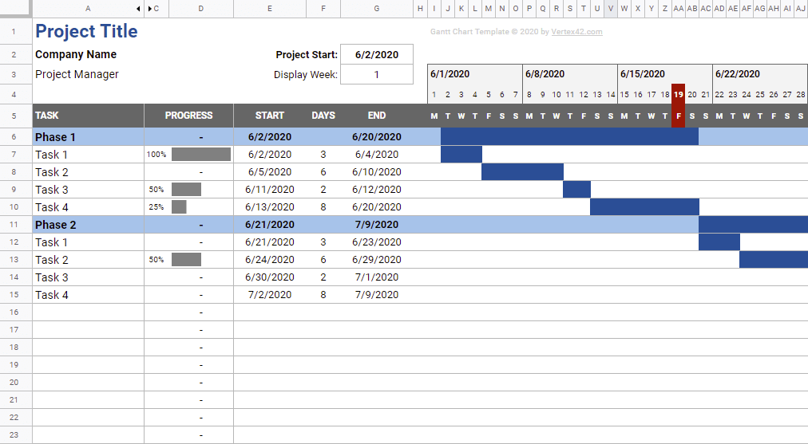
Example of Top Level Schedule
Notes:
A Gantt chart is a type of bar chart that illustrates a project schedule, named after its inventor, Henry Gantt, who designed such a chart around the years 1910–1915. Modern Gantt charts also show the dependency relationships between activities and current schedule status.

Slide 22
Risks, Issues, and Opportunities
Risk Management: Planning for the “bad things” that may occur during the project’s life cycle
Issue Management: Addressing events that have occurred during the project’s life cycle
Opportunity Management: Seeking “good things” that may benefit the project
Identify
Analyze
Plan
Implement

Slide 23

Helpful Collaboration Tools
The 12 Best Free Project Management Apps*
Trello (Web, macOS, Windows, iOS, Android) for individuals and teams who need a work pipeline
MeisterTask (Web, Windows, macOS, iOS, Android) for combining project ideation, planning, and execution
KanbanFlow (Web) for combining kanban, time tracking, and Pomodoro
Freedcamp (Web, iOS, Android) for managing all projects and communications in a single tool
Asana (Web, iOS, Android) for creating a to-do list powerful enough to manage projects
Paymo (Web, Windows, macOS, Linux, iOS, Android) for freelancers who charge by the hour
Bitrix24 (Web, Windows, macOS, iOS, Android) for classic project management with Gantt charts
Wrike (Web, Windows, Mac, iOS, Android) for spreadsheet-like features in a project management app
Podio (Web, iOS, Android) for customizing your project management tool
Yodiz (Web, iOS, Android) for Agile and Scrum teams
Agantty (Web) for creating Gantt charts quickly and easily
AND CO (Web, macOS, iOS, Android) for projects that require invoicing
https://zapier.com/blog/free-project-management-software/
Drive
Calendar
Photos
Docs
Sheets
Slides

Slide 24
Questions?
Questions
“Building what we’ve never built before, to discover what we’ve never known before.”

Slide 25
Additional Resources

Slide 26
Definitions
Project Phase - A collection of logically related project activities, usually culminating in the completion of a major deliverable
Key Decision Points (KDPs) - The event at which the Decision Authority determines the readiness of a program/project to progress to the next phase of the life cycle
Formulation – The identification of how the program or project supports the Agency's strategic needs, goals, and objectives; the assessment of feasibility, technology and concepts; risk assessment, team building, development of operations concepts and acquisition strategies; and establishment of high-level requirements and success criteria
Implementation – Execution of the Program Plan [the Formulated Project] in a cost effective manner

Slide 27
Project Phases
Pre-Phase A – Concept Studies - Evaluation of a broad spectrum of ideas and alternatives for new missions including mission concepts, requirements, and technology
Phase A – Concept & Technology Development - Formation of project team, development of baseline mission concept, define/begin development of needed technologies
Phase B – Preliminary Design and Technology Completion - Completion of preliminary design and technology development
Phase C – Final Design and Fabrication - Completion of final design, begin fabrication of test and flight article components, assemblies, and subsystems
Phase D – System Assembly, Integration and Test, Launch - Completion of system assembly, integration and test
Phase E and F – Operations and Closeout – Transition from Phase D to Phase E occurs when on-orbit checkout has been completed—typically 30 to 90 days after launch.
At the end of the nominal operational lifetime of the mission, HQ may decide
(on the basis of science and programmatic data provided by the Center) to go into “Extended Operations”. A formal decision is made – KDP-F - to continue operations or to initiate decommissioning.
At the end of the useful lifetime of the mission, a Decommissioning Review
is held to confirm readiness to proceed with the safe decommissioning and disposal of mission assets in accordance with NASA policy on limiting orbital debris.

