Slide 1



First Nations Launch
Proposal, Budget, and Design Review Development Webinar
December 2, 2022
Genevieve Bennally
Material Program Manager
Raytheon Missile Defense

Slide 2
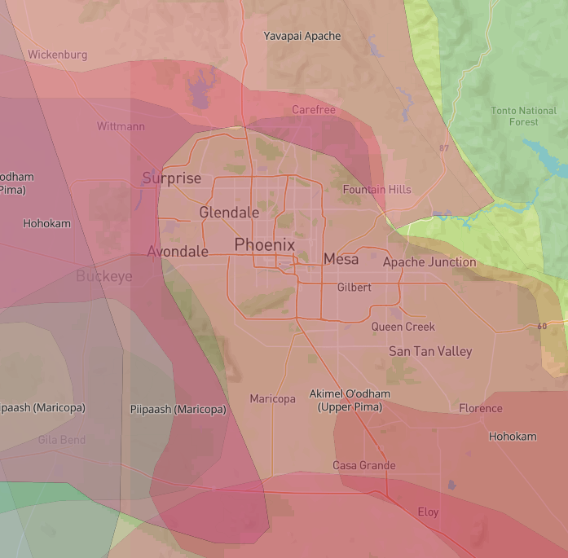
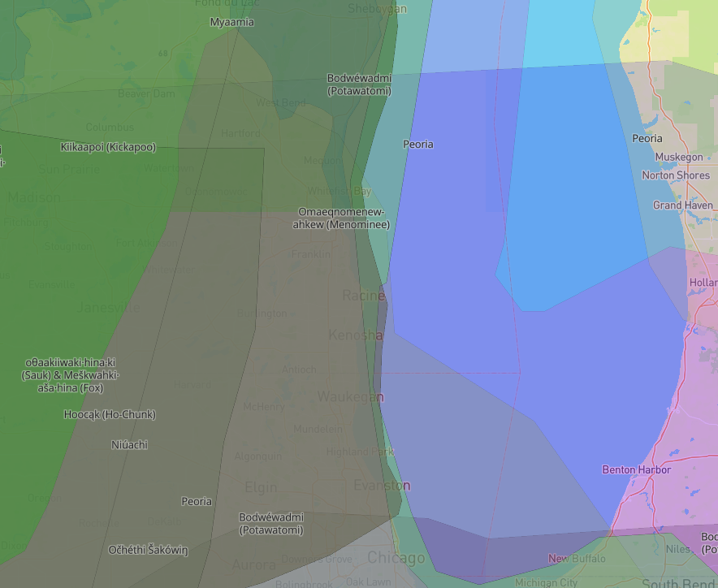
Land acknowledgment
Akimel O’odham
O’odham Jewed
Hohokam
Potawatomi
Ho-Chunk
Myammia
Kickapoo
Peoria
Phoenix, AZ
Kenosha, WI
Notes:
Before we start this webinar, we would like to acknowledge the traditional and ancestral lands of the Akimel O’odham, O’odham Jewed, Hohokam people on which we are hosting this event from Phoenix, Arizona.
In addition, I would like to acknowledge the home lands of the Potawatomi, Ho-Chunk, Myammia, Kickapoo, and Peoria people on which the First Nations Launch office is located in Kenosha, Wisconsin.

Slide 3

Genevieve Bennally
Towering House, born for the Red Streak in the Water, her maternal grandparents are Black Streak in the Wood and her paternal grandparents are Edgewater
Page, Arizona / Navajo Nation
Northern Arizona University- Mechanical Engineering
Raytheon Technologies (8 years)
Materials Program Manager
Sr. Systems Engineer, Principal Quality Assurance Engineer
Global RTX RAIN Community Partnership Lead
Associate Director for the Southwestern Native-American Foundation (17 years)
Coach basketball and love family time. Love traveling and trying new restaurants.

Slide 4



Welcome to the First Nations Launch Program…
High powered rocket competition at the Richard Bong State Recreational Area in Kansasville, WI.
Team effort
Everyone at FNL is available to help you along the way.

Slide 5
Should have:
Notice of Intent submitted
Handbook for what the proposal consists of
Team members committed
Regular cadence for team meetings
Identified a mentor
RockSim in possession and learning
Template found in Design Reports on website
Notes:
By now, you should have all of these lined up. If you do not have this, please get with one of the FNL team members to help you get them in order.
Remember this is your project and we are guiding you along the way.

Slide 6

Overview
Schedule
Proposal
Budget
  Monies
  Time
Preparing the Preliminary Design Phase Report
Preparing the Critical Design Phase Report
Resources
Notes:
Today we will go briefly over the schedule of the project to ensure you are all aligned. We will also cover the proposal, budget, how to prepare for the reports and available resources for you. Although we are doing rocket science, I assure you, you have help!

Slide 7
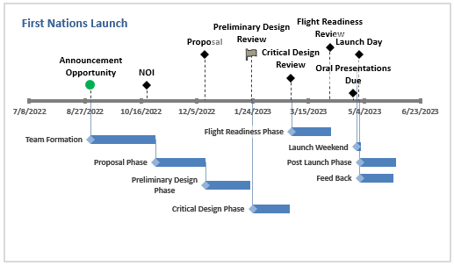
Do not skip any items. Each phase builds from the previous!

Slide 8
Each Report Builds on the Next
Proposal
Planning and research phase
Preliminary Design Report
More research and details are tested
Critical Design Report
Refining design and working with mentors.
Flight readiness

Slide 9

Proposal Overview
General Information Section
Safety Section
Design Overview
Technical Overview
Project Plan
Due December 12, 2022

Slide 10
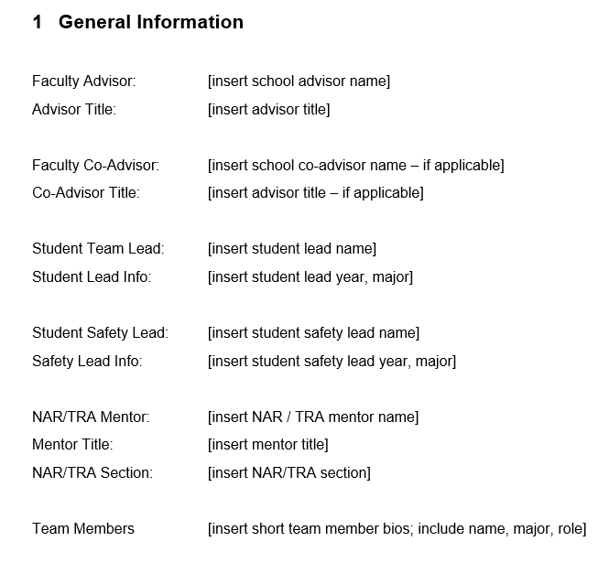
General Information/ Facilities & Equipment
Populate the fields in the template
Assign team members roles
Identify facilities/equipment and relevant supplies to design and build
Acquire RockSim
  Get with Connie about licenses available
  Training is coming (webinar)

Slide 11

Safety Section
Safety Standards for handling high-powered
Rockets must be followed
National Tripoli Rocketry Association
Requires all teams identify and
Utilize certified mentor
If COVID-19 safety plans are needed to
comply with your academic institution,
local or state requirements,
include this in this section.
Notes:
Ensure compliance to FAA governing the use of airspace.
Safety codes, guidelines, procedures, and handing combustible and flammable material
Important to know what the safety guidelines – Safety officer is responsible for compliance at federal, state, and local levels
Safety plan will address material used, facilities and personnel.
Questions like, how will we store the rocket motors?
Who will purchase? How do we transport the motors?
You will be required to have ALL members of the team understand and comply to following the safety regulations.

Slide 12

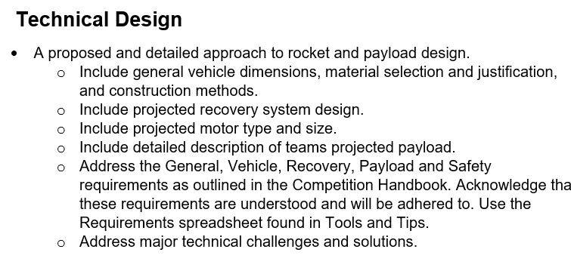
Technical Design Overview
Notes:
Details of this portion are filled in after research.
Vehicle dimensions, material and general information is available in kits researched.
Take note on airframe material, tube diameters, airframe lengths, fin counts
Overall understanding of HPR should be shown
Identify the challenge you will be participating in

Slide 13
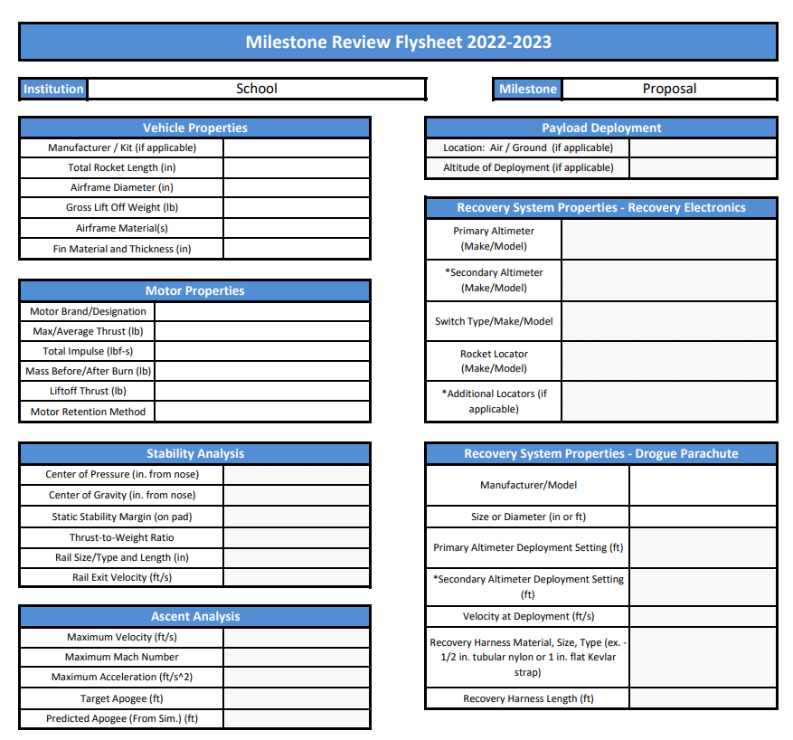
Flysheet due with Proposal
Dec. 12, 2022
Notes:
This is a snap shot of part of the flysheet required for submission. This is found on the FNL website. You will not have all the information for all parts of this sheet at the beginning of the report. You will be filling this out just before submission, after you have created the report.
The green boxes are information you should have including the Payload portion of the flysheet. The pink highlighted box is not known currently.
The yellow box will be learned along the way if you do not know this. We are not requiring all boxes to be known at the proposal phase. Once you get further into your project, these requirements will become well known.
Get with Mark if you have any questions regarding this.

Slide 14

Project Plan
Timeline
Scheduling utilizing Gantt chart
Entire project lifecycle addressed
Budget
Include all travel and necessary supplies
Funding
Is additional funding needed?
Sustainability
Plan for future FNL teams at your institution
List partners (industry/community/local state etc)
Notes:
Like most plans, plans change. Be mindful of what hard dates you have.
Dates are set and should be turned in on time.
Communication is key. Involve the team at FNL when you get hung up on any issues. Remember at the end of the project, you will be rating your team.

Slide 15

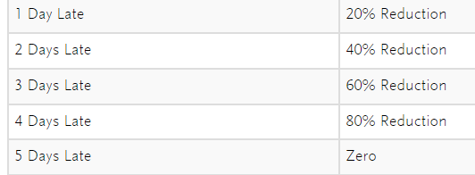
Budget
Money
  Team members should all be aware of the financial status of the group.
  Keep receipts and submit paperwork for reimbursements in a timely fashion.
Time
  Schedule and give enough notice for meetings and the project.
  Do not procrastinate.
  One day slip is costly.
Due Dec. 12, 2022

Slide 16
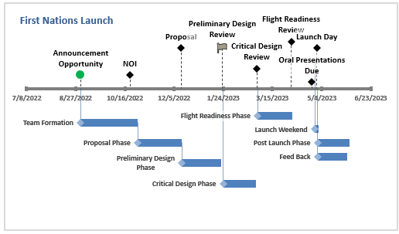
Preliminary Design Report
Due January 23, 2023

Slide 17
Design Cycle
Iterative process
Building from previous report
Report changes the team has decided on
What impact does it have on your design
Schedule, cost, manpower etc.

Slide 18
PDR Overview
 | Proposal | PDR | CDR
Team Summary | X | X | X
Report Summary |  | X | X
Changes from Previous Report |  | X | X
Vehicle Design | X | X | X
Safety | X | X | X
Payload Design | X | X | X
Project Plan | X | X | X
Facilities/Equipment | X
Notes:
The PDR is going to have more details from the previous proposal submission. You are required to submit the changes that were made.
This is just like any projects I have in my day job. We are required to report to our customer the changes that have been made. Explain why you made those changes and what course of actions you have from it.
You will be able to change your design, just ensure everyone is on board and is communicated clearly in the report.
Your changes will be noted and the judges will ask questions, any member of the team should be able to answer clearly and confidently.

Slide 19
Immediate Steps
Research your challenge
1
Obtain and become familiar with RockSim
2
Simulate rocket kit/ motor combinations
3
Learn and practice build techniques, train to build payloads and avionics
Do not purchase any rocket supplies until your design is mature
4
FNL recommends purchasing in the CDR stage

Slide 20

Writing the Report
Communicate the engineering and design effort involved
Follow the template provided on the website
Personalize to your liking
  Do not change the flow (i.e. order of sections, titles, footers and headers)
Communicate with all senses available
  Use pictures and diagrams
Keep the ORDER
Notes:
Follow the template provided on the website
Let me re-emphasize, follow the template provided on the website.
Use the template to communicate the project efforts. Everything you need is in the template, we have made it as easy as possible for everyone to succeed.
Again, FOLLOW THE TEMPLATE.
Do what you need to do to make the report your own, just make sure you have everything we need to rate your project.
Use charts and diagrams as needed for the report. Please ensure the order of the report is kept!
If you have any questions, please reach out.

Slide 21
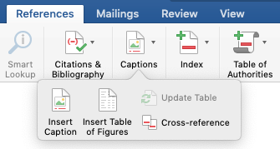
Writing the Report
Navigation Pane
  Allows quick editing by jumping to sections
Table of Contents
  Should match navigation pane, remember to update
Section Heading Styles and Levels
  Insert 2nd and 3rd levels, ensure no blank headers
Bullets vs. Paragraphs vs. Tables
  Use tables as much as possible to list information, instead of paragraphs
  Can maintain an Excel spreadsheet then copy to Word table
Figure/Table Captions
  When adding figures (tables) use captions (Reference -> insert caption)
References to Sections and Figures/Tables
  In the text, make sure to reference your caption/figure (Reference -> cross-ref)

Slide 22


Report Writing Best Practice
Use Team Structure to divide up report writing tasks
  It is best to have consistent assigned tasks over the duration of the project
  Team Lead – handles more team management than technical
  Safety Officer – handles all safety documentation
  Simulation Lead – integrates and updates simulations as the project progresses
  Payload Team – handles the payload/challenge solution
    Hardware, Software
  Structures Team – handles the vehicle design, test and build
    Recovery, Avionics, Airframe

Slide 23

Virtual Presentation Best Practice
Write the report first, with all details defined
Highlight critical information
Include visuals of your report
  RockSim screenshots, drawings, tables for analysis
Every team member should present; limit to based on number of team members
Judges and admin team will be present, feedback is immediate. Include anything you want feedback on.
Allow time at the end of the presentation for grading your presentation and questions.
Notes:
Your team should be prepared to give virtual presentations like the webinars you have attended so far.
These presentations should be clear and have all pertinent information for your report. It is not limited to written words, use graphics and your voice. In the virtual space, you have audio issues that may arise, do a dry run with your team.
This will help to get the team comfortable presenting. How many have done virtual presentations?
What was the number one issue? AUDIO
Give time and grace to your team members to learn. We encourage you to bring your friends and even family into the dry run. This will give you a great practice run, they will have no knowledge of what your presentation is about. This will force you to be clear about the message and explain what you did and why you did it. Get your mentor to listen in.
I cannot emphasize enough, how important presentation skills are. Once in the professional world, you will be giving presentations more than you think.
Please remember the time allocated for your presentation will include scoring and questions at the end.

Slide 24
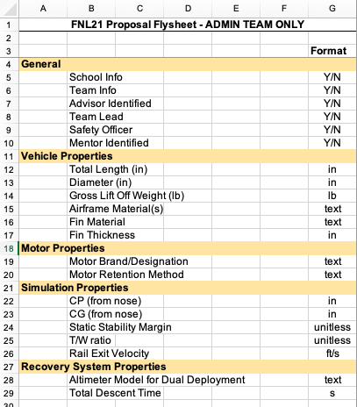
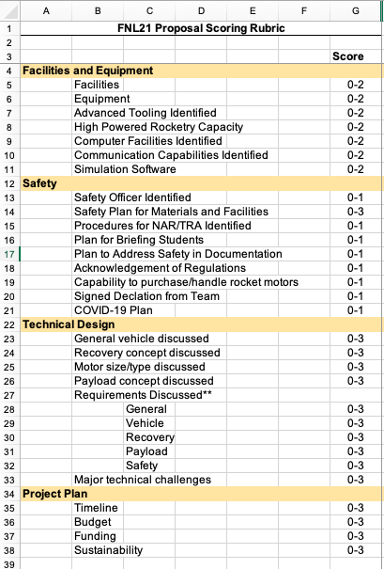
Rubrics
Previous years
Something similar will be used this year for reports and presentations.

Slide 25
Critical Design Report
Due February 28, 2022

Slide 26
CDR Overview
 | Proposal | PDR | CDR
Team Summary | X | X | X
Report Summary |  | X | X
Changes from Previous Report |  | X | X
Vehicle Design | X | X | X
Safety | X | X | X
Payload Design | X | X | X
Project Plan | X | X | X
Facilities/Equipment | X
Notes:
Expectations are the same from PDR. Judges will be looking at changes made.
You should be working very closely with your mentor by now.

Slide 27
After PDR
Flush out details in your challenge design
Refine your RockSim model
Strategize and implement plan on how building will begin from previous reports (facilities, resources, material procurement)
Determine local launch plans for competition flight

Slide 28
Writing the CDR
Update any and all changes from the previous report and communicate why
Provide analysis and reasoning
What is the impact to the project (schedule, cost, etc)
Remember to personalize your report if desired
Template and rubic can be found at the FNL website

Slide 29

CDR Virtual Presentation
Brief overview of report
Emphasis on charts and visuals
We want to see the analysis!
Address all questions in the Handbook

Slide 30
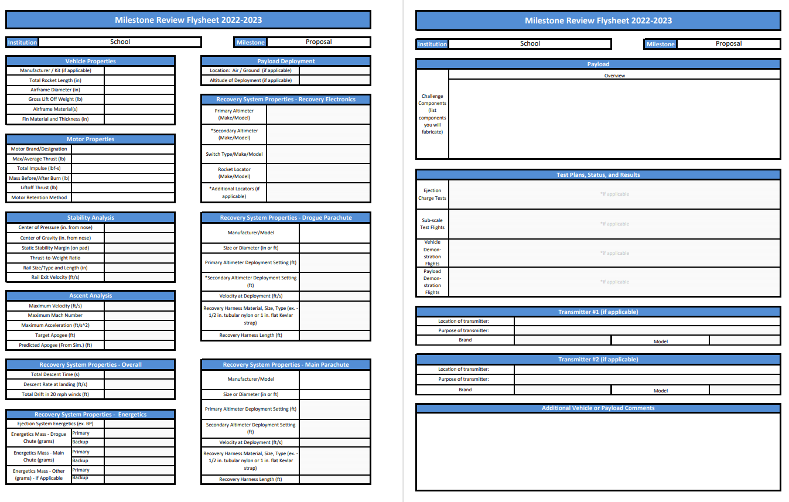
Flysheet
Like before, this will be populated after the report has been written.
Fill in all of the flysheet except for the Payload deployment. This is not known.

Slide 31

Summary
Manage your time and project
Stay on schedule
Communicate with your team and FNL to be successful
Ask questions
Reference the resources on the website
Embrace change in the design and report them

Slide 32

Questions?

