Slide 1




First Nations Launch 2023
Launch Operations Webinar
Mark Abotossaway, Blue Origin Structures Engineer, FNL Advisor Liaison
Frank Nobile, TRA Wisconsin, FNL Technical Advisor
March 28, 2023
The material contained in this document is based upon work supported by a National Aeronautics and Space Administration (NASA) grant or cooperative agreement. Any opinions, findings, conclusions or recommendations expressed in this material are those of the author and do not necessarily reflect the views of NASA.

Slide 2
Presentation Overview
NASA STEM Gateway Requirement
Launch Site Overview
  Richard Bong Recreation Area
Pit Area Details
  Layout / Provided / Personnel
Tripoli Wisconsin Overview
Launch Area Details
  Inspections / Launch Pad prep / Launch expectations
WSGC Updates

Slide 3

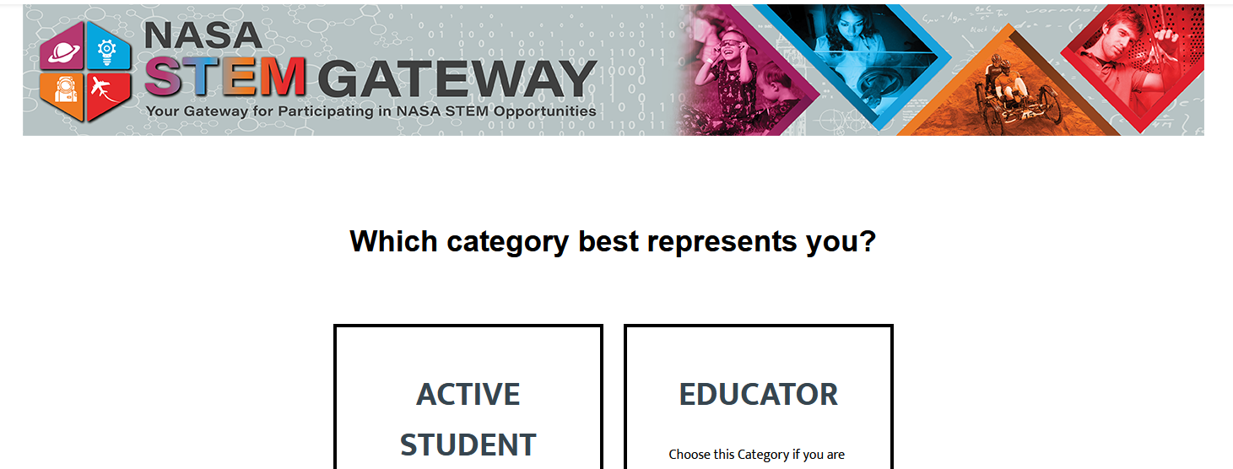
NASA STEM Gateway
Each participant needs to create a
profile in the new system,
NASA STEM GATEWAY, prior to
launch weekend
  https://stemgateway.nasa.gov/s/
  https://stemgateway.nasa.gov/public/s/login/SelfRegister
After individual profile has been created, NASA will link your profile to First Nations Launch

Slide 4

Launch Site Overview
What to expect at the Launch Site

Slide 5
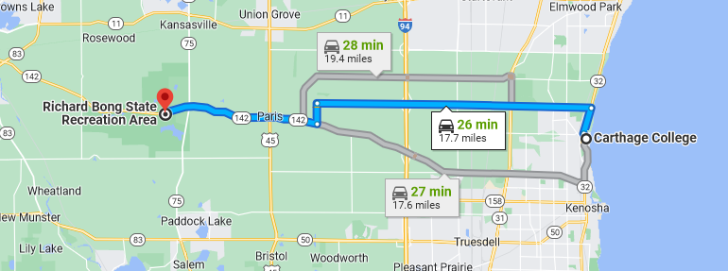
FNL Launch Site - Drive
Richard Bong State Recreation Area
  About 30 min drive from hotel / school
  Fairly remote – bring everything you will need for the day
Notes:
Pants, closed toe shoes, long sleeve shirts, hats, jacket (depending on weather), insect repellent (ticks), sunblock

Slide 6
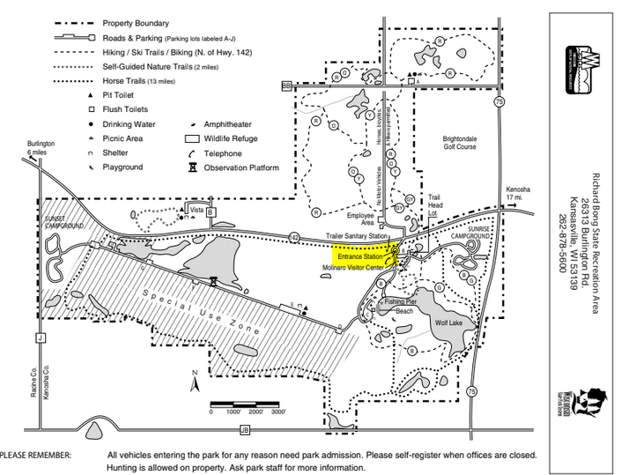
FNL Launch Site – Entering the Park
First Nations Launch Parking Pass
  Provided by Wisconsin Space Grant Consortium during registration
  Show pass to the Park Ranger at the entrance gate if someone is on duty
  Must be displayed on dashboard at all times
    Department of Natural Resources will ticket vehicles that do not have a pass displayed
  Non-Competitors
    WI license plate (daily fee) $8.00 Fee
    Out-of-state plates $11.00 fee

Slide 7
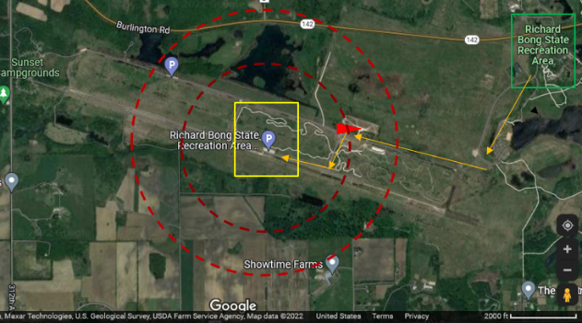
FNL Launch Site – Inside the Park
From the entrance (green) to the launch site (yellow)
  There will be signage and wind flags
Entrance booth
Note the hazards when recovering rockets
Note the scale
Notes:
Note the map scale – site is about 1 mile x 2 miles
Note the hazards – there are water hazards scattered about the landing area (there are also trees in the landing area, and tall grass everywhere)

Slide 8
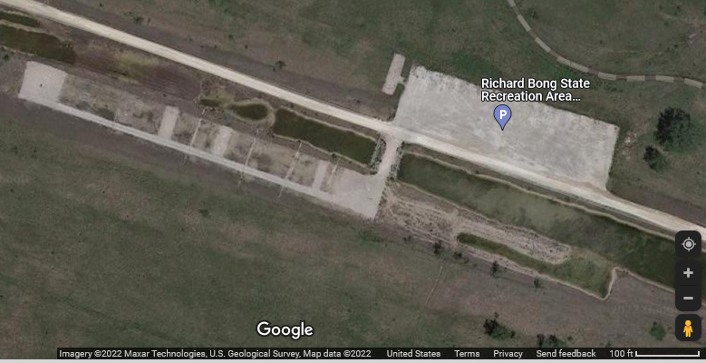
FNL Launch Site – Rocketry Site
Tripoli Wisconsin Launch Site
Team Prep Area (Pit Area)
Parking
Pads / Range
LCO Table
RSO Inspection

Slide 9
Parking
Parking is limited – please park as directed by attendants
  There will be cones – align with the cones
  Buses will park along the road entrance (to the side) or side of parking lot
  Parking attendants will assist your team with parking location

Slide 10
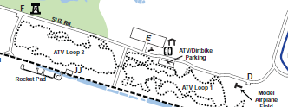
Parking
Parking is limited – overflow parking
  Teams limited to one (1) vehicle each, in parking lot JJ
  Extra vehicles and guests can park in Parking Lots E or F, or alongside entrance road as space is available

Slide 11

Rocketry Vendor
There will be a rocketry vendor on-site
Wildman Rocketry (https://wildmanrocketry.com/)

Slide 12
Conveniences
There will be:
bagels and coffee, snacks, lunch, and water
port-a-johns along the back row
a WSGC table for shirt purchases, etc.
a 10x10 canopy for shade
Notes:
While we have the bagels and coffee

Slide 13
Pit Area Details
What to expect in the pit

Slide 14
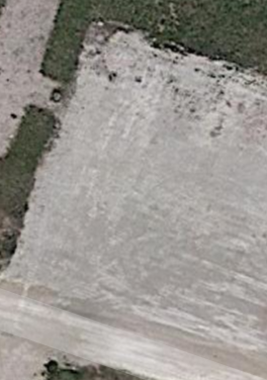
Team Prep Area (Pit Area)
Tables arranged for teams on arrival
  Tables will have label with team name
Teams are grouped by competition
Note: WSGC / TRA Wisconsin also host a statewide rocketry competition on the same day
  There will be another set of tables / teams for the Collegiate Rocket Launch (CRL) competition
  CRL tables will be to the right of those shown
Notes:
Mark will provide support in the Pit Area (with 2 other Project Assistants)

Slide 15
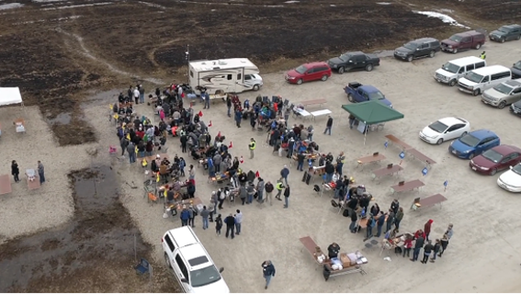
Team Prep Area (Pit Area)
Notes:
Note: Park restrictions – no drones allowed without permit (FNL has a film crew at launch, with drones for footage)
Do not plan to bring a drone to aid with rocket retrieval – that is why you are required to use a GPS tracker

Slide 16
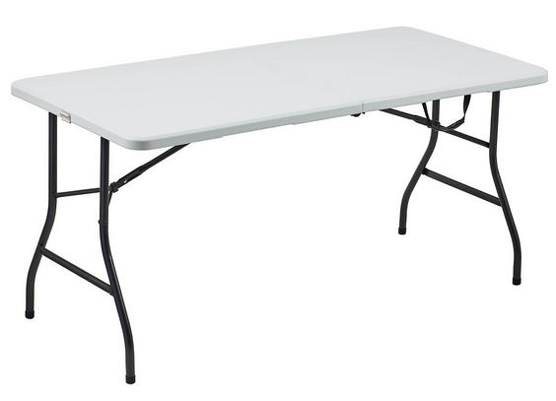
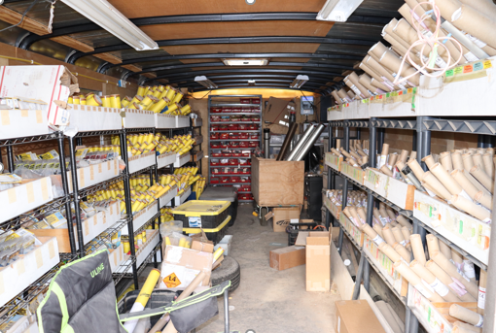
Provided to Teams on Launch Day
Table (8-foot folding) and 4 folding chairs
  No power source (you may bring generator if desired - needed)
  No power or hand tools (bring what you need)
  No room for canopies at tables
Lunch / Water
  Variety of Subway sandwiches and chips / drinks available
    You will have a lunch ticket in your name badge
  Alternative food options can be arranged
On-Site Rocketry Vendor
  If you need spare parts / last minute replacements

Slide 17
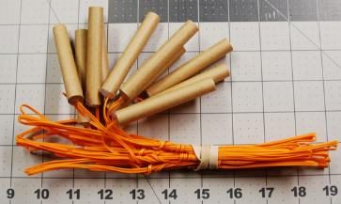
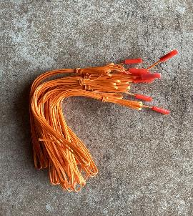
Provided to Teams on Launch Day
Ejection charges (distributed by Project Assistants)
  Assistance to wire two types of charges also provided
  Do not transport black powder to WI
Cellulose wadding a.k.a Dog Barf (self serve)
  For additional recovery protection
  A box will be available in pit area
Motors (at RSO Inspection table)
  Team lead or designee picks up motor at the RSO table following safety briefing
  You must be fully assembled and ready for flight
  Proceed to RSO table for your pre-flight inspection

Slide 18
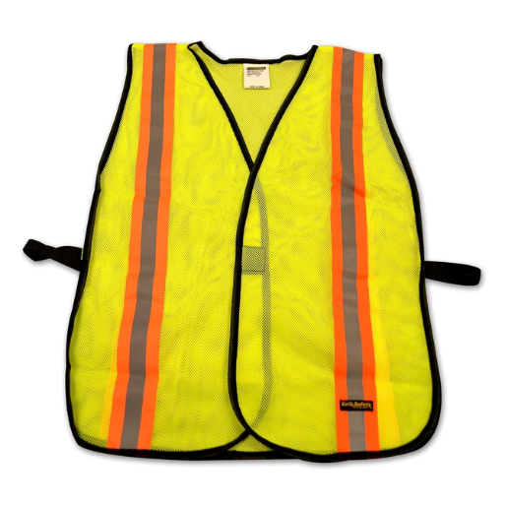
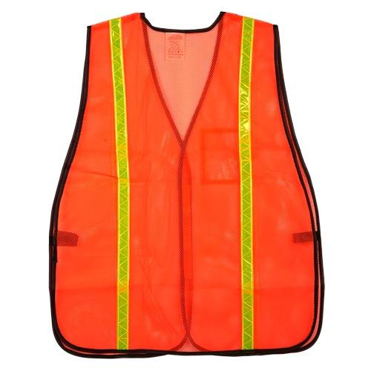
FNL Personnel on Launch Day
FNL Project Assistants will be identified by yellow vests
  Are available for rocket prep assistance in Pit Area
  There are 3 Project Assistants
FNL Judges will be identified by orange vests
  They will monitor / score your vehicle / payload prep
  They may ask you questions – please take time to respond / explain
  There are 8 Judges
Notes:
PA – Mark, Aaron, Sean – we may assign one to each challenge group

Slide 19
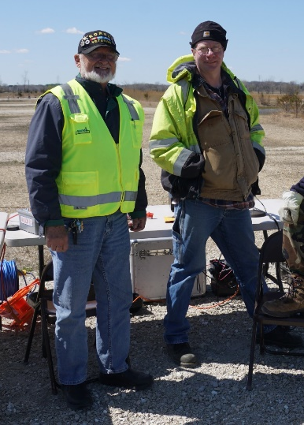
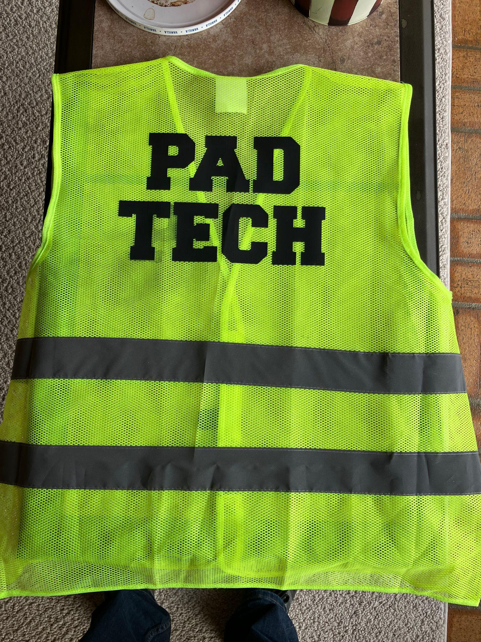
FNL Personnel on Launch Day
Tripoli Wisconsin will be identified by yellow vests
  They will approve rocket for flight and get you on a launch pad
  There will be numerous TRA Wisconsin
WSGC Individuals will be identified by green vests
  Non-technical questions can go to WSGC individuals
  They will facilitate parking, lunch etc.
Notes:
PA – Mark, Aaron, Sean – we may assign one to each challenge group

Slide 20
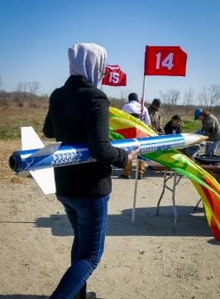
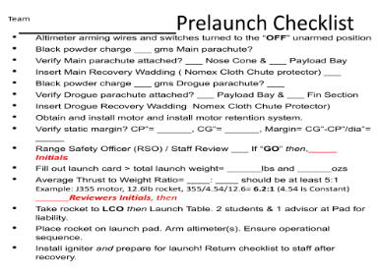
Launch Day – Prep Area
Arrive – Park
  Follow parking attendant instructions
Find your team table
  There will be a numbered flag at each table
Prepare your rocket for flight (use your checklists)
  Things to include (not an exhaustive list):
    Program / calibrate your altimeters and tracking
    Use fresh power sources
    Fold parachutes and connect recovery hardware
    Ensure sections fit together properly
Project Assistants available for assistance
Notes:
PA’s will conduct a basic pre-inspection prior to RSO – save RSO from having to double up inspections, save teams from having to come back to pit area having missed a step

Slide 21
Launch Day – Prep Area
When ready, request ejection charges from Project Assistants
  Wait until your altimeters are programmed / ready
  If it is your first-time handling ejection charges, ask for assistance
    We will show you how to wire your charges safely / properly
  Do not power on electronics after charges are installed
    Safety requirement – electronics now remain off until on Launch Pad
Once ejection charges are installed, complete final assembly
Notes:
PA’s will conduct a basic pre-inspection prior to RSO – save RSO from having to double up inspections, save teams from having to come back to pit area having missed a step

Slide 22
Launch Day – Prep Area
Complete final assembly
  Close and seal avionics bay
  Ensure recovery hardware is all attached and closed (quick links etc.)
  Pack your parachutes and shock cords
  Close your sections together ensuring everything fits properly
Fill out your orange Flight Card (found in your packet)
  Get a Project Assistant to review your launch card when complete
  Project Assistant will do a pre-inspection with you
    One complete you will move on to RSO Inspection
Notes:
PA’s will conduct a basic pre-inspection prior to RSO – save RSO from having to double up inspections, save teams from having to come back to pit area having missed a step

Slide 23
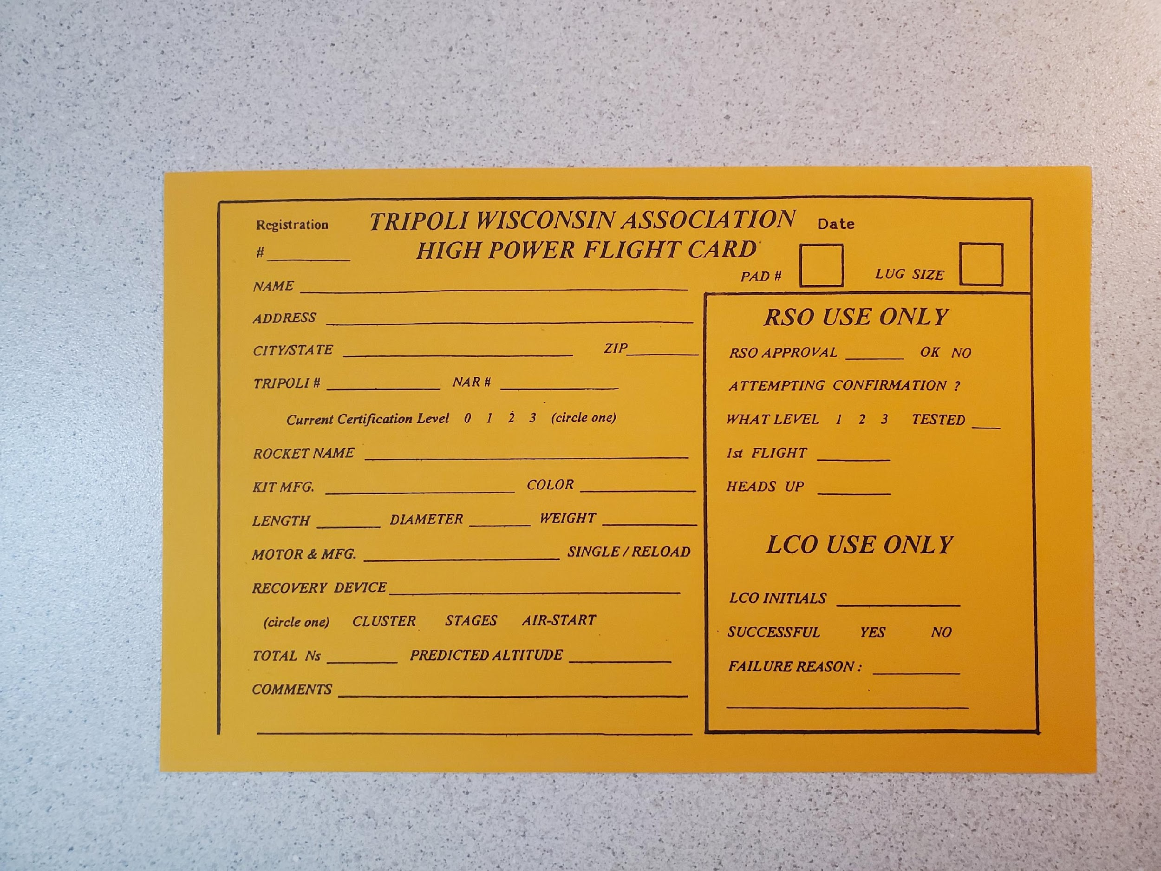
Flight Card
NO ONE IS PERMITTED AT THE LAUNCH PADS UNLESS YOU ARE A CURRENT TRA/NAR MEMBER
Fill out legibly
Enter membership number
Name of Rocket
Type of motor
Notes:
Similar to workshop – ensure teams are aware of flight cards ahead of time.

Slide 24
Tripoli Wisconsin Details
What to expect at a Tripoli Launch

Slide 25
Tripoli Wisconsin Association
Rocket Launches
Tripoli Wisconsin Association
  Conducts launch operations per:
    Per Tripoli Rocketry Association (TRA)
    NFPA 127 rules
  Assigns/delegates representatives to organize and run the launch
    Range Safety Officer (RSO)
    Launch Control Officer (LCO)
    Launch Pad Tech (LPT)
‹#›
Notes:
‹#›
Frank
‹#›

Slide 26
Tripoli Wisconsin Association
Rocket Launches
Range Safety Officer
  Minimize the risks to personnel and property
    Model and High Power Rocket Launches
    Handling, preparation, and launch operations
  Inspects each rocket for flight integrity
  Has the final call for a go or no-go launch
‹#›
Notes:
‹#›
Frank
‹#›

Slide 27
Tripoli Wisconsin Association
Rocket Launches
Launch Control Officer
  Manages flight cards to coordinate each flier with a particular launch pad
  Oversees operation of the Launch Control System
  Follows all safety rules governing who has access to the range
    Spectators are not allowed on the range
  Secures/Activates FAA waivers to the assigned area parameters
‹#›
Notes:
‹#›
Frank
‹#›

Slide 28
Tripoli Wisconsin Association
Rocket Launches
Launch Pad Tech
  Familiar with both launcher and launch control operations
  Has appropriate tools available
  Ensures all fliers follow Launch Safety Guidelines
  Has fire suppression capability available
  Makes sure all rockets are pointed away from the flight line and spectators while loading the rocket at the launch pad
  Secures/Activates FAA waivers to the assigned area parameters
‹#›
Notes:
‹#›
Frank
‹#›

Slide 29
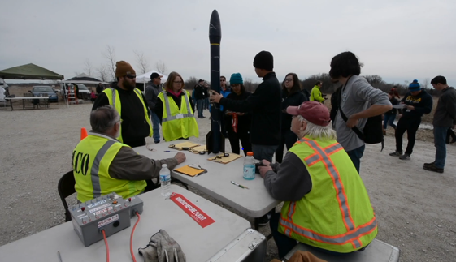
The Launch Crew
Very experienced in high-power rocketry community
Has been conducting FNL since 2009
Hosts the WSGC Collegiate Rocket Launch annually
Hosted Large and Dangerous Rocketships (LDRS 33) in 2014, and will host (LDRS 41) in 2023 at Richard Bong
Notes:
LDRS is currently scheduled for launch in July 2023

Slide 30
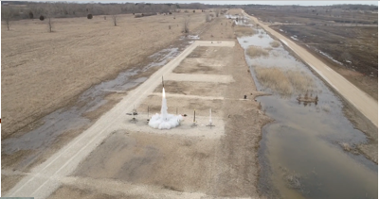
TWA Launch Site
Richard Bong Recreational Area
Launching at Richard Bong Recreational area since 1995
Wisconsin Depart of Natural Resources (WDNR) have graciously supported this activity for rocketry enthusiasts and members
Designated Model Rocketry Launch Area – former runway
Typical April Launch
  Average April Weather varies
    Mean Temp: 47 °F
    Precipitation: 1.21"
    Wind: 11 mph
    Visibility: 9 mi
  Fire break - winds
    Ponds
    Roads
Notes:
April Climate & Weather Averages in Kansasville
High Temp: 56 °F
Low Temp: 37 °F
Mean Temp: 47 °F
Precipitation: 1.21"
Humidity: 66%
Dew Point: 34 °F
Wind: 11 mph
Pressure: 29.97 "Hg
Visibility: 9 mi

Slide 31
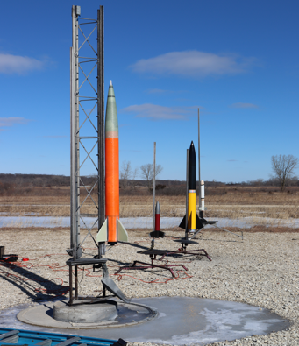
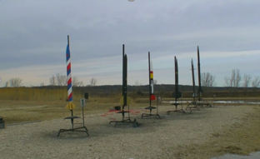
TWA Launch Pad Area
Richard Bong Recreational Area
TWA launch system
  Wireless launch system
  Dual safety arming features
Far away launch cells (right)
  10’ 1515 rail and 1010 rail tower
Standard pads with 6’ rails (below)

Slide 32
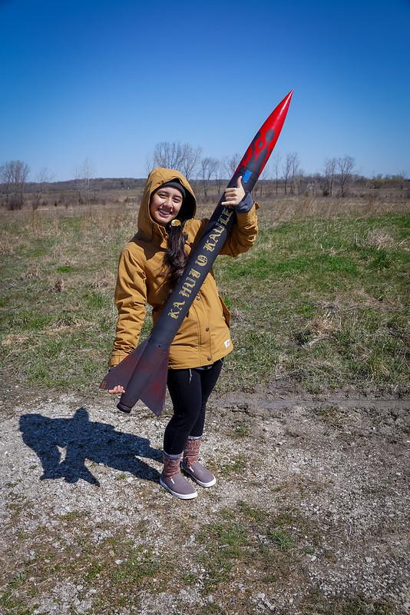
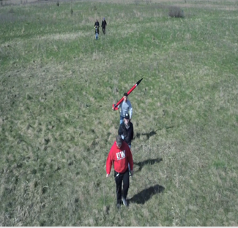
Walking in the Park
Richard Bong Recreational Area
Watch your step
Wear proper footwear - closed toe shoes
Wear pants, long-sleeve shirts, and hats (Tick Season)
Avoid walking and looking in the distance simultaneously
“Stop and Look” will help you avoid tripping and possible injury
Notes:
Ground is uneven and soft. The danger for tripping and the danger for tripping increases

Slide 33
Launch Area Details
What to expect once you are ready to launch

Slide 34
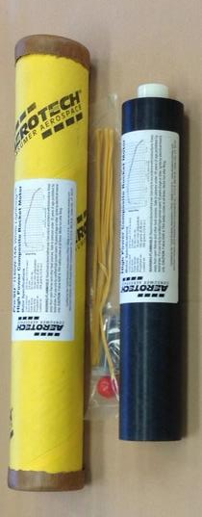
Launch Day - Motor
After the FNL Safety Meeting, send team lead or appointed representative over to RSO (Frank) to pick up motor
  You will have prepared your motor on Friday
  In Prep area:
    Load the motor in your rocket and secure your retention
    Ensure it fits properly (not loose or tight – don’t force it)
    Prepare motor igniter
      Remove wire from the bag and straighten the wire
      Strip at least 1-inch bare wire from the free end
      Keep the tape, you will need that in a moment
    Tape the motor ignitor to the outside of your rocket airframe between the fins
      This ensures everyone you have ignitor when you go to the pad
      This ensures that you have the piece of tape needed at pads
Notes:
Should move this content to (or after) slide 21

Slide 35
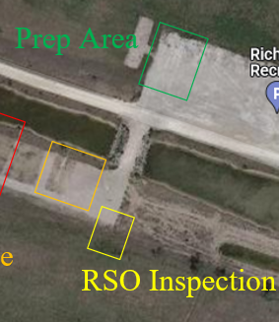
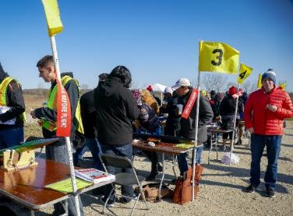
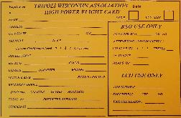
Launch Area – Rocket Prep
Starting in Prep Area, after Project Assistant approves your rocket prep
  Proceed to RSO tent for your inspection
    Take your TWA High Power Flight Card (filled out)
    Take your Remove Before Flight flag for flight
    Take your screwdriver/tool for switches
    Take masking tape

Slide 36
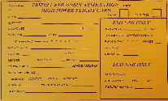
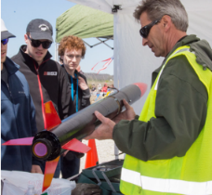
Launch Day – RSO Inspection
RSO will then inspect your flight ready rocket
  RSO will ask you questions about your rocket, for example
    CG and CP and Stability Margin
    Altimeter settings
    Expected altitude – time to apogee
  RSO will examine your rocket, for example
    Motor retention and installation
    Fin fillets
    Section fit
  RSO will ask you to change / correct any issue
    If this is the case, return to Prep Area and make corrections
Notes:
There is no launch schedule – first come, first serve (you can fly at 8 am, must be on the pads by 3 pm)
If you fly early, you can help other teams get their rockets ready if you wish
These items covered in more detail in later slides

Slide 37

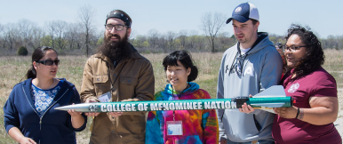
Launch Day – LCO Table
If you pass inspection - RSO will sign your orange Flight Card
Proceed to LCO table
  There may be a line if multiple teams are ready for flight
  Turn in your Flight Card to LCO once at front of line
    LCO will assign you a launch pad number
Before proceeding to Launch Pads
  JJack Productions will take a team photo w/rocket
    Turn in Blue Ticket to JJack after photo
Notes:
There is no launch schedule – first come, first serve (you can fly at 8 am, must be on the pads by 3 pm)
If you fly early, you can help other teams get their rockets ready if you wish
These items covered in more detail in later slides

Slide 38
Launch Day - Flight Procedures
Launch Pad Tech will help you load on rail
Observe your flight / Retrieve your rocket
After you retrieve your rocket
  Bring it back to your Prep table – Judges will need to inspect
  Pull your altimeter data and provide a copy to a Project Assistant (via flash drive)
  Your payload / challenge data will be submitted later
Notes:
This slide is obsolete (content distributed elsewhere) - please delete

Slide 39
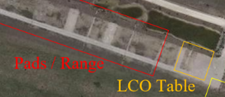
Launch Day – Launch Pads
For safety, ensure the range is open before you proceed
  You can ask the LCO
If range is open, proceed to assigned Launch Pad
  Note - Only Tripoli/NAR members allowed at Launch Pads
  Note - Max 3 people per team at Launch Pads
Once you get to your Launch Pad
  Launch Pad Tech will help you load your rocket on the pad
  If you are TRA/NAR Certified Level 2
    You may load your own rocket
Notes:
There is no launch schedule – first come, first serve (you can fly at 8 am, must be on the pads by 3 pm)
If you fly early, you can help other teams get their rockets ready if you wish
These items covered in more detail in later slides

Slide 40
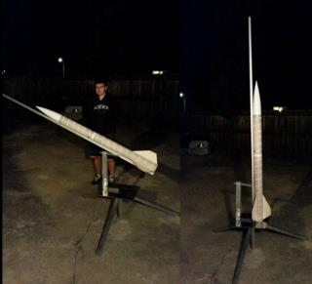
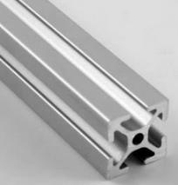
Launch Pad - Rocket on Rail
TRA Wisconsin individual available to assist with loading
Begin by tilting the rail
  Hold the rocket parallel to the rail
    The rocket sits on top of rail, button down
  Slide the bottom rail button into the rail
    Keep the rocket parallel sliding onto rail
  Slide the top rail button into the rail
    DO NOT damage your rail buttons by
forcing your rocket on rail
  Return the launch pad to vertical

Slide 41
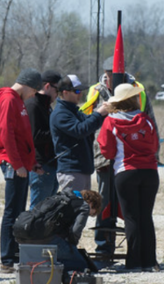
Launch Pad - Rocket on Rail
Before you load ignitor, power on your electronics
  Safety requirement that electronics are on prior to ignitor install
  Safety requirement that electronics (with black powder charges connected) are not powered on until vertical on the rail
    You may need a ladder / stool to reach your switches
      Middle of rocket may be 6 - 8 feet in the air once its on the rail
      You may not be able to see your switches / access holes
    Listen for sequence of beeps to ensure your electronics systems are armed properly
      If you can’t confirm, turn off electronics and remove from rail
      Do not disassemble rocket at pads
      Proceed back to pit area - retrieve Flight Card from LCO
    If confirmed, move to next step

Slide 42
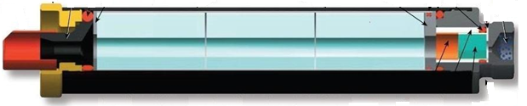
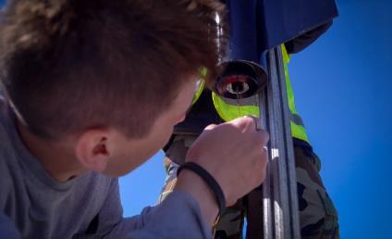
Launch Pad - Rocket on Rail
Next, prepare the motor ignitor
  Remove your motor ignitor taped to side of rocket
  Insert the wire as far as it will go into your motor
    Insert until it stops (hits the top of the motor)
    Kink the wire at the bottom 90 degrees
    Tape the wire you kinked in place (using the piece of tape) to the motor retainer

Slide 43
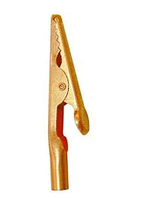
Launch Pad - Rocket on Rail
Prepare the motor ignitor (continued)
  Find the alligator clips for your launch pad (look on the ground)
    Ensure the circuit is not live by touching the clips together
      A live circuit would produce sparks
    Wrap one exposed ignitor wire around the alligator clip
      As much contact area as possible – keeps from coming loose
    Repeat for other ignitor wire and alligator clip
    Ensure the two alligator clips are not (will not) contact each other, blast deflector or rail – position / tape as needed
    Check continuity on your circuit
      Ask TRA Wisconsin personnel for assistance
  Your rocket is ready to go – proceed back to LCO area

Slide 44
Launch Pad - T-Minus 5
LCO will announce (over PA system) that launch is about to commence
  Stop what you are doing and pay attention – eyes on the launch pad
    Do NOT walk any further (regardless where you are)
      Observe the flight path of the rocket until the recovery system has deployed
    STOP working on your rocket (if you are in Prep Area)
  TRA will stop launch operations to ensure safety
LCO and area safety monitors look out for incoming rockets near the launch area
  LCO announces “heads-up” if a rocket is descending in or near spectator areas
Do NOT attempt to catch a rocket

Slide 45
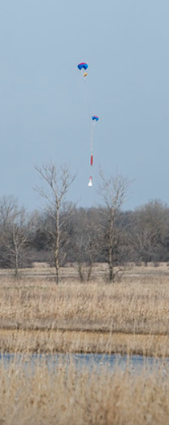
Launch Day - Rocket Retrieval
Post-Launch retrieval tips
  Have a dedicated group (at least two) to retrieve the rocket
    Not everyone – some can stay back to clean area etc.
    You will get dirty – dress appropriately
  Ensure your GPS system is working, and you have coordinates
    Plan your approach
    Do not just start walking directly
    Drive to a better location (another road for example)
  Be mindful of the launches still going on
    Watch when rockets are going up or coming down – be safe

Slide 46
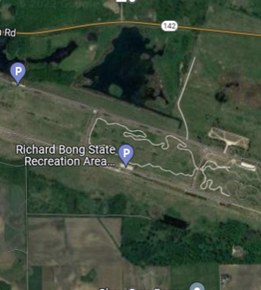
Launch Day - Rocket Retrieval
Post-Launch retrieval tips
  Do NOT attempt to climb trees to retrieve a rocket
  Do NOT enter water to retrieve a rocket
  If you are in one of these situations, ask for help
    TRA Wisconsin has:
      Poles to help extract rockets from trees
      Waders / canoe to help with water extraction
    Speak to a Project Assistant / TRA Wisconsin individual
      Trees and water everywhere

Slide 47
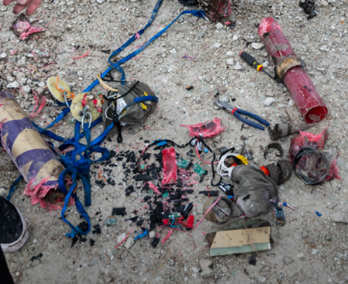
Launch Day - Rocket Retrieval
Post-Launch retrieval tips
  Ensure the ejection charges have fired completely
    Power off electronics first to move the rocket
    Remove any charges that have not gone off
    Assemble rocket for ease of transportation
  Return your rocket to Prep Area
    Judges will inspect rocket for any damage
    Provide altimeter data to Project Assistants
      They will give you a flash drive
  Clean / pack your rocket for return trip home
  Return motor casing to Project Assistants

Slide 48
WSGC Updates
Checklists will be emailed out soon for upcoming launch reviews
Come with rocket structure complete, preferably altimeter installed and pre-wired
  Do not add charges yet
  No rocket build workshop time this year
    Will be split into groups to proceed through:
      Concurrent Altimeter & Motor Workshops
      Safety Inspection

Slide 49
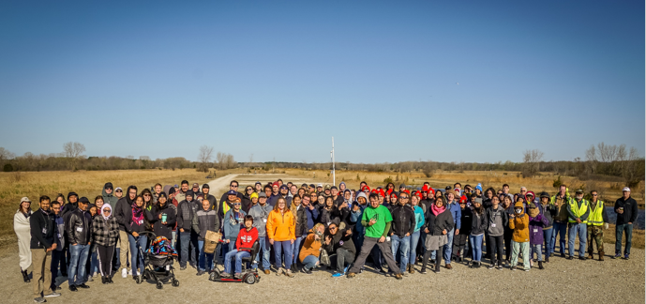
Q & A

